Slide 1


To our class 4B
Teacher: Duong Thi Hoang Anh

Slide 2


My birthday party
4
Lesson 2 – Period 4

Slide 3
01
Warm-up
Guessing game

Slide 4

shpic
chips

Slide 5

apergs
grapes

Slide 6
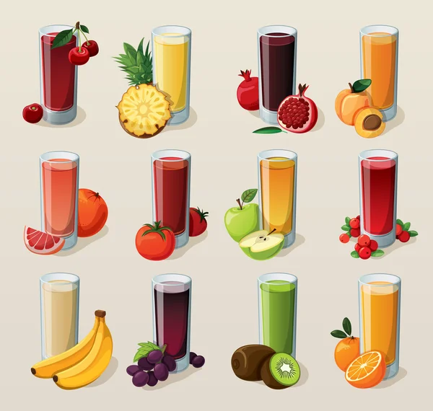
uicje
juice

Slide 7
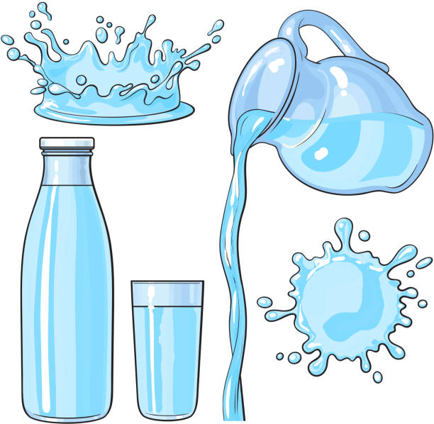
wtera
water

Slide 8

amj
jam

Slide 9

emonlaed
lemonade

Slide 10
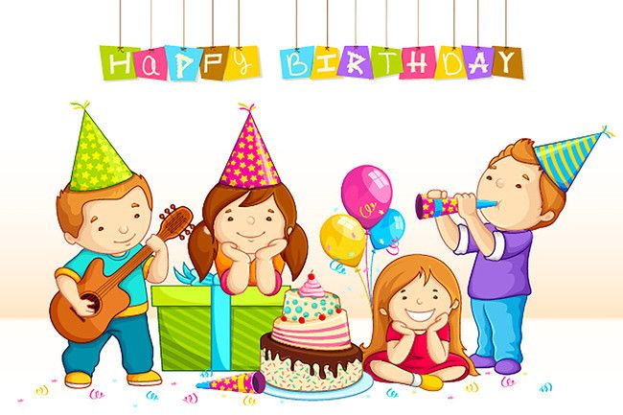
prayt
party

Slide 11
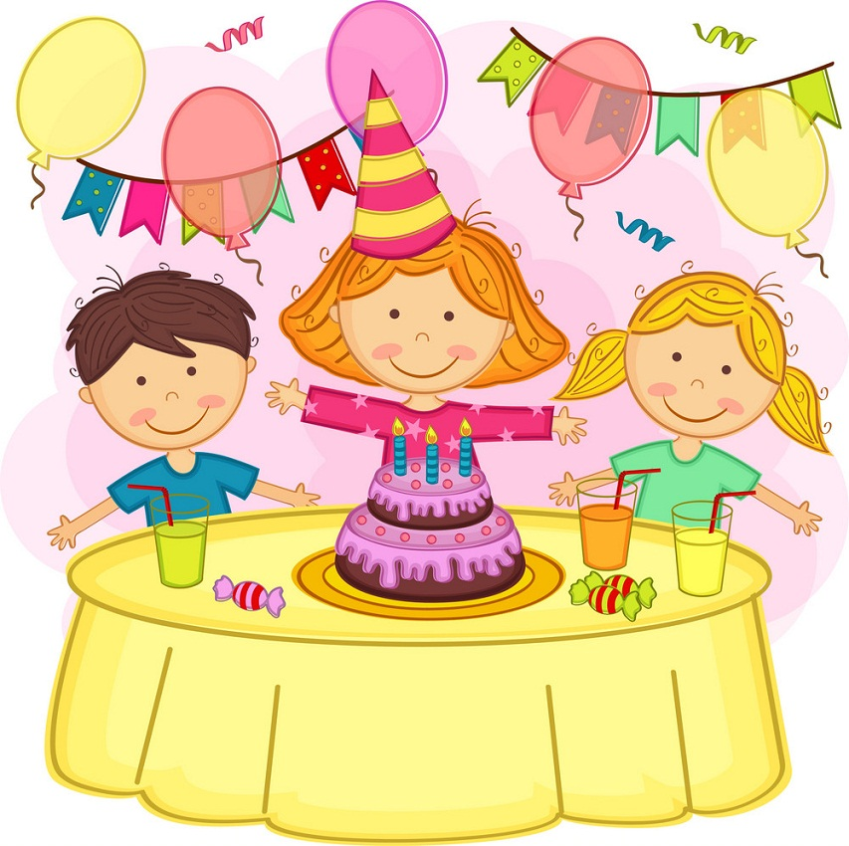
irdbayth
birthday

Slide 12
02
Activity 4
Listen and tick.

Slide 13
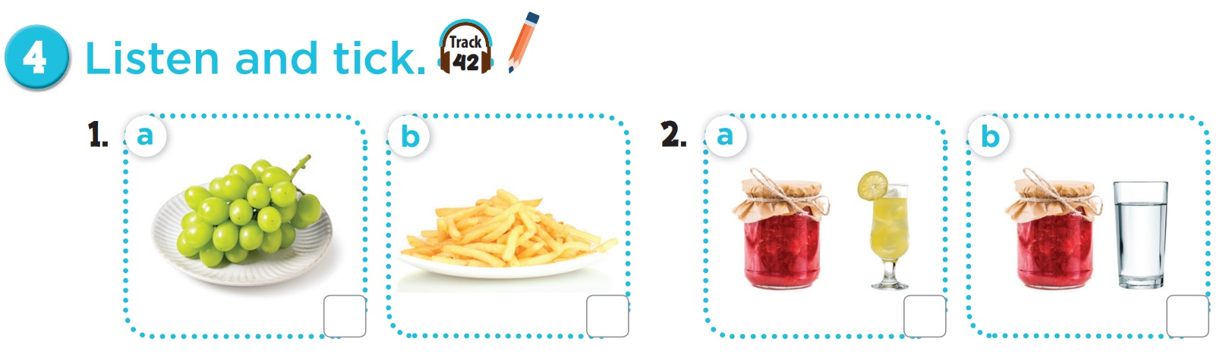


Slide 14
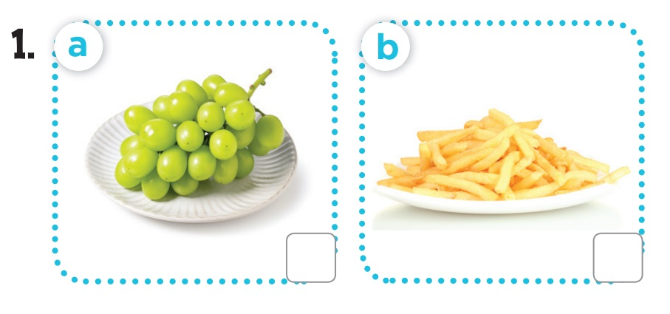

Listen and tick.
grapes
chips

Slide 15
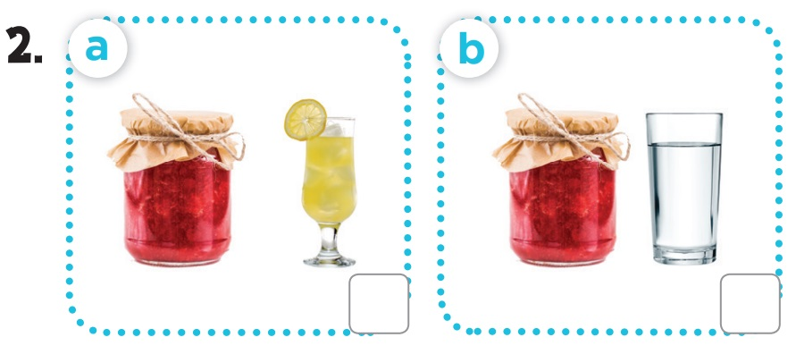
Listen and tick.
jam - lemonade
jam - water

Slide 16
03
Activity 5
Look, complete and read.

Slide 17
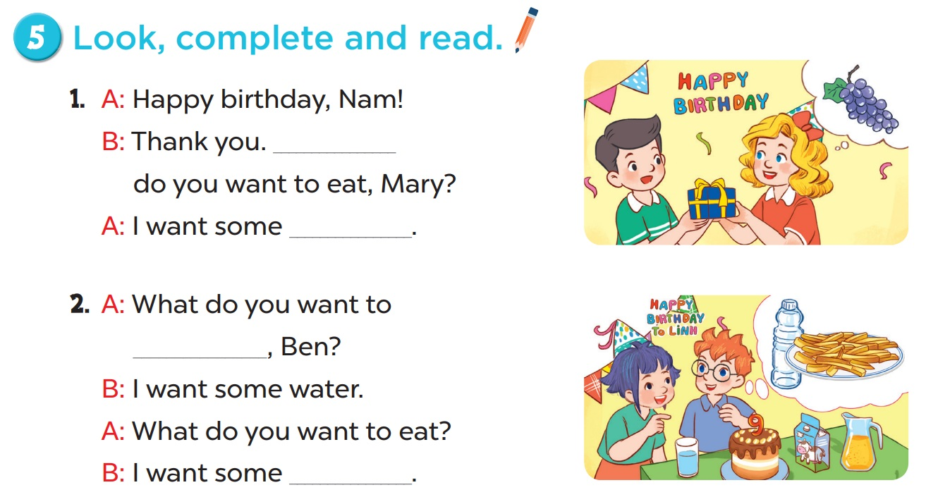

Slide 18
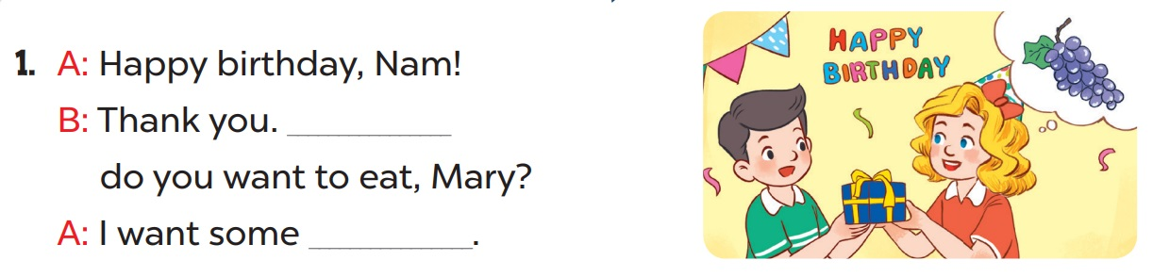
What
grapes

Slide 19
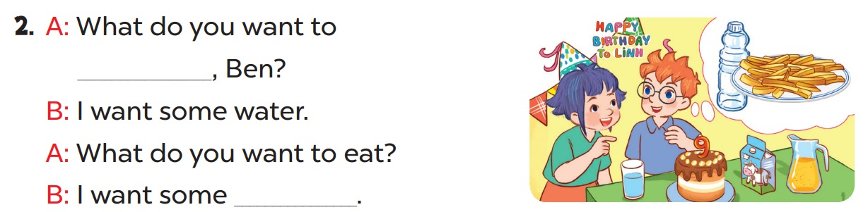
drink
chips

Slide 20
04
Activity 6
Let’s play.

Slide 21
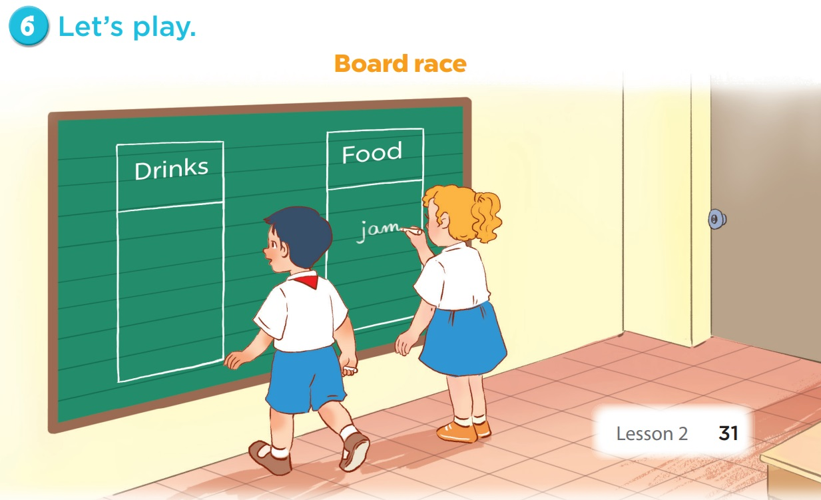

Slide 22
05
Fun time

Slide 23
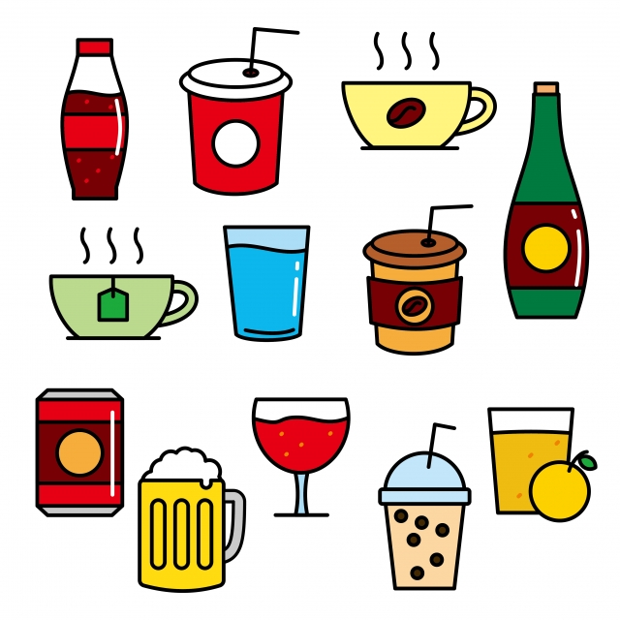
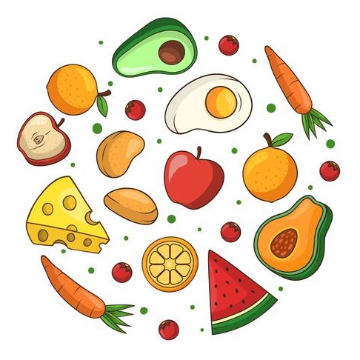
Food
Drinks

Slide 24
(Option 1)
Food or Drinks

Slide 25


juice
A
B

Slide 26
jam
A
B

Slide 27
water
A
B

Slide 28
lemonade
A
B

Slide 29
grapes
A
B

Slide 30
chips
A
B

Slide 31
(Option 2)
PINE TREE

Slide 32








9
8
7
6
5
4
3
2
1
0
9
8
7
6
5
4
3
2
1
9
0
8
7
6
5
4
3
2
1
0
9
8
7
6
5
4
3
2
1
9
0
8
7
6
5
4
3
2
1
0
9
8
7
6
5
4
3
2
1
0
TEAM 1
TEAM 2
TEAM 3
End

Slide 33

1
2
3
4
5
6
7
8
Score

Slide 34

I want to eat some ____.
A. juice
B. jam

Slide 35

+7
Score

Slide 36
What do you want to ___?
A. eat
B. drink

Slide 37
+2
Score

Slide 38
Happy birthday!
A. Thank you.
B. Sorry.

Slide 39
+12
Score

Slide 40
- What do you want to drink?
- I want some ____.
A. lemonade
B. chips

Slide 41
+8
Score

Slide 42
I want to drink ___ water.
A. a
B. some

Slide 43
+5
Score

Slide 44

I want to eat some ____.
A. grapes
B. grape

Slide 45
steal 7 points
Score

Slide 46
I want _____ some juice.
A. to drink
B. drinking

Slide 47
+20
Score

Slide 48
_ar_y
A. p - t
B. b - d

Slide 49
+10
Score

Slide 50

THANK
YOU

