Slide 1
19
The animal world
LESSON 1 – 4,5,6

Slide 2
Warm-up
1
Guess the animals.

Slide 3
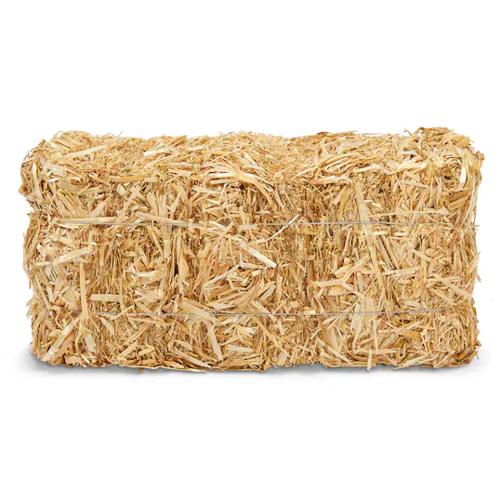
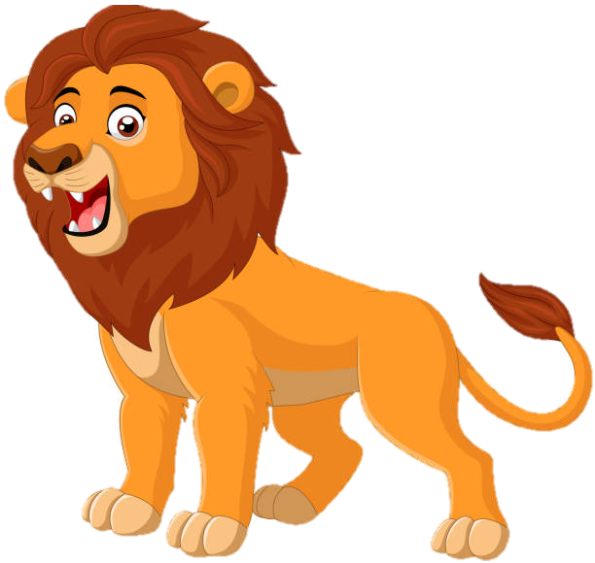
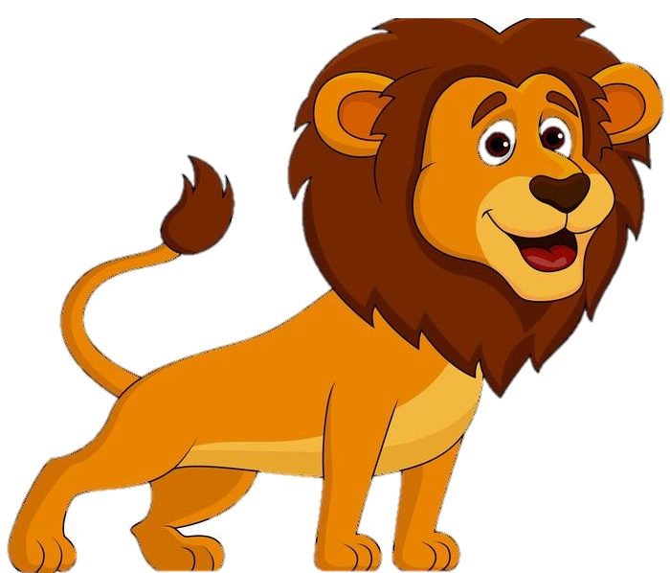
lions

Slide 4
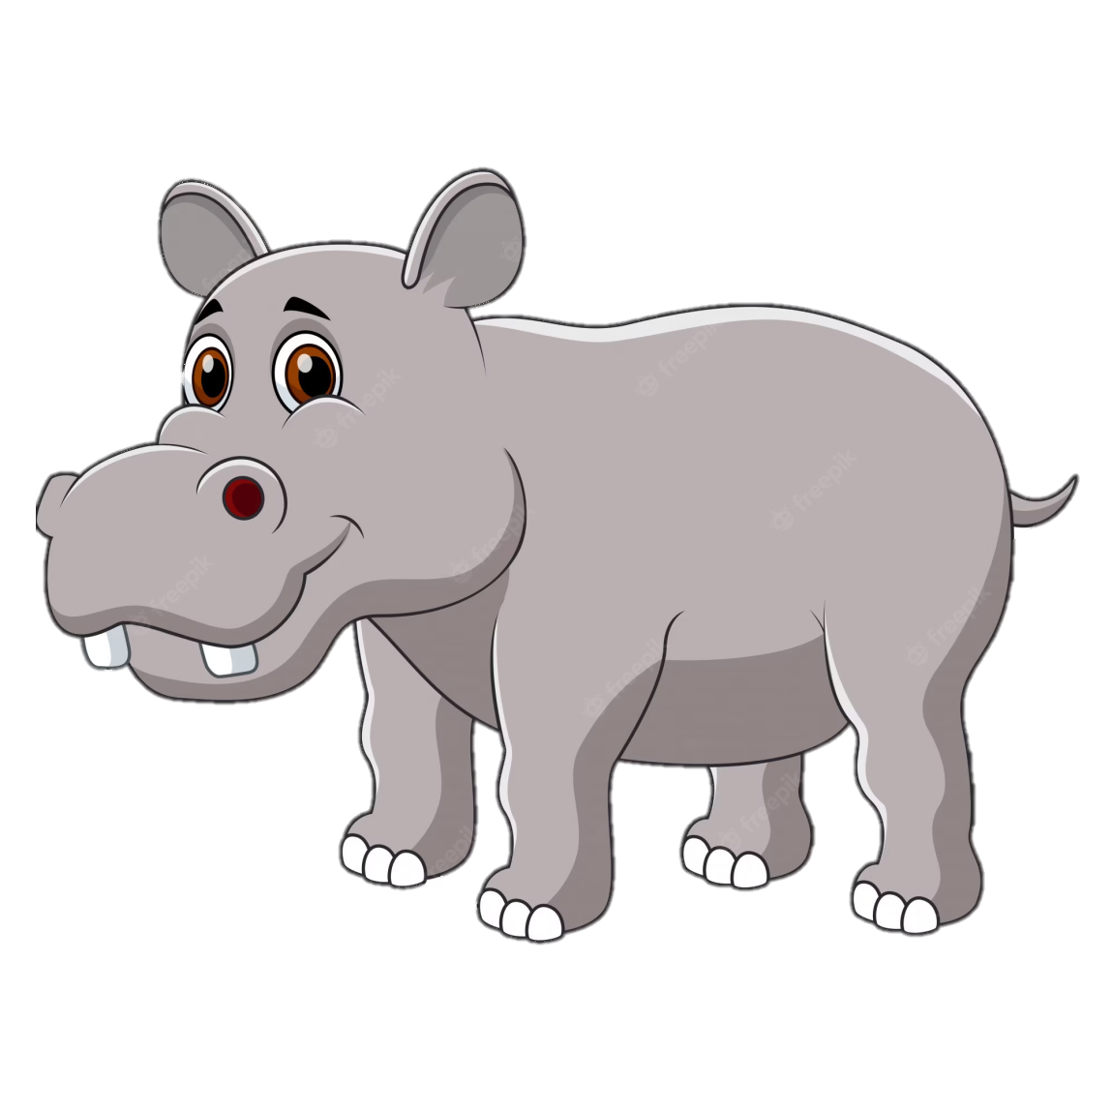
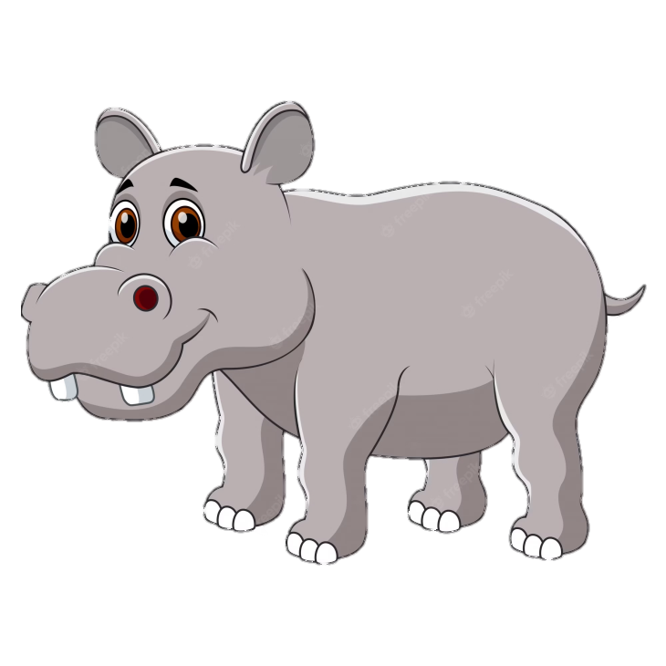
hippos

Slide 5
crocodiles

Slide 6
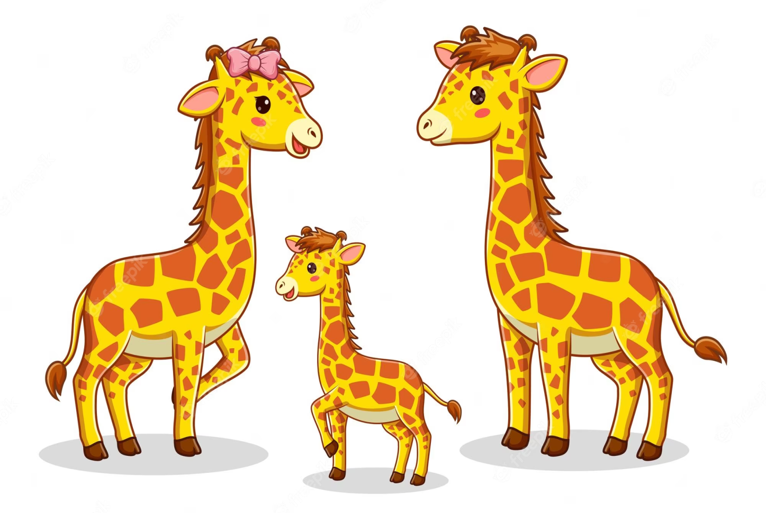
giraffes

Slide 7
Listen and number.
2

Slide 8
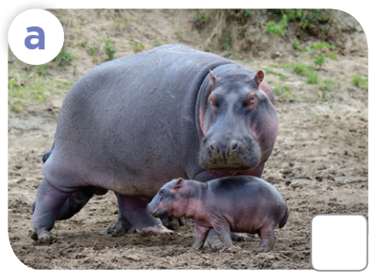
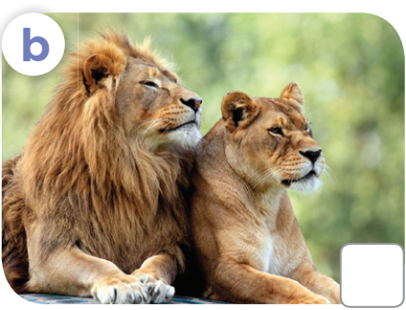
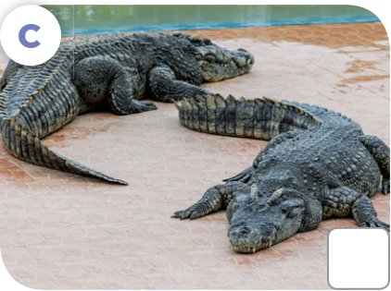
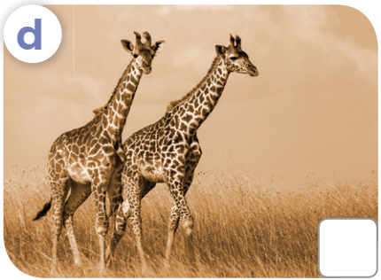
Look and answer.
What are these animals?

Slide 9
Listen and number.
Let's check!
2
3
4
1

Slide 10
Game
5

Slide 11
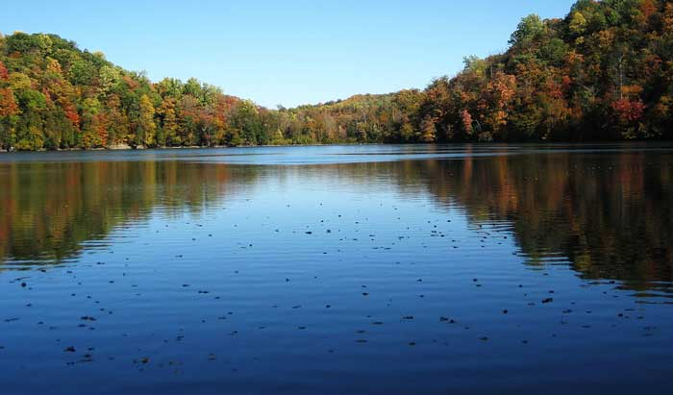
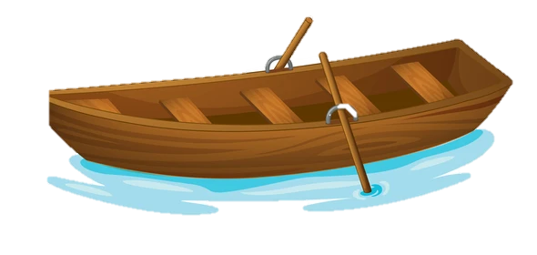
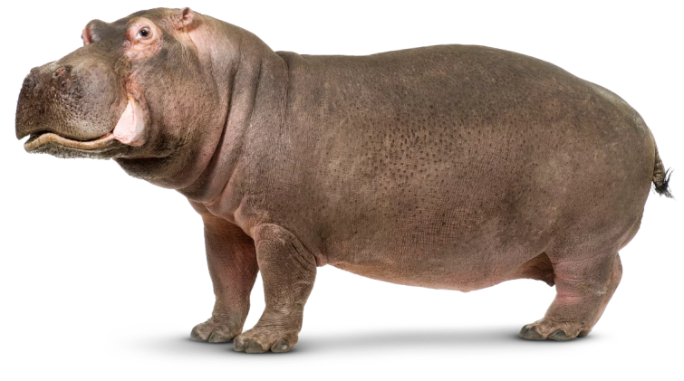
What are these animals?
A. It is a hippo.
B. They're a hippo.
C. They're hippos.
Notes:
Click 3 times to show choices
Click the object to reveal the hidden animals

Slide 12
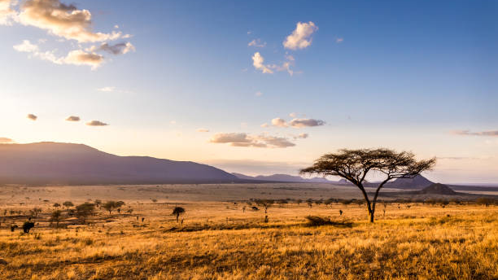
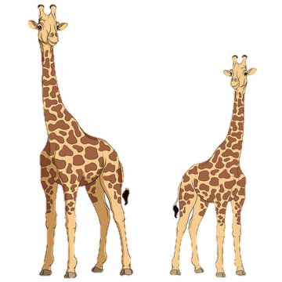
What are these animals?
A. It's a giraffe.
B. They're giraffes.
C. They're a giraffe.
Notes:
Click 3 times to show choices
Click the tree to reveal the hidden animals

Slide 13
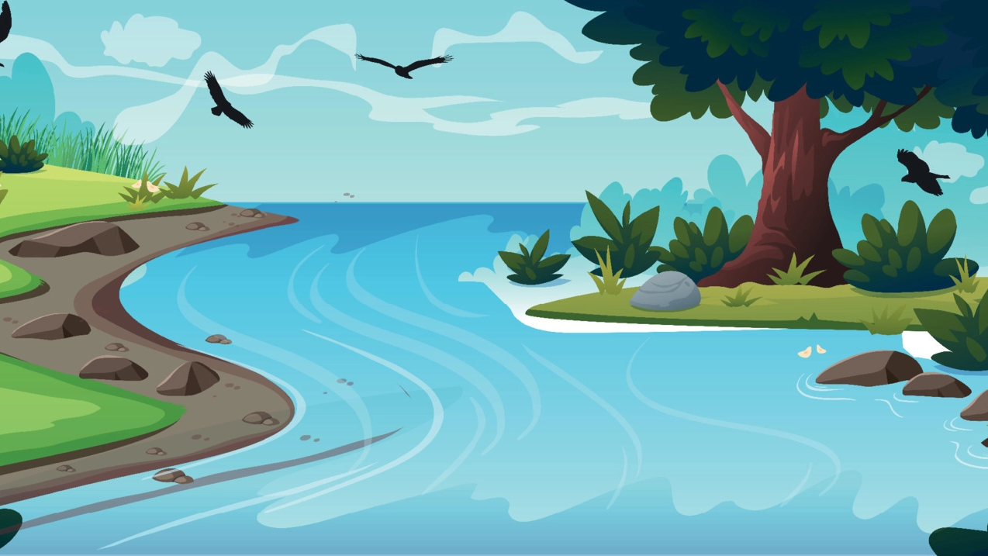
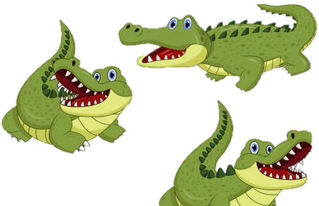
What are these animals?
A. They're hippos.
B. They're crocodiles.
C. It's a crocodile.
Notes:
Click 3 times to show choices
Click the water splash to reveal the hidden animals

Slide 14
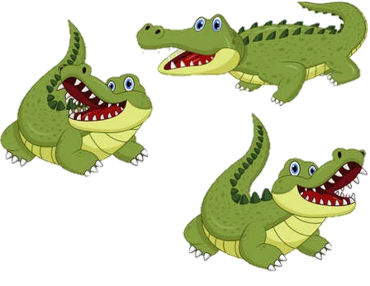
_____ are these animals?
A. Who
B. How
C. What

Slide 15
Look, complete and read.
3

Slide 16
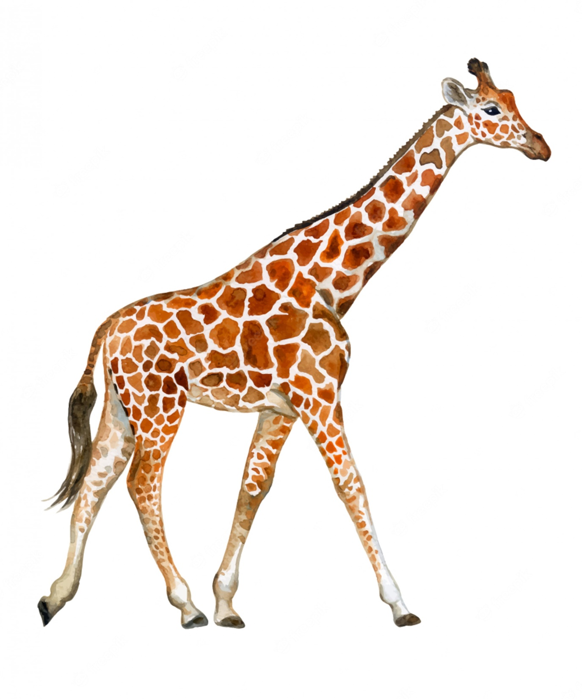
long neck

Slide 17
long legs

Slide 18
short legs

Slide 20
What's the missing word?
A: What are these animals?
B: They’re ______.
lions

Slide 21
What's the missing word?
A: What are these animals?
B: They’re ___________.
crocodiles

Slide 22
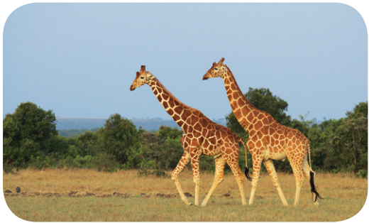
What's the missing word?
A: These animals have long necks and legs. _______ are they?
B: ________ giraffes.
What
They’re

Slide 23
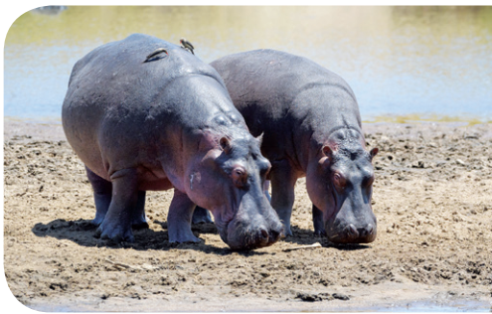
What's the missing word?
A: These animals have short legs. What _________?
B: They’re _______.
are they
hippos

Slide 24
Practise reading aloud in pairs.

Slide 28
4
Let's sing.

Slide 29
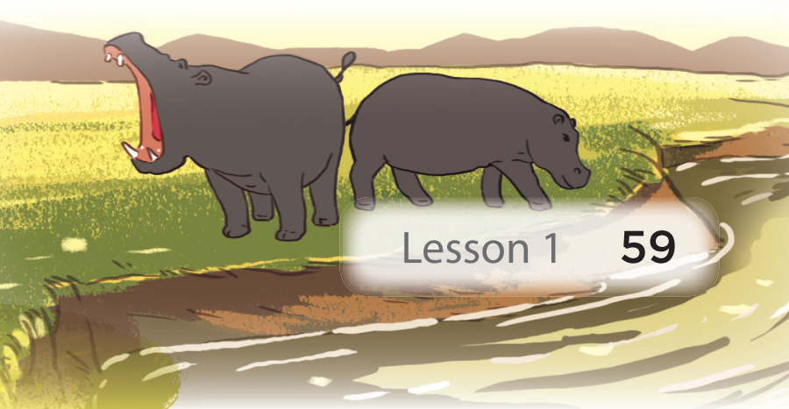
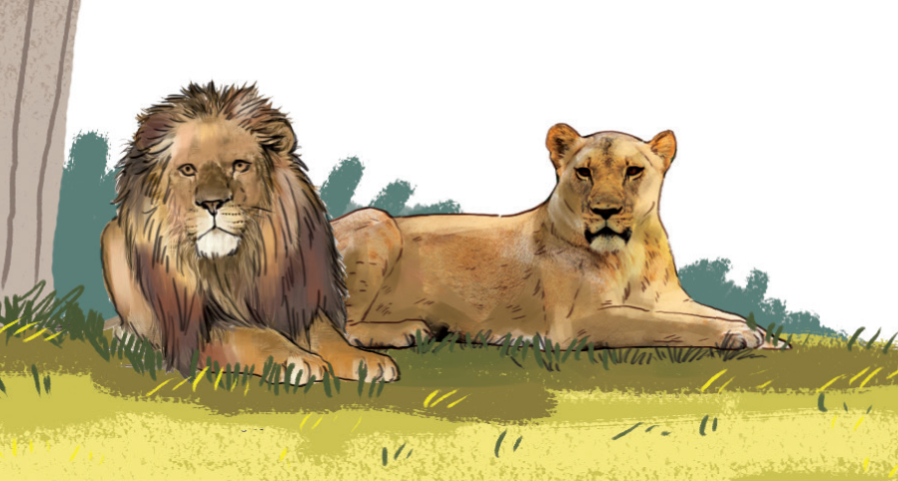
What are these animals?
Look! Look! Look!
What are these animals?
They are lions.
They look brave.
Look! Look! Look!
What are these animals?
They are hippos.
They look strong.

Slide 31
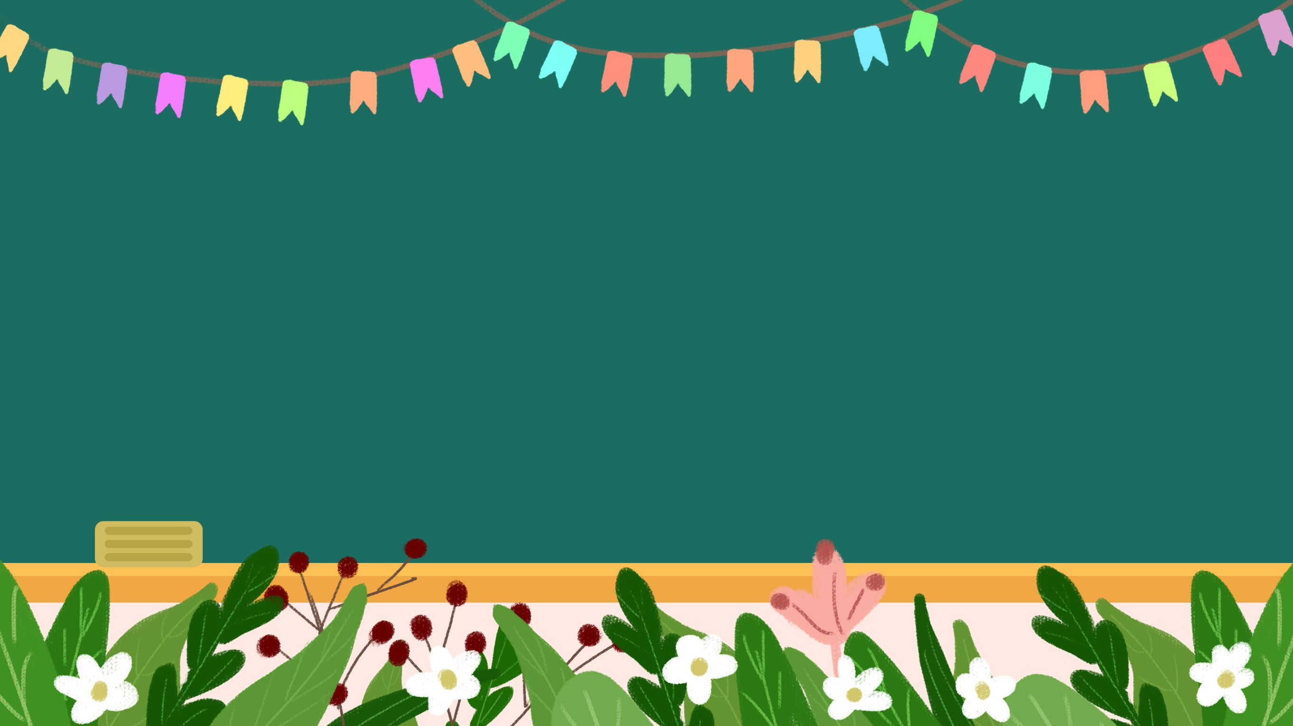
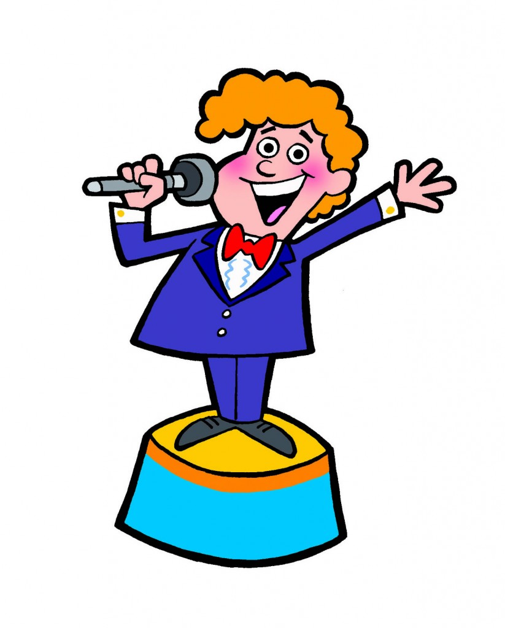
It’s time for presenting.

Slide 34
Educational value from this lesson.
+ Learn about animals
+ Keep them safe.
+ Be friendly with all animals.

