Slide 1
Unit 8 : Transportation
Lesson 2.1: Phonics
Page: 54

Slide 2
Objectives
By the end of this lesson, students will be able to recognize the /ks/ and /j/ sounds.
Vocabulary: fox, box, yo-yo, yogurt
Phonics: /ks/, /j/

Slide 3
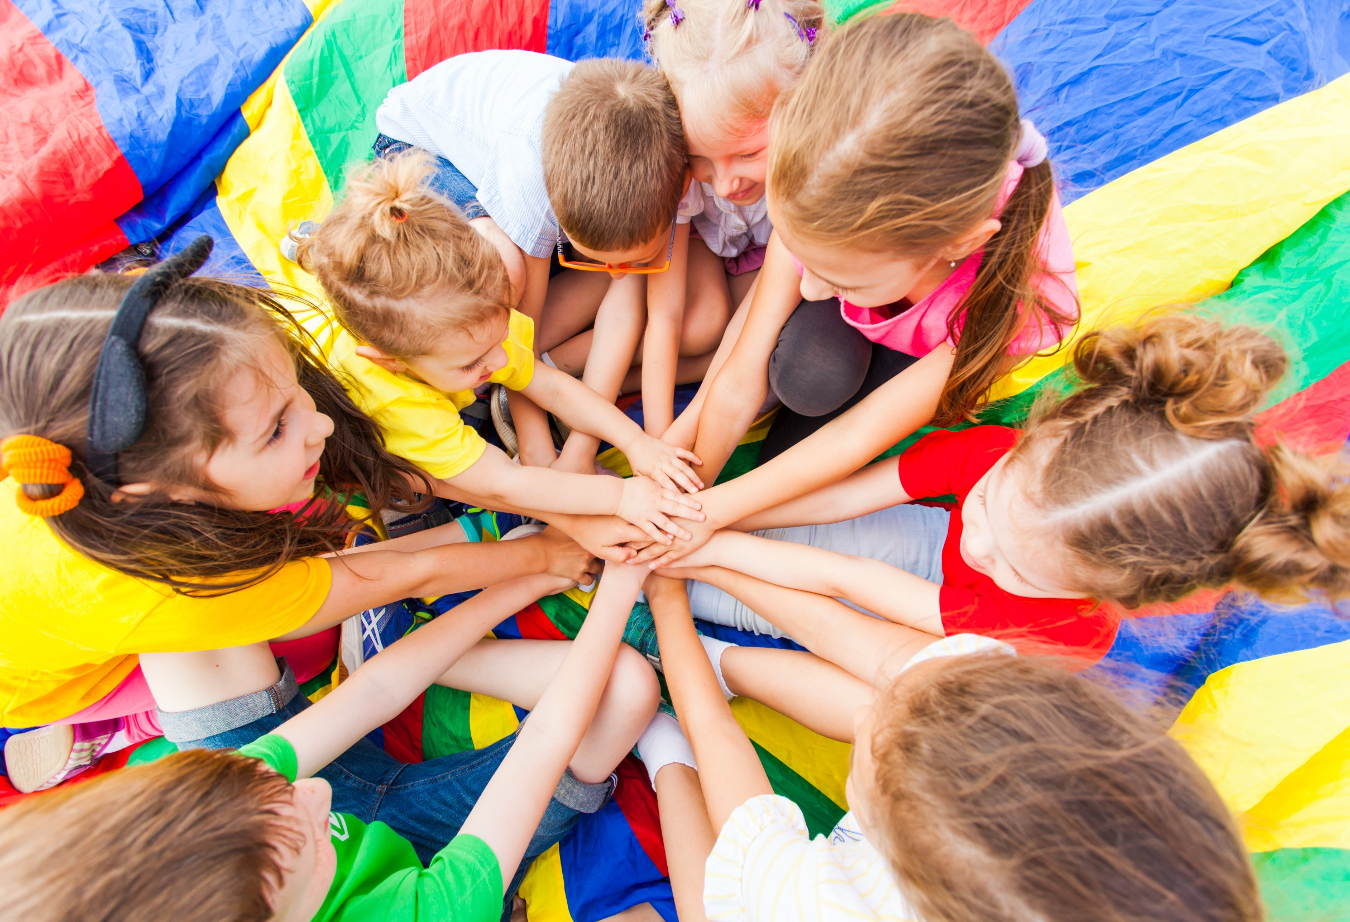
WARM UP

Slide 4
LET’S PLAY!
What’s missing?
Notes:
Put three or four FLASHCARDS (transportation) on the board and tell your child to look at them. Ask them to close their eyes and take one card away. When your child opens their eyes, ask them to guess what is missing.

Slide 5
Let’s sing!

Slide 6
Alphabet song

Slide 7
It’s time to learn …

Slide 8
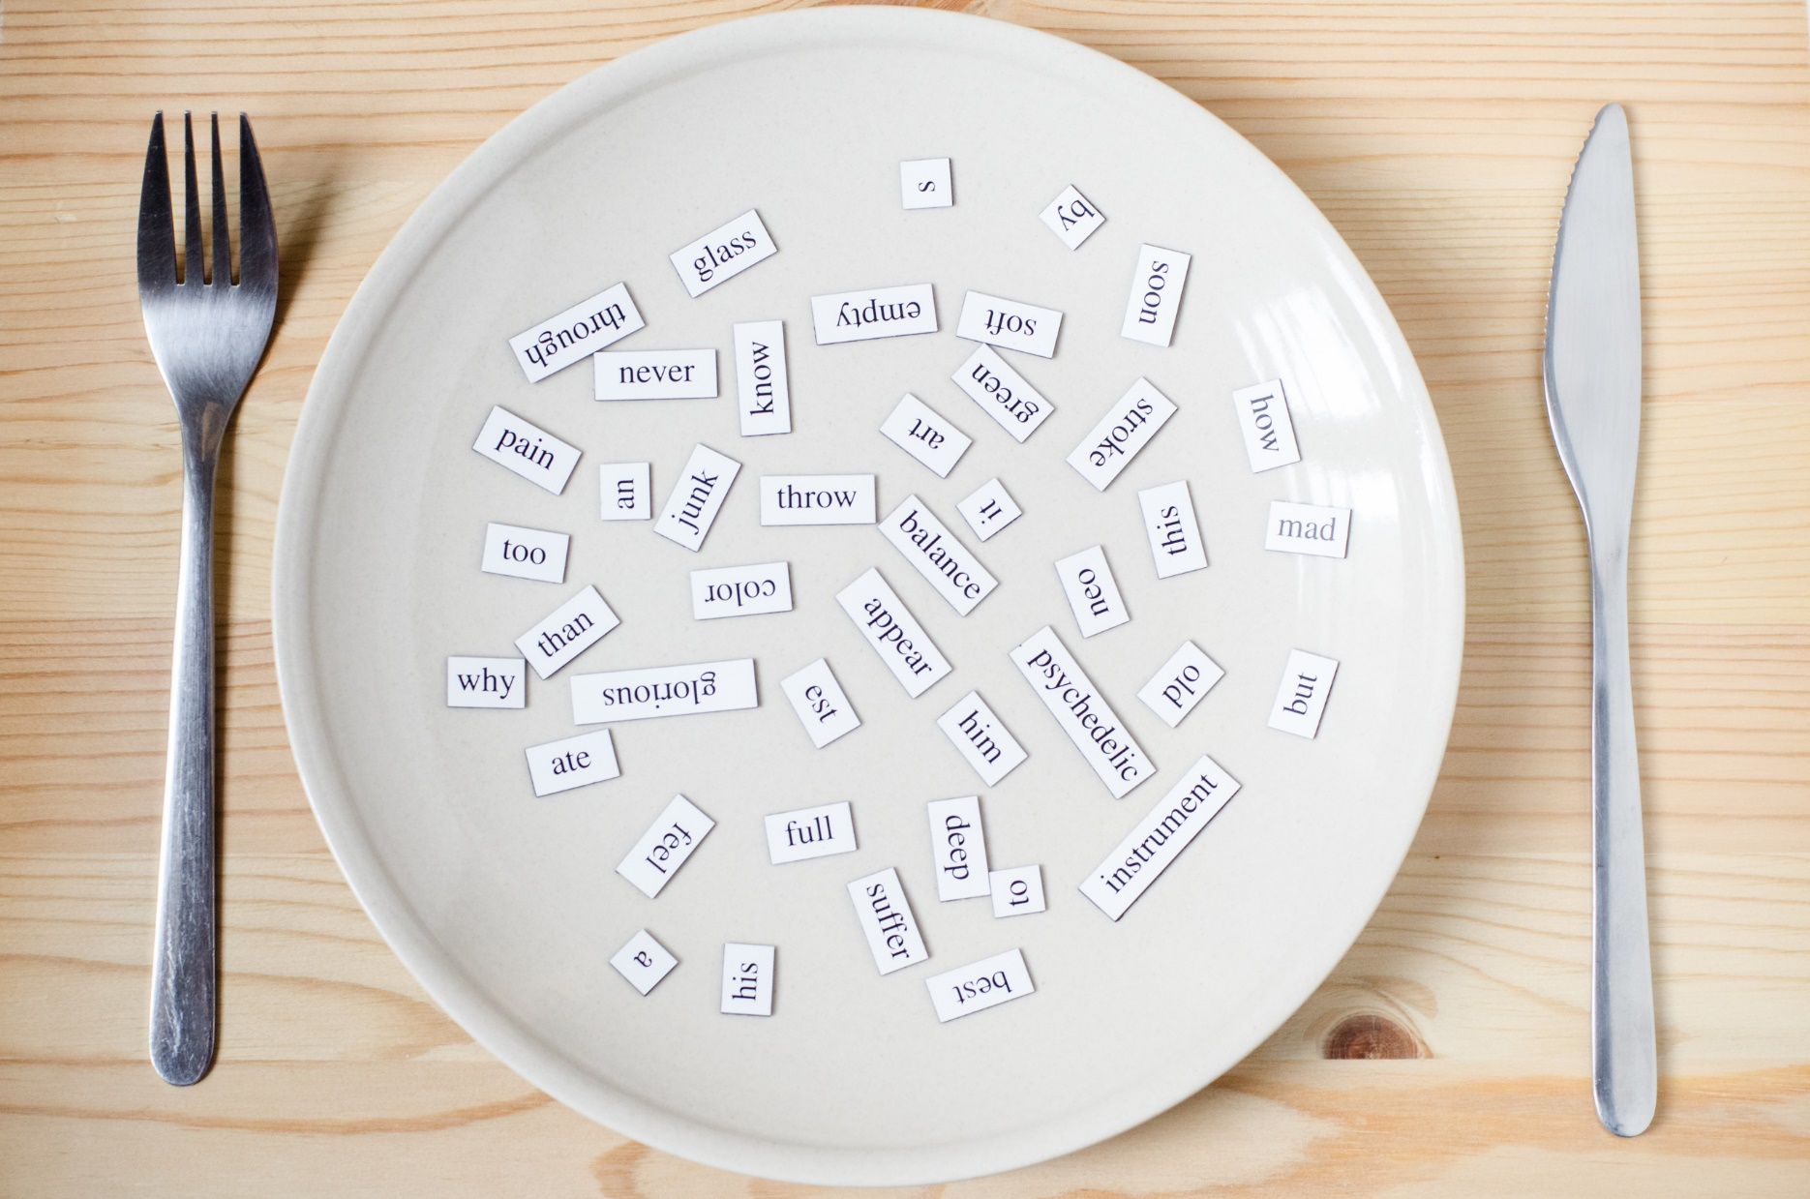
Phonics
/ks/,
/j/,

Slide 9
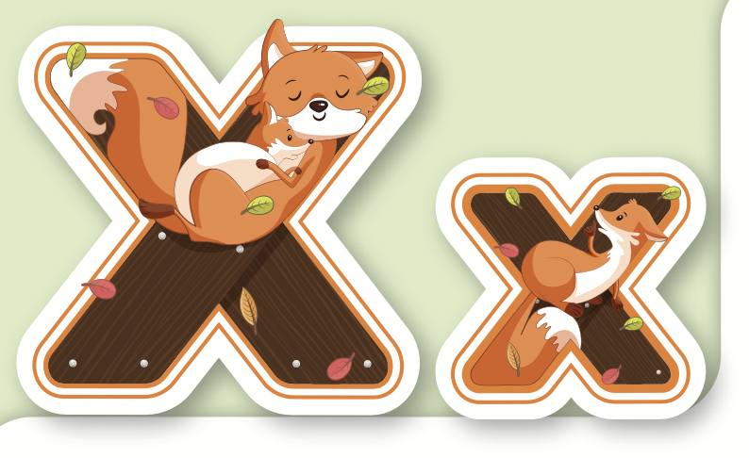
Click on the icon to hear the sound.
X, x
/ ks /

Slide 10
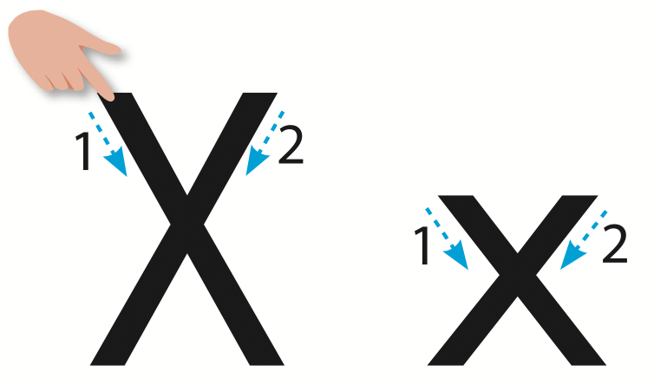
Let’s trace!

Slide 11
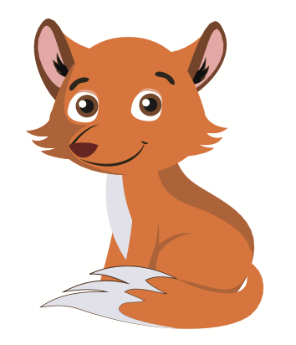
Click on the icon to hear the sound.
box
fox
/ks/
/ks/

Slide 12
Click on the picture to hear the sound.
fox
/ks/

Slide 13
Click on the picture to hear the sound.
box
/ks/

Slide 14
Let’s write!

Slide 15
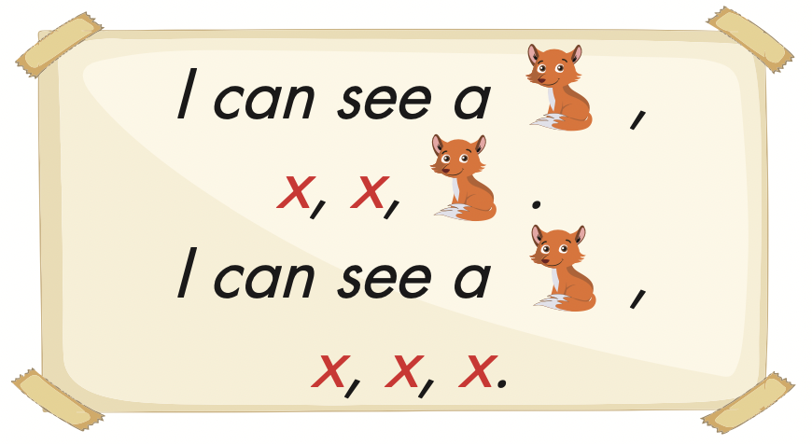
Click on the icon to hear the sound.

Slide 16
Let’s play!

Slide 17
/ks/
X
box

Slide 18
/ks/
X
fox

Slide 19
/kx/
box
fox

Slide 20
/ks/
box
fox

