Slide 1
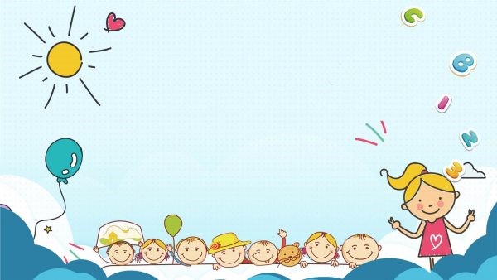
To our class 4C
Teacher: Duong Thi Hoang Anh

Slide 2
REVIEW 3
Lesson 1

Slide 3
Table of contents
01
02
Warm-up and review
Listen and number.
04
Fun corner and wrap-up
03
Ask and answer.

Slide 4
Warm-up
Sing a song.
01

Slide 5
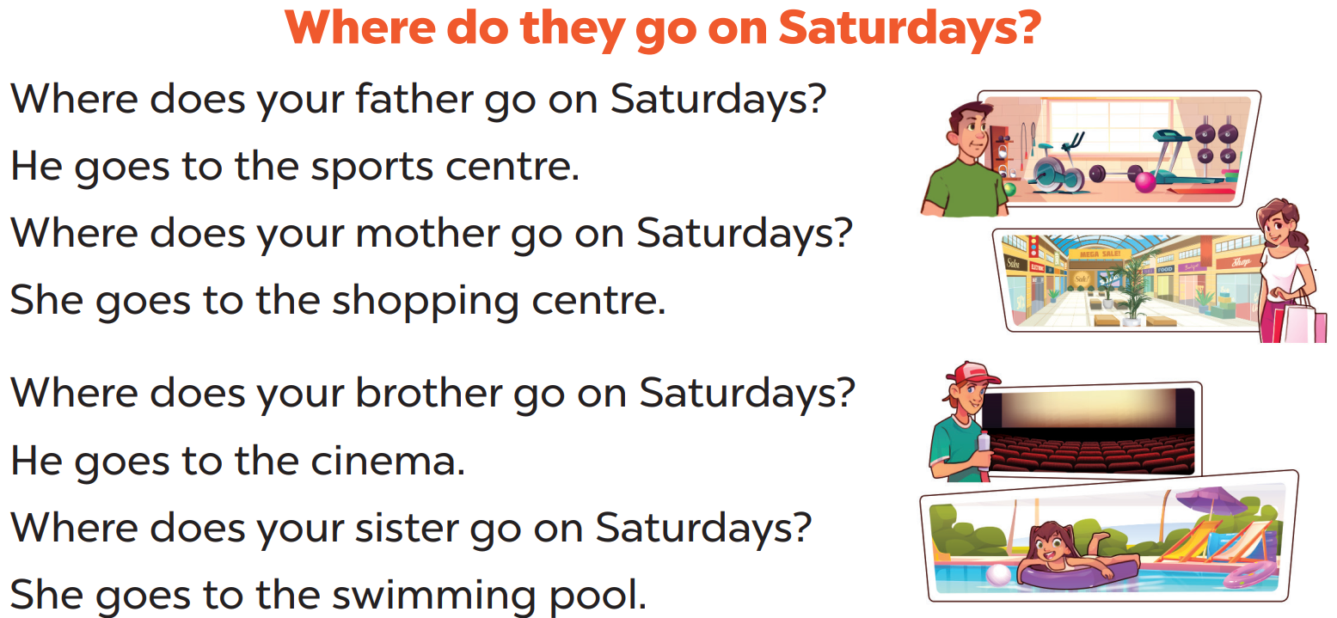
Notes:
Animation video: https://www.youtube.com/watch?v=brJK_Ke9Btw&list=PL8_ETpRL2xNay3h-a-vBjWhplE1wXFpSJ&index=31

Slide 6
Listen and number
02

Slide 7
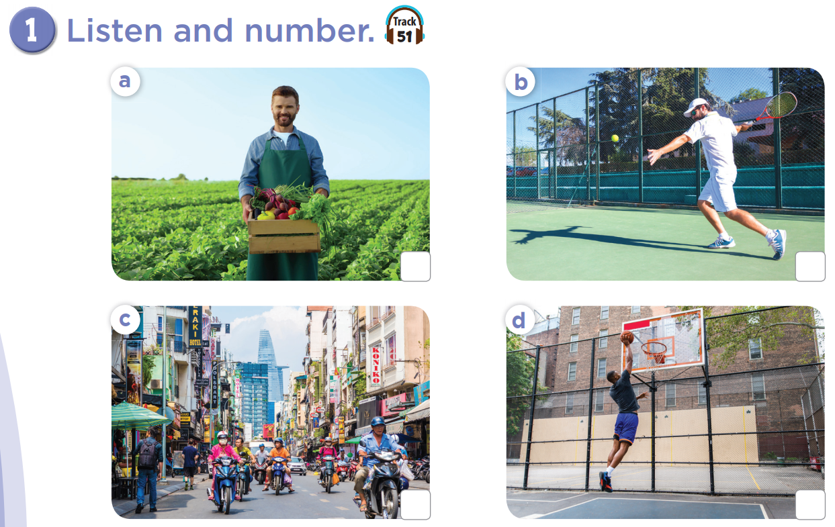

Slide 8
a farmer
play tennis
2
4
busy street
1
tall
3

Slide 9
Ask and answer.
03

Slide 10
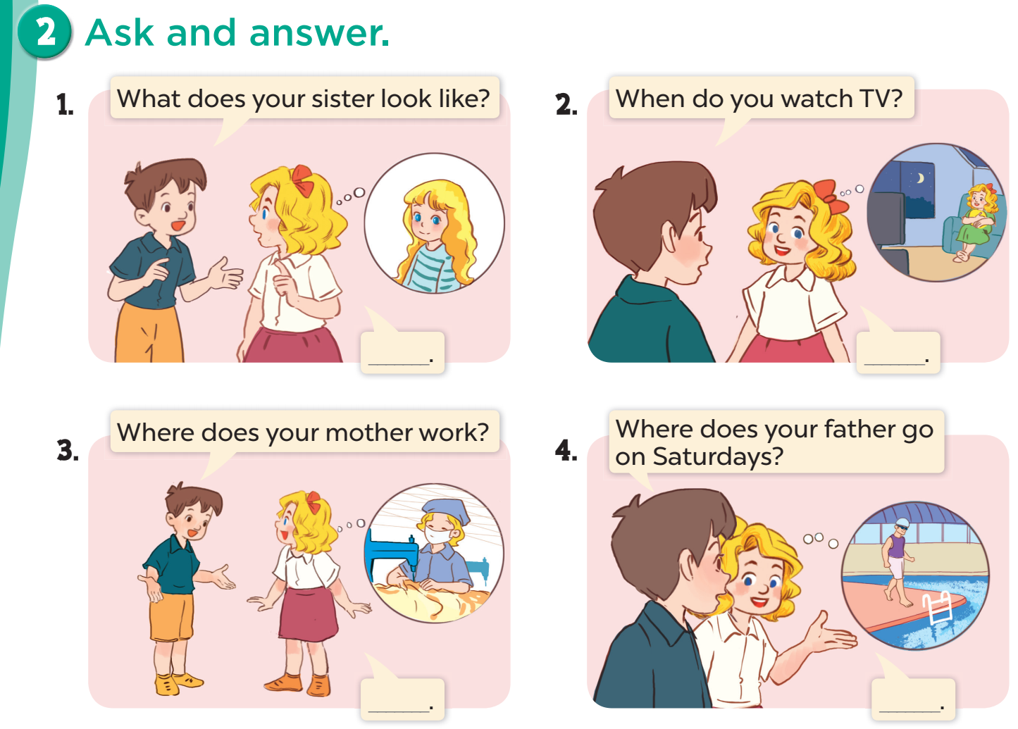

Slide 11
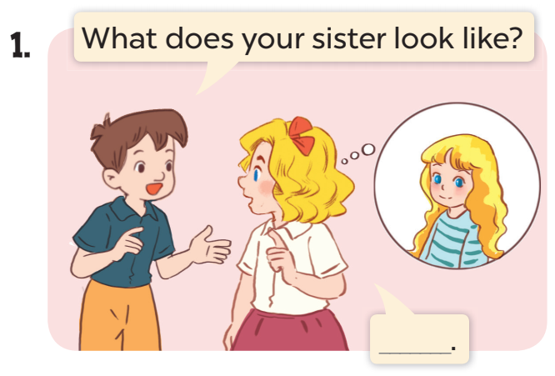
She has long hair.

Slide 12
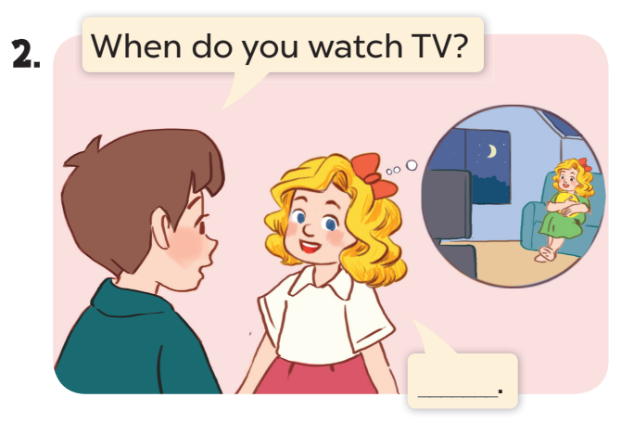
I watch TV in the evening.

Slide 13
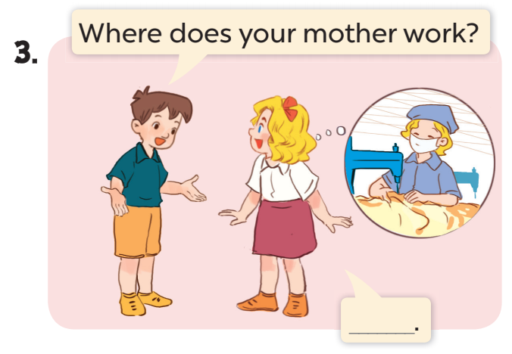
She works at a factory.

Slide 14
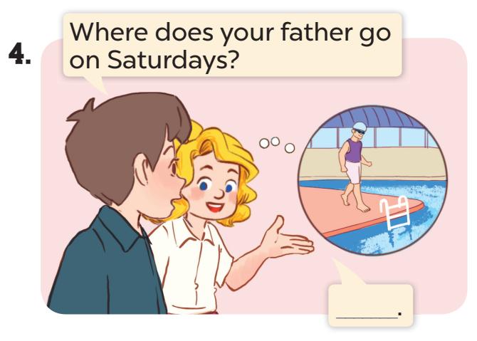
He goes to the swimming pool.

Slide 15
Fun corner
Review game
04

Slide 16
REVIEW GAME
JOBS
APPEARANCE
DAILY ACTIVITIES
MY FAMILY’S WEEKEND
10 Points
10 Points
10 Points
10 Points
20 Points
20 Points
20 Points
20 Points
30 Points
30 Points
30 Points
30 Points
40 Points
40 Points
40 Points
40 Points
NEXT

Slide 17
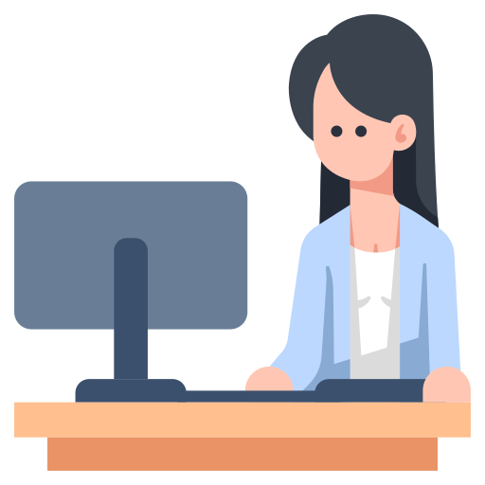
1. COMPLETE THE WORD.
_FF_CE _O_K_R
OFFICE WORKER

Slide 18
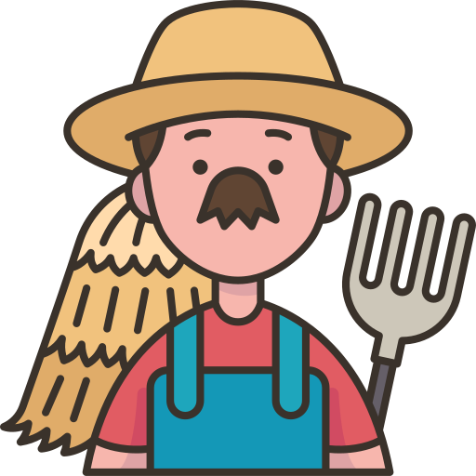
2. UNSCRAMBLE
RAFERM
FARMER

Slide 19
3. WHAT DOES HE DO?
a farmer
He is .........
an office worker
a policeman
A
B
C

Slide 20
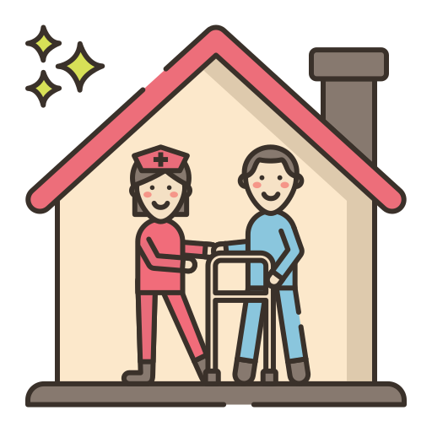
4. WHERE DOES SHE WORK?
She works at a nursing home.

Slide 21
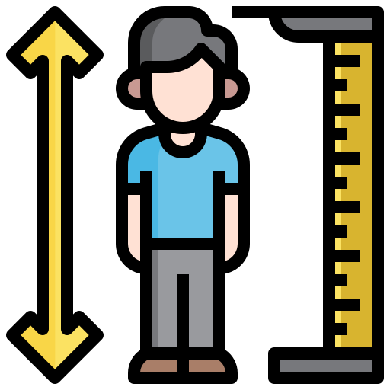
1. LOOK, CHOOSE THE BEST ANSWER
tall
short
big
A
B
C

Slide 22
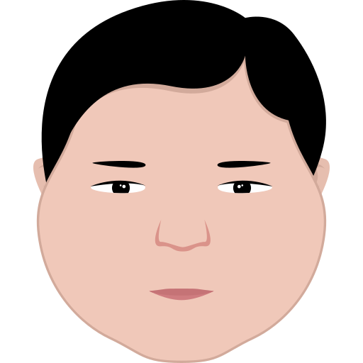
2. WHAT DOES HE LOOK LIKE?
He ...... a round face.
A
is
B
has

Slide 23
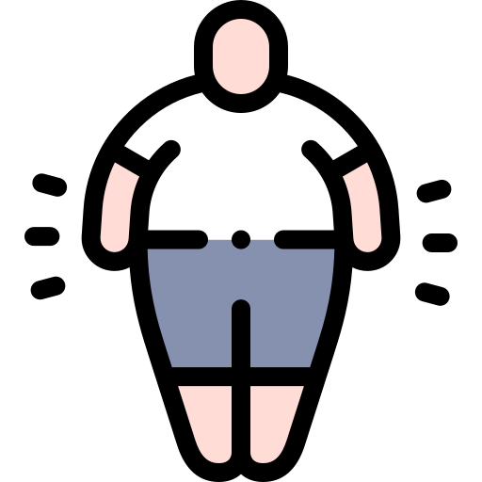
3. WHAT DOES YOUR FATHER LOOK LIKE?
He is big.

Slide 24
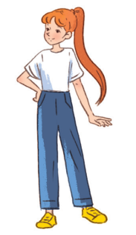
4. WHAT DOES YOUR SISTER LOOK LIKE?
She is____. She has_____.
She is slim. She has long hair.

Slide 25
1. CHOOSE THE BEST ANSWER
A
in the morning
B
in the afternoon
C
in the evening

Slide 26
2. WHEN DO YOU CLEAN THE FLOOR?
I clean the floor in the morning.

Slide 27
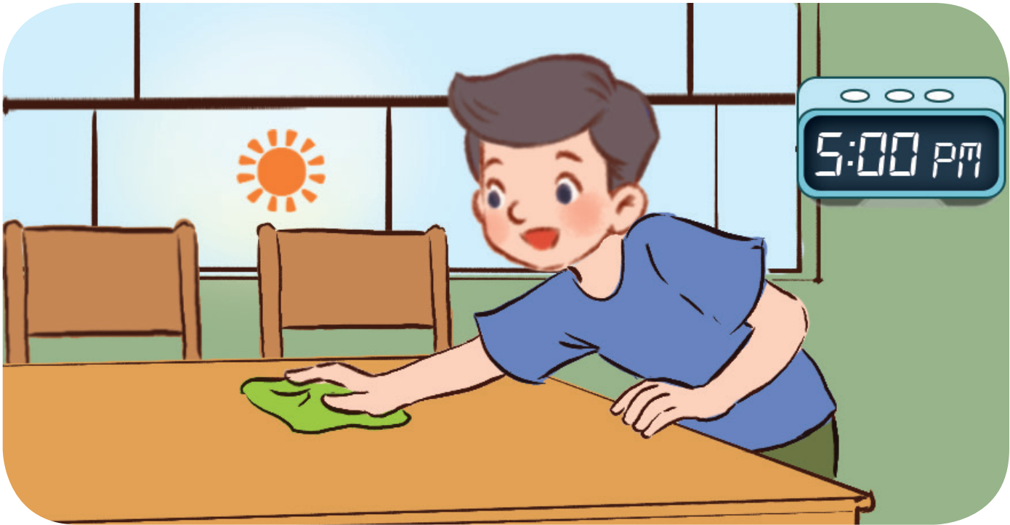
3. WHEN DO YOU DO THE HOUSEWORK?
In the afternoon.

Slide 28
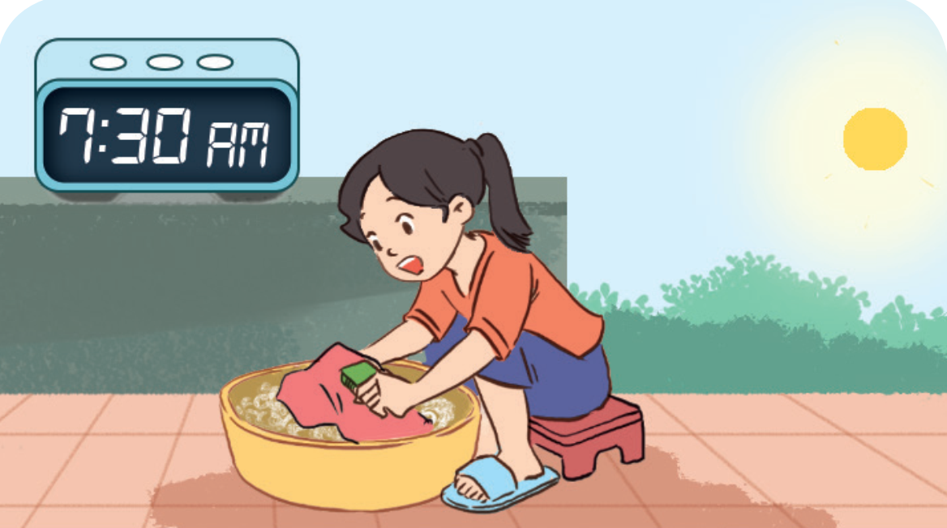
4. WHAT DO YOU DO IN THE MORNING?
I wash the clothes.

Slide 29
1. LOOK, COMPLETE THE WORD.
SW_MMING PO_L
SWIMMING POOL

Slide 30
2. LOOK. CHOOSE THE BEST ANSWER.
Shopping centre
Sports centre
Cinema
A
B
C

Slide 31
3. WHERE DOES SHE GO ON SUNDAYS?
She goes to the cinema on Sundays.

Slide 32
4. WHAT DOES SHE DO ON SATURDAYS?
She does yoga.

Slide 33
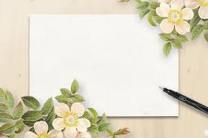
THANK
YOU

