Slide 1
Unit 6: Activities
Lesson 2.1
Page 40

Slide 2
Objectives
By the end of this lesson, students will review the /e/ and /f/ sounds and pronounce them correctly.
Vocabulary: elephant, food
Phonic: / e /, / f /

Slide 3
WARM UP

Slide 4
Let’s sing!

Slide 6
It’s time to learn …

Slide 7
Click the icon to hear the sound.

Slide 8
Review

Slide 9
Phonics
/ e /,
/ f /

Slide 10
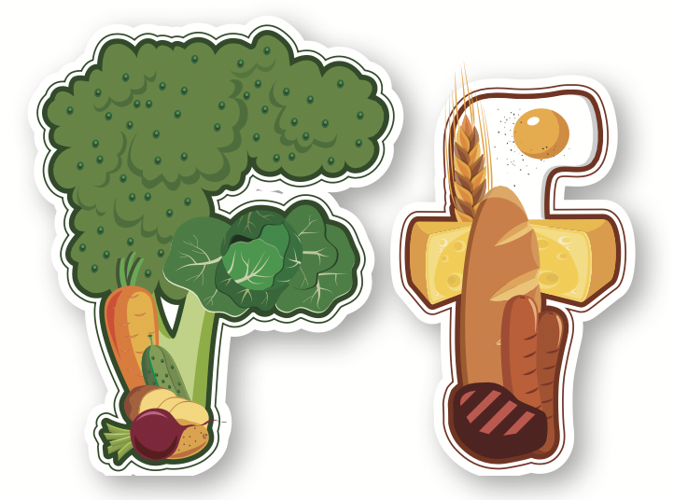
Click the icon to hear the sound.
/ e /
/ f /

Slide 11
Click the icon to hear the sound.
E, e
F, f
/ f /
/ e /

Slide 12
Practice

Slide 13
Listening

Slide 15
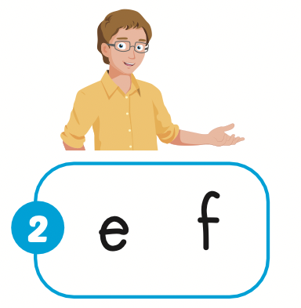

Slide 18
Production

Slide 19
Let’s play!
Listen and choose

Slide 20
food
elephant
father

Slide 21
/g/
/ e /
/ f /

Slide 22
/g/
/e/
/ f /

Slide 23
father
food
elephant

