Slide 1
Unit 6: Activities
Lesson 1.1
Page 38

Slide 2
Objectives
By the end of this lesson, students will be able to talk about their abilities.
Vocabulary: swim, sing, run
Structure: I can (run).

Slide 3
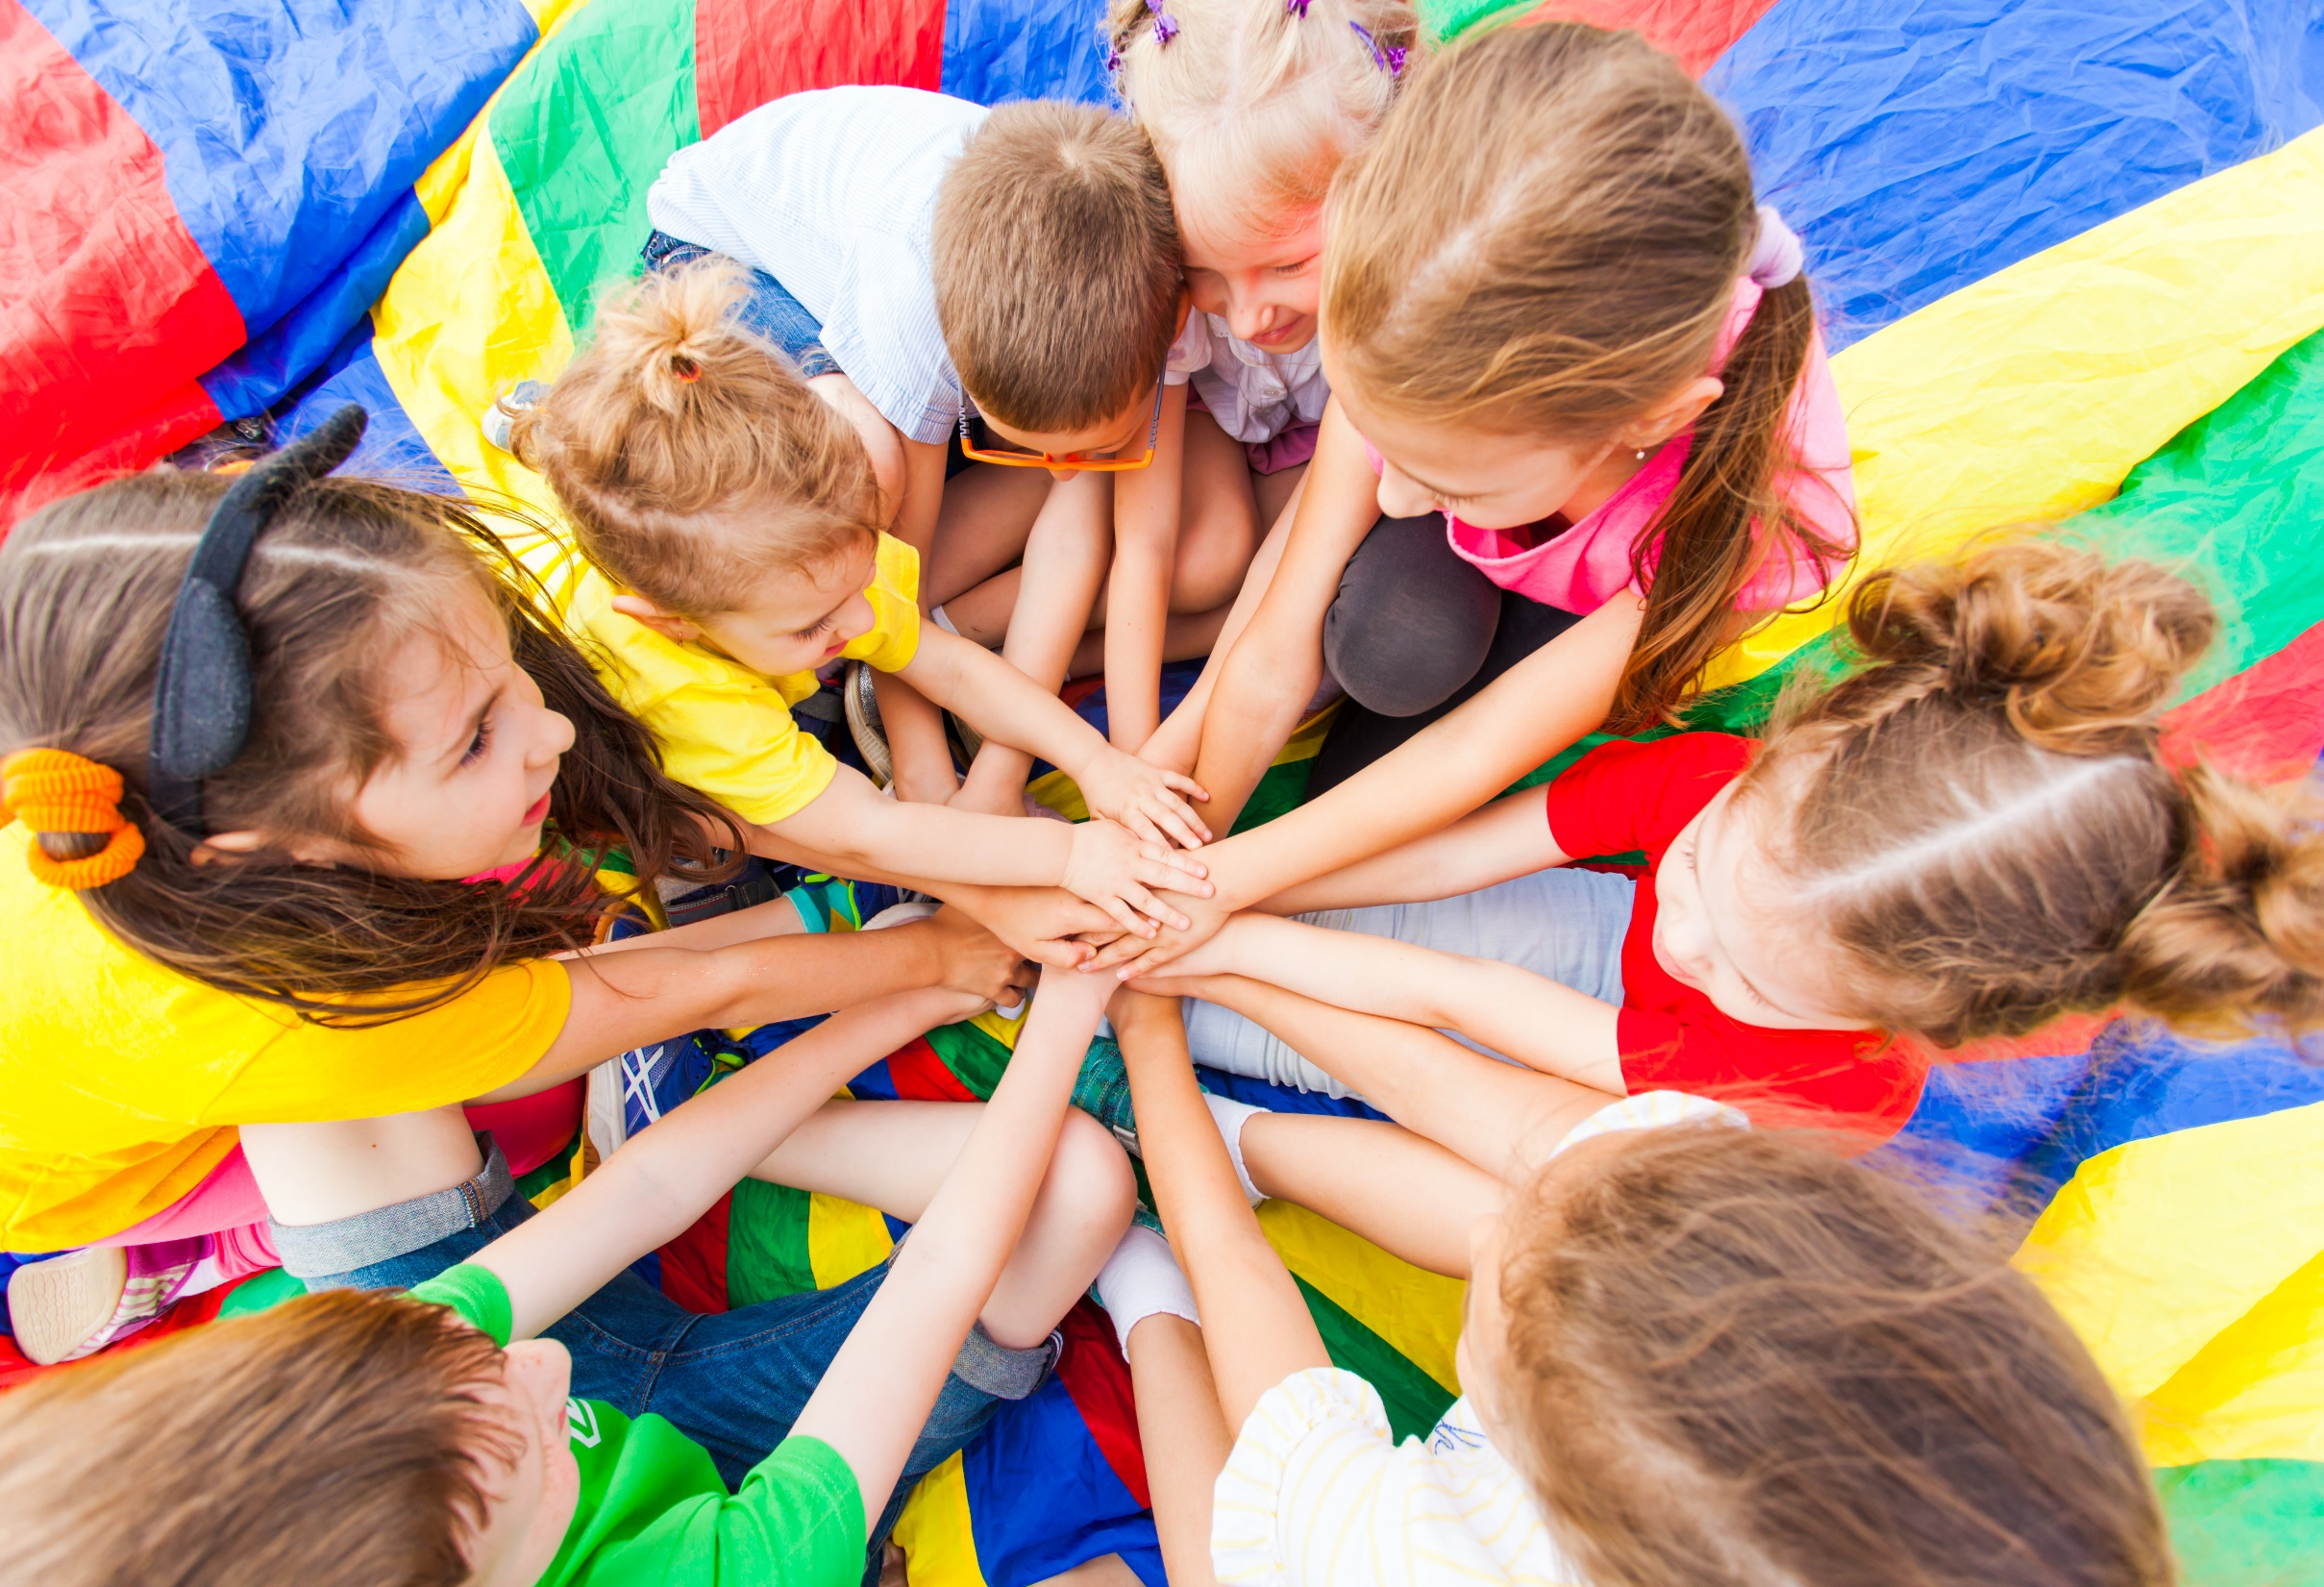
WARM UP

Slide 4
Let’s sing!

Slide 6
It’s time to learn …

Slide 7
New words
Swim,
Sing,
Run

Slide 8
Presentation

Slide 9
Click the icon to hear the sound.

Slide 10
Practice

Slide 11
Listening

Slide 12
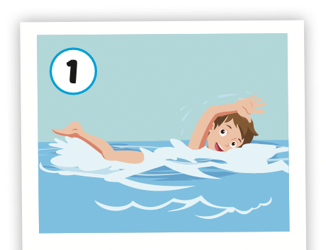
Click the picture to hear the sound.
swim
/swɪm/
bơi

Slide 13
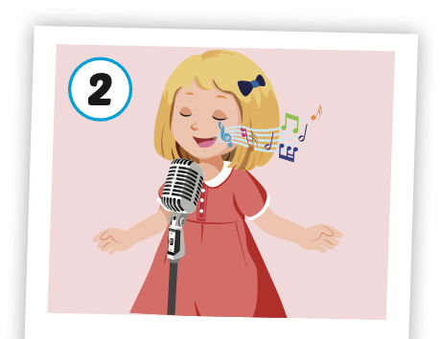
Click the picture to hear the sound.
sing
/sɪŋ/
hát

Slide 14
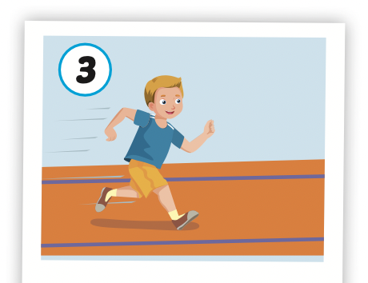
Click the picture to hear the sound.
run
/rʌn/
chạy

Slide 15
Structures
I can (run).

Slide 16
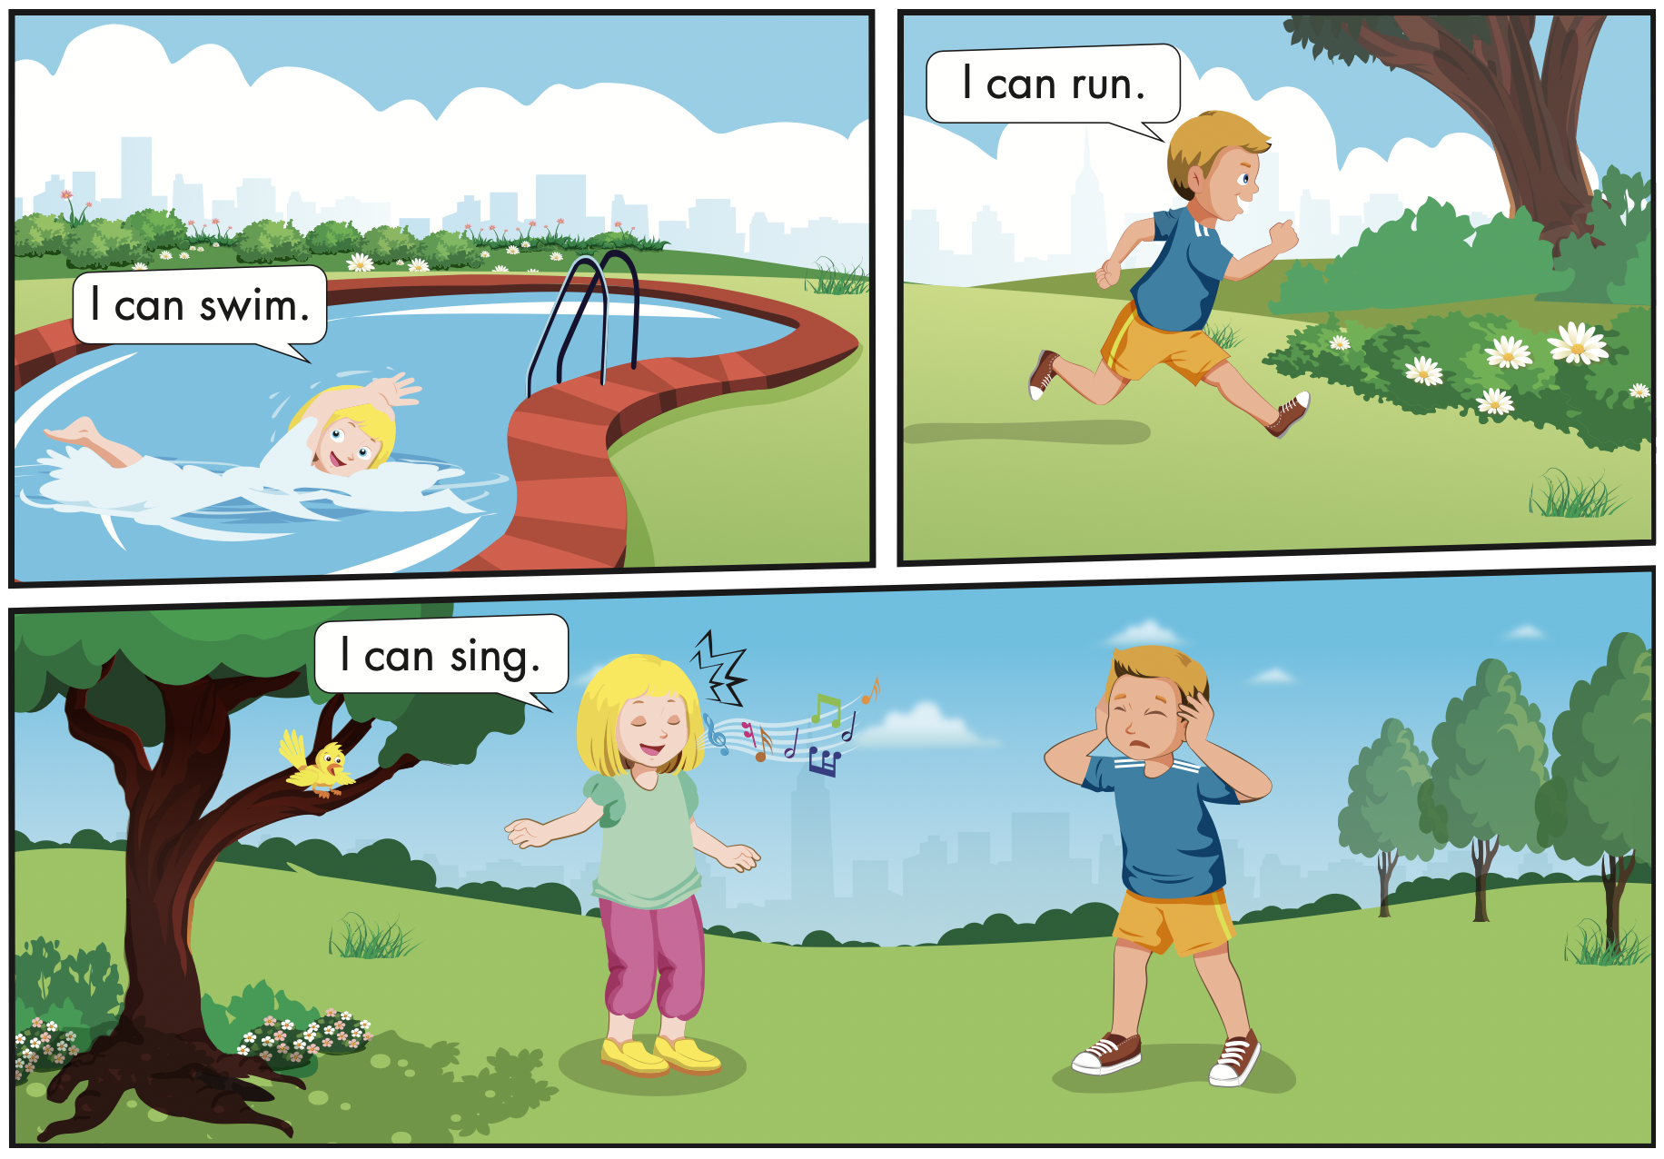
Click the icon to hear the sound.

Slide 17
Speaking

Slide 18
Let’s say!
swim
I can swim.

Slide 19
Let’s say!
sing
I can sing

Slide 20
Let’s say!
run
I can run.

Slide 23
Production

Slide 24
Let’s play!
Look and guess

Slide 25
Start
Check

Slide 26
Start
Check

Slide 27
Start
Check

Slide 29
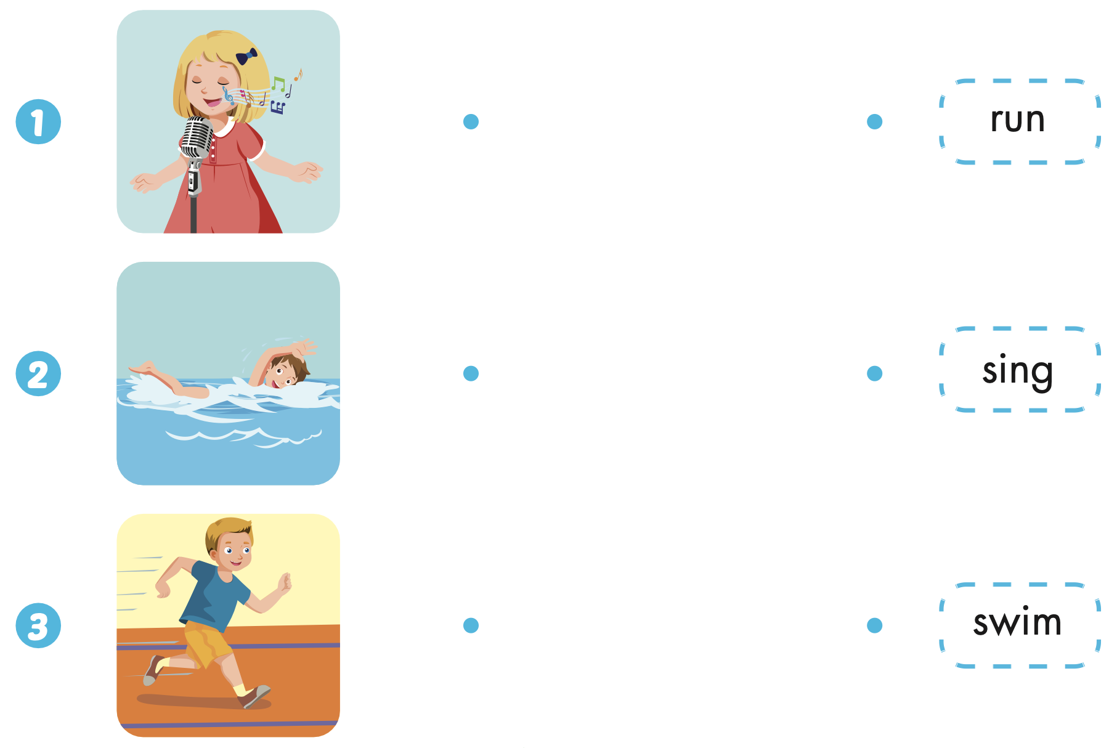
Extra Practice
WB, page 36

Slide 30
CONSOLIDATION

Slide 31
Let’s play!
Simon says Game

