Slide 1


To our class 4A
Teacher: Duong Thi Hoang Anh

Slide 4

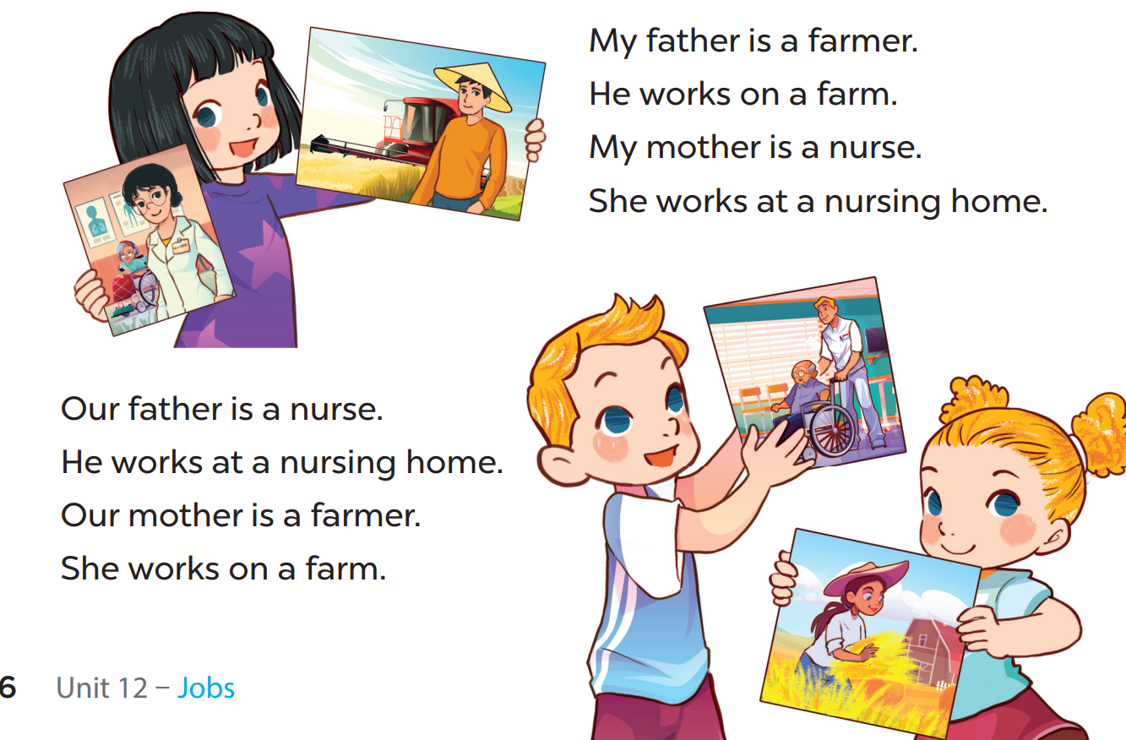

Slide 5
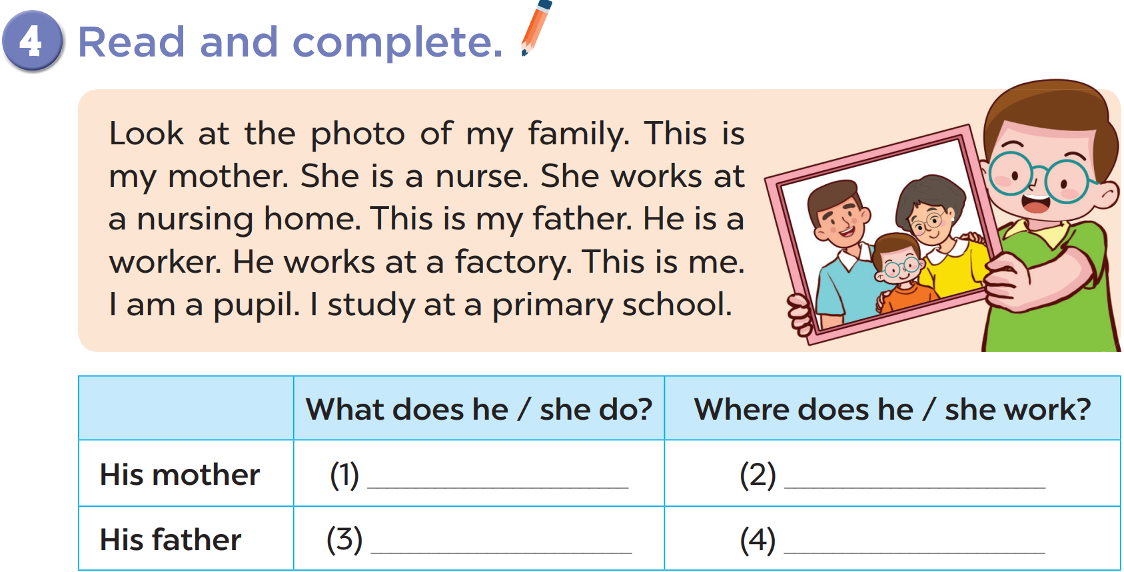
Notes:
chant several times, change the lyrics

Slide 6
a nurse
at a nursing home
a worker
at a factory
Notes:
chant several times, change the lyrics

Slide 7
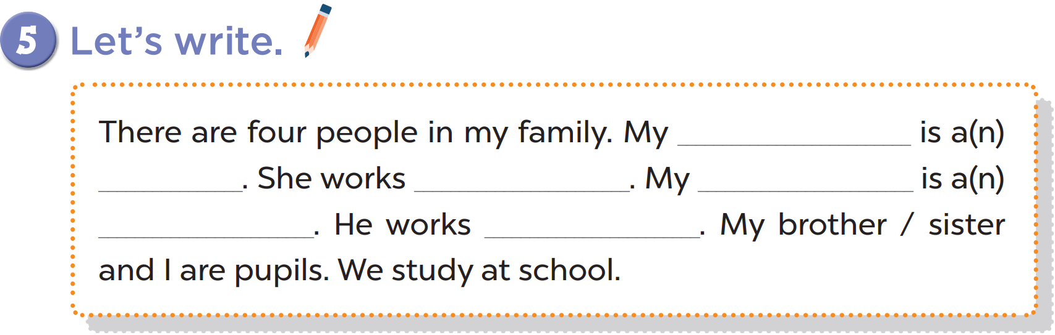

Slide 8
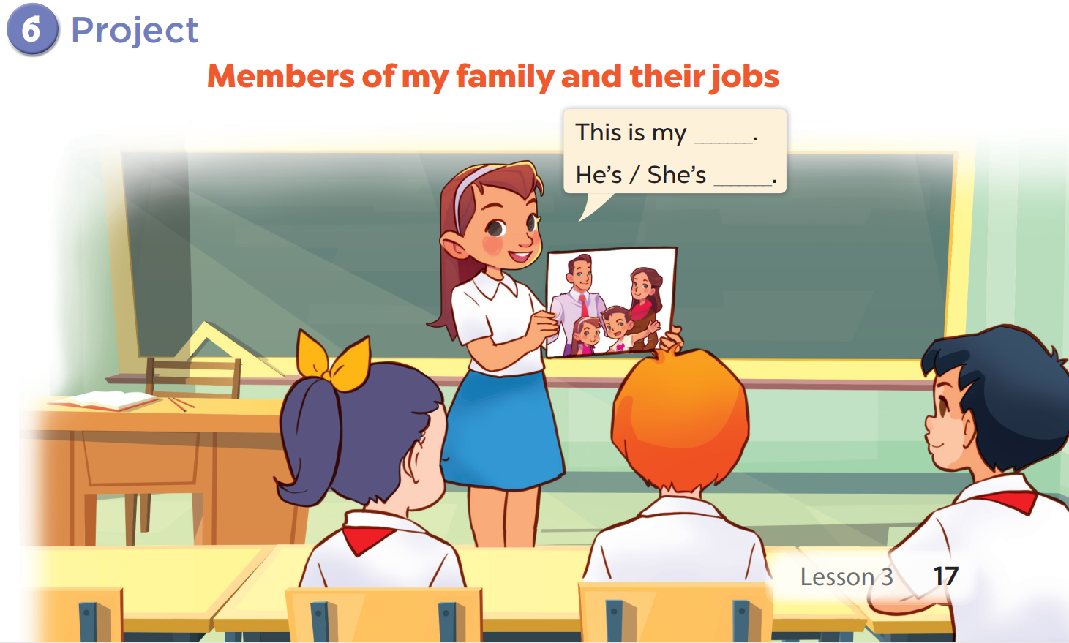

Slide 9





Scrambled Jobs game

Slide 10
eifcof rrkoew
eacoiplmn
office worker
policeman
rrmaef
taorc
farmer
actor

Slide 11

THANK
YOU

