Slide 1


To our class 4B
Teacher: Duong Thi Hoang Anh

Slide 2
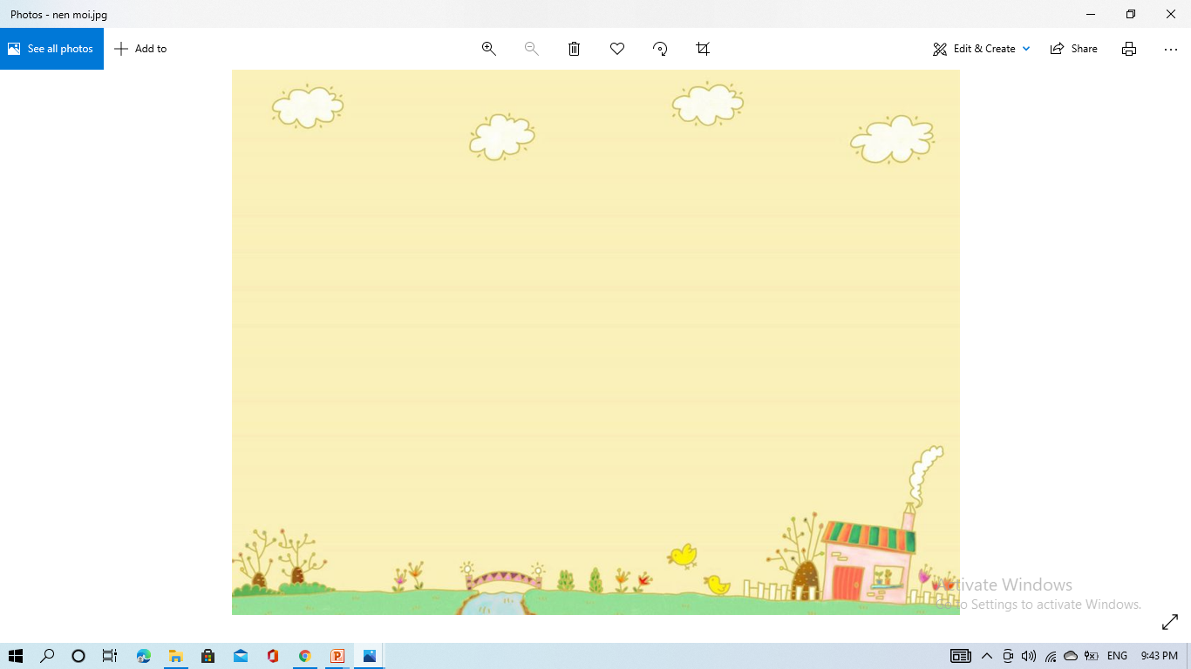
Week 19
Monday, January 15th 2024
Warm up: Sing the song
Where do you live?
https://www.youtube.com/watch?v=GlYJKcbpVdw

Slide 3
Week 11
Monday, January 15th 2023
Unit 11 My home
LESSON 1 – Activities 1,2,3

Slide 4
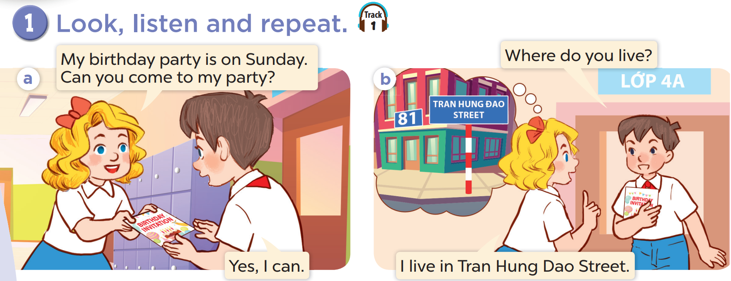


Slide 5
02
Listen, point and say.

Slide 6
vocabulary

Slide 7
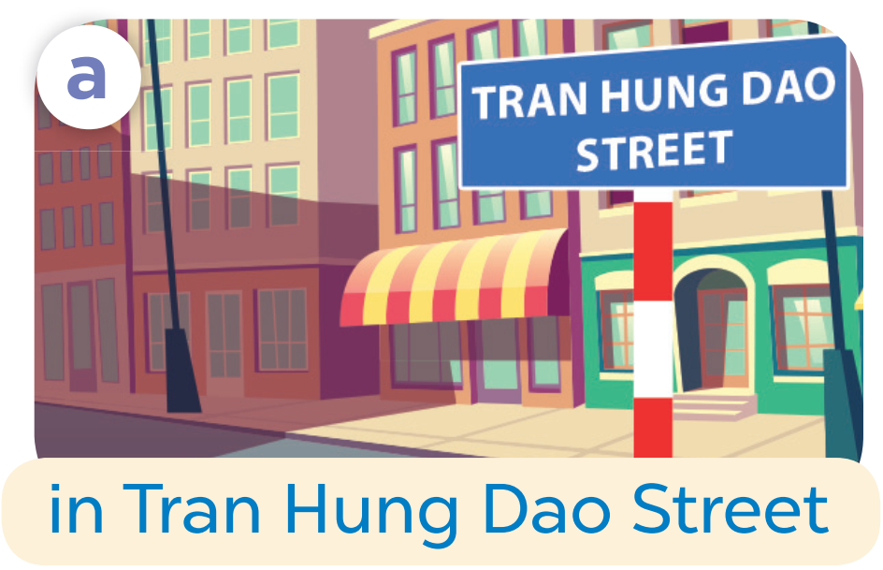

Slide 8
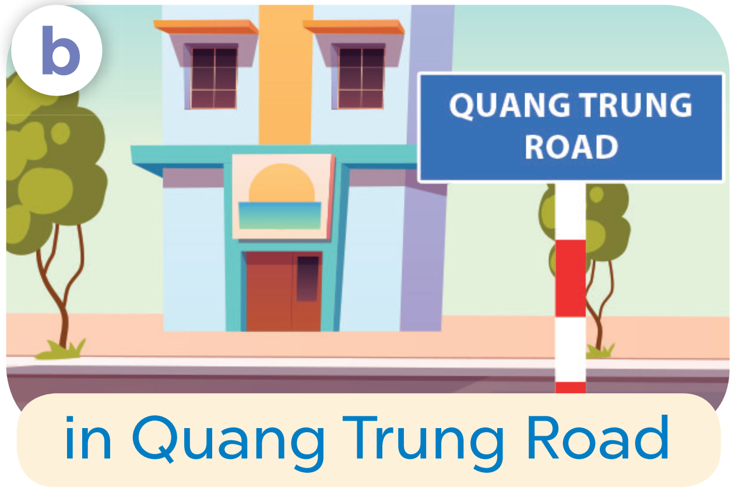

Slide 9
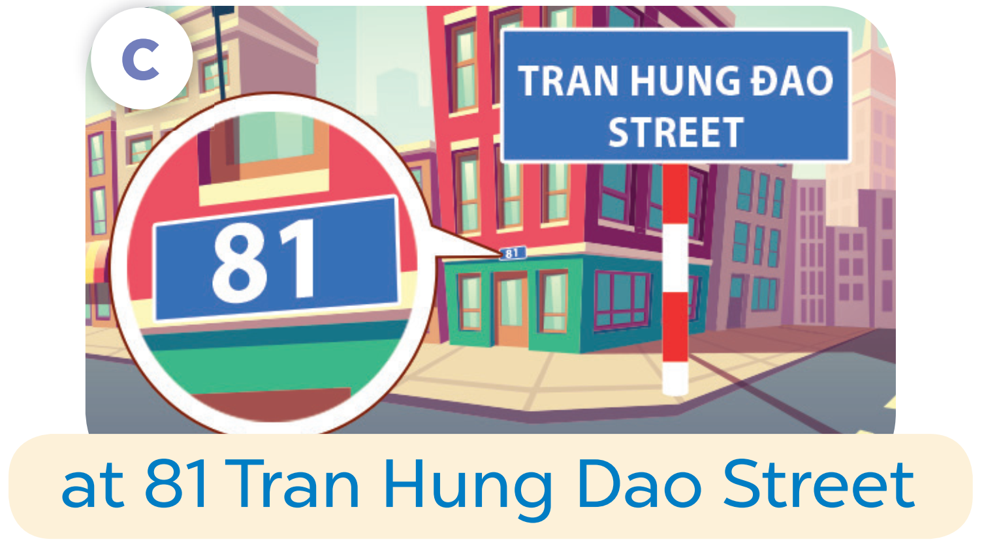

Slide 10
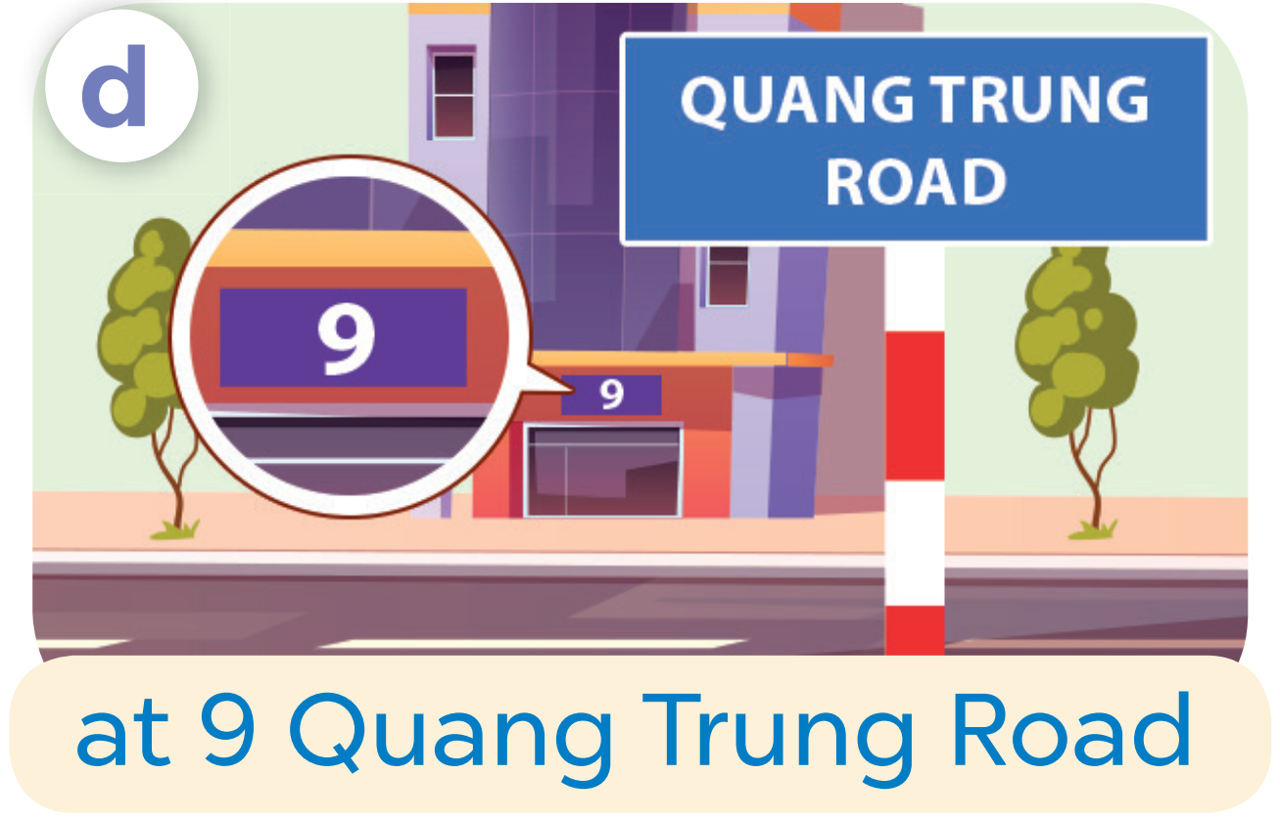

Slide 11
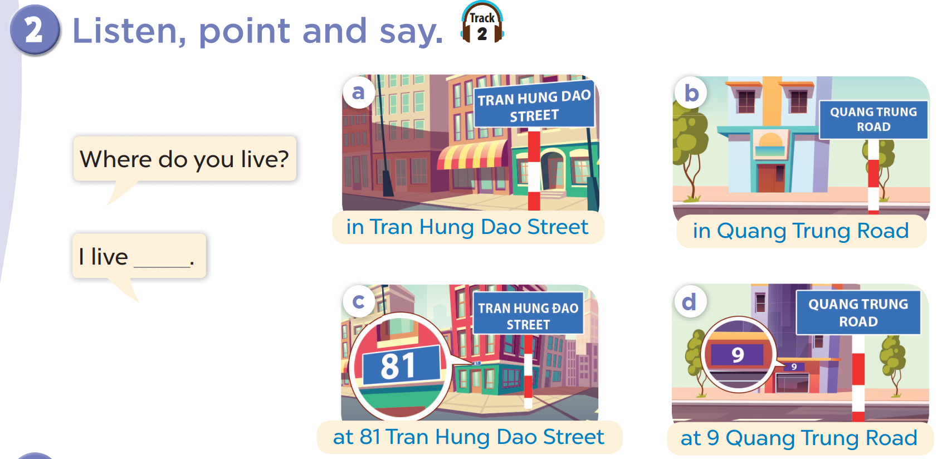

Slide 12
Where do you live?
I live in Tran Hung Dao Street.

Slide 13
03
Let’s talk.

Slide 14
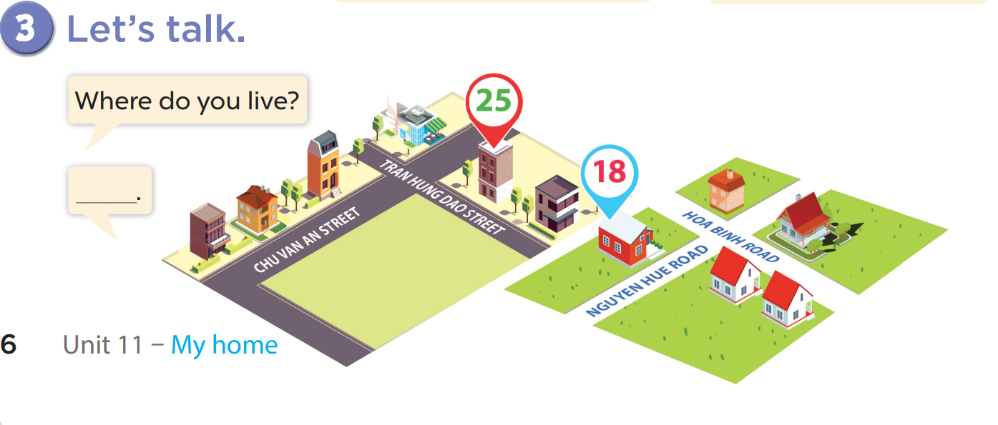

Slide 15
fun corner & Wrap-up

Slide 16
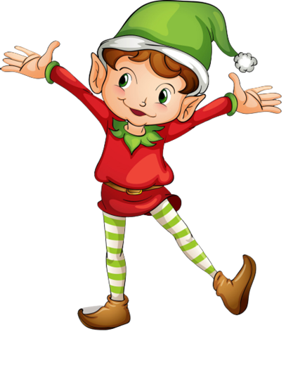
1
point
5
points
Lucky wheel!
Question
Question
Question
Question
Question
Question
SPIN
Question
3
points
2
points
10
points
End
Notes:
Click on “spin” button to spin the wheel, click again to stop

Slide 17
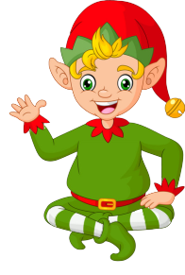
Ask and answer!
Where do you live?
I live in Tran Hung Dao Street.
Check
Back

Slide 18
Ask and answer!
Where do you live?
I live in Quang Trung Road.
Back
Check

Slide 19
Ask and answer!
Where do you live?
I live at 81 Tran Hung Dao Street.
Back
Check

Slide 20
Ask and answer!
Where do you live?
I live at 9 Quang Trung Road.
Back
Check

Slide 21
Ask and answer!
Where do you live?
I live in/at…….
Back
Check

Slide 22
Ask and answer
Where do you live?
I live in/at…….
Back
Check

Slide 23

Ask and answer!
Where do you live?
I live in/at…….
Back
Check

Slide 24

THANK
YOU

