Slide 1
UNIT 5: FREE TIME ACTIVITIES
Lesson 2

Slide 2
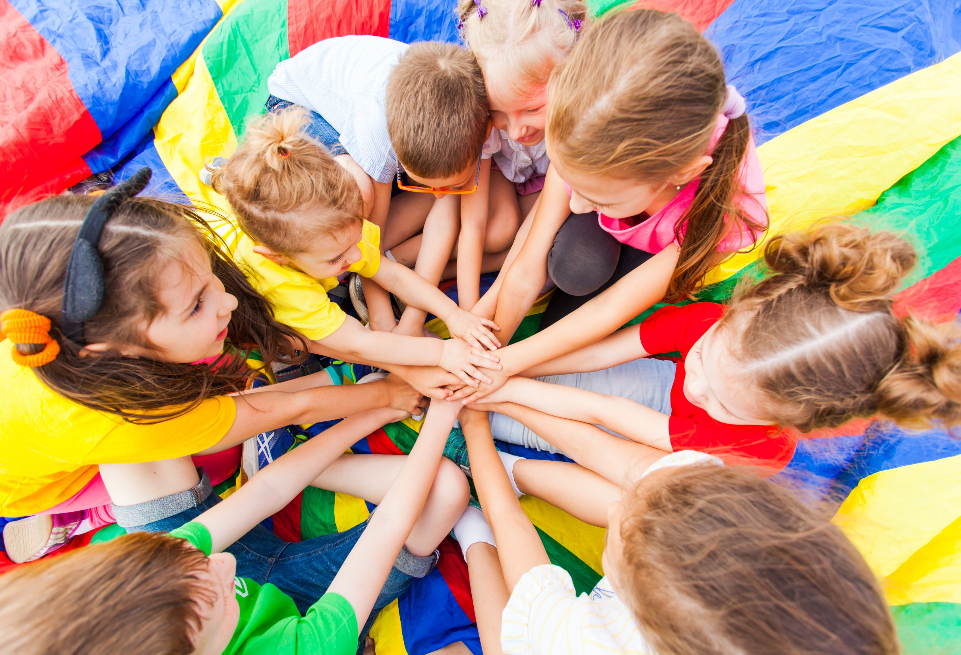
WARM UP

Slide 3
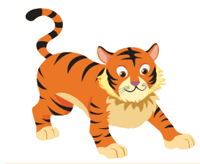
tiger
1
t
g
i
r
e

Slide 4
top
2
p
t
o

Slide 5
It’s time to learn …

Slide 6
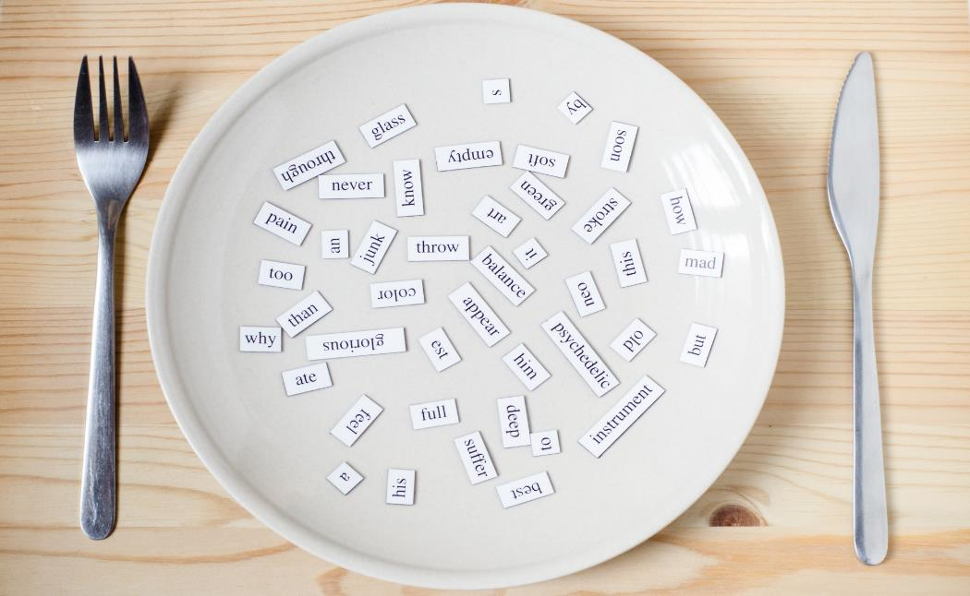
Phonics
/ ʌ /

Slide 7
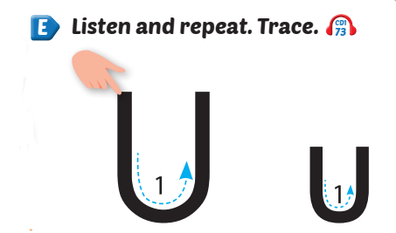
Click the Alphabet to hear the sound.

Slide 8
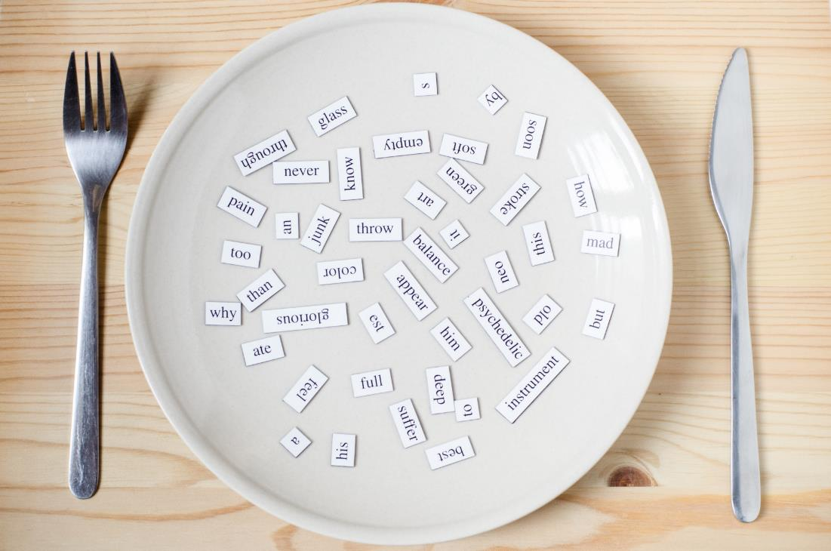
New words
umbrella,
uncle

Slide 9
Click the picture to hear the sound.
/ ʌ / / ʌ /
umbrella
/ʌmˈbrelə/
cái ô, cây dù

Slide 10
Click the picture to hear the sound.
/ ʌ / / ʌ /
uncle
/ˈʌŋkl/
chú, bác, cậu, dượng

Slide 11
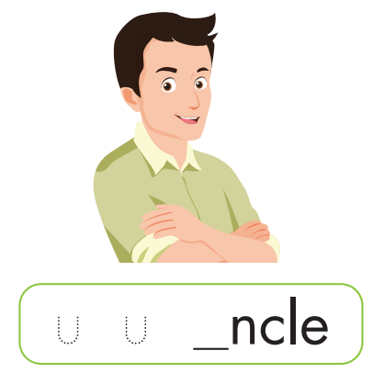
Click the picture to hear the sound.
u
u

Slide 12
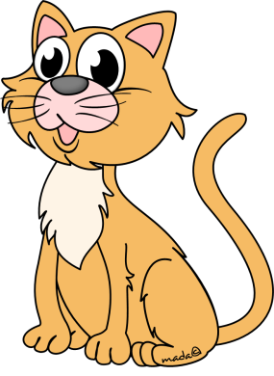
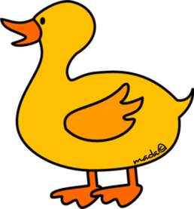
Tt Uu

Slide 13
Tt
Which item starts with ... ?
top

Slide 14
Tt
Which item starts with ... ?
tag
two

Slide 15
Tt
Which item starts with ... ?
tiger

Slide 16
Uu
Which item starts with ... ?
umbrella

Slide 17
Uu
Which item starts with ... ?
uncle

Slide 18
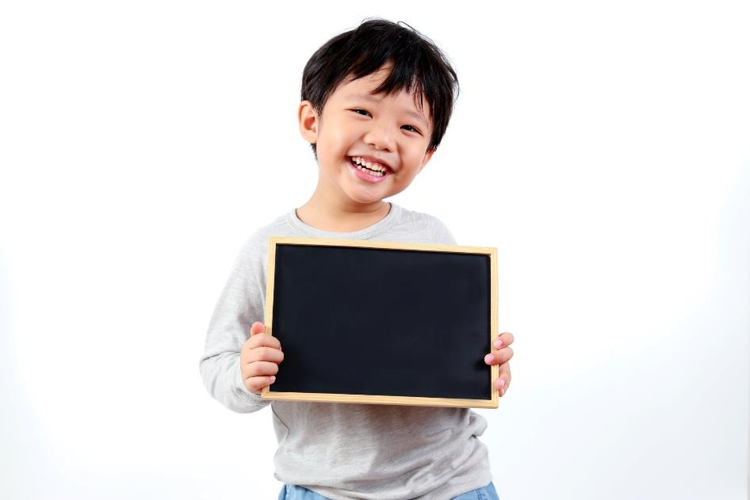
Practice

Slide 19
This is my ,
u, u, .
This is my ,
u, u, u.
Notes:
Click vào hình A. 1. Listen and point. Repeat để cho cả audio full chạy

Slide 21
Further Practice

Slide 23
4
2
3
1

Slide 24
u
u

Slide 25
CONSOLIDATION

