Slide 1
To our class 4A
Teacher: Duong Thi Hoang Anh

Slide 2
Unit 7 Our timetables
Week 11
Friday, November 24th 2023
Lesson 1 - period 1

Slide 3
01
Warm-up

Slide 4
Notes:
https://www.youtube.com/watch?v=JoDm0RC5gk8

Slide 5
02
Look, listen and repeat.

Slide 6
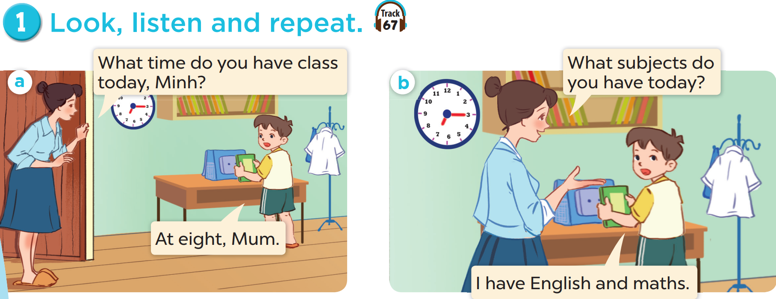

Slide 7
03
Listen, point and say.

Slide 8
vocabulary

Slide 14
What subjects do you have today?
I have Vietnamese.

Slide 15
04
Let’s talk.

Slide 17
05
Fun corner & wrap-up

Slide 18
Answer the questions.
Play
MsPham-0936082789

Slide 19
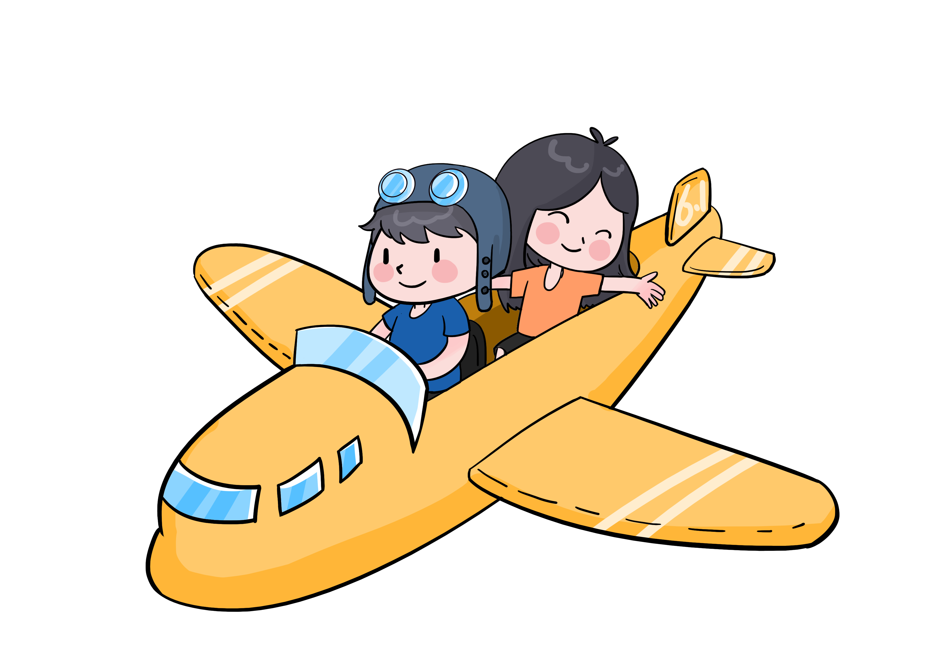
What subjects do you have today?
English (+5)
Check
Next

Slide 20
What subjects do you have today?
Science (+10)
Check
Next

Slide 21
What subjects do you have today?
Vietnamese (+6)
Check
Next

Slide 22
What subjects do you have today?
Maths (+7)
Check
Next

Slide 23
Week 11
Friday, November 24th 2023
Unit 7 Our timetable
LESSON 1 – Activities 1,2,3
* Home link
- Learn the vocabulary and model sentences by heart.
- Be ready for: Unit 7-Lesson1 -Activities4,5,6.

