Slide 2
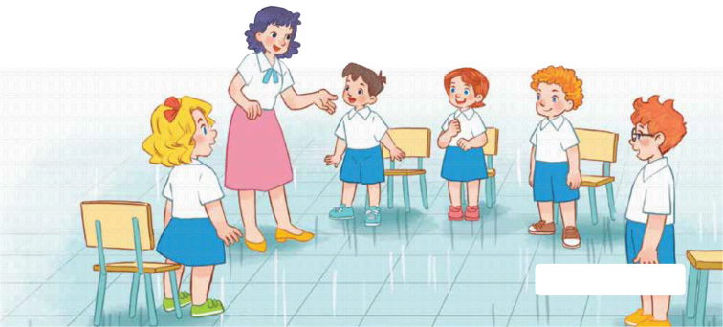
7
Classroom instructions
LESSON 1 – PERIOD 1

Slide 3
CONTENTS
Look, listen and repeat.
Let’s talk.
Listen, point and say.
Fun corner and wrap-up
Warm-up and review

Slide 4
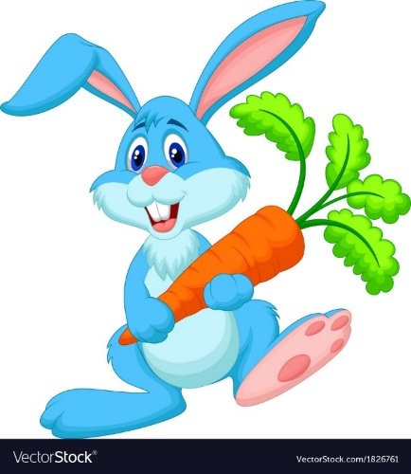
Warm-up and review
Notes:
- Divide the class into 2 teams. Each team chooses one carrot to go to the question.
- Have pupils listen and choose the right answer.
- Back to the menu for another question.
- Pupils take turns to play the game until there are no carrots left.
- The team who gets the most carrots is the winner.

Slide 5
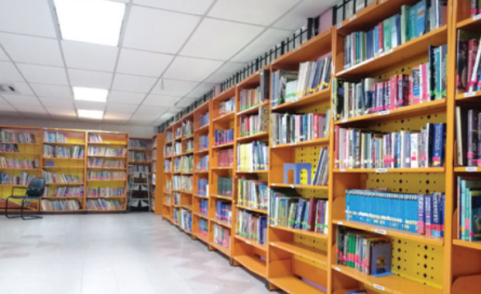
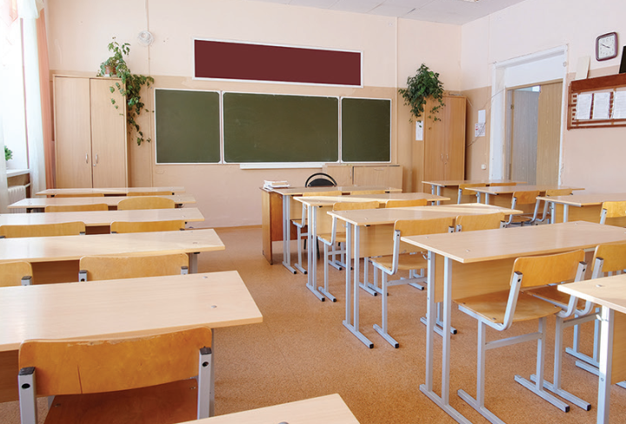
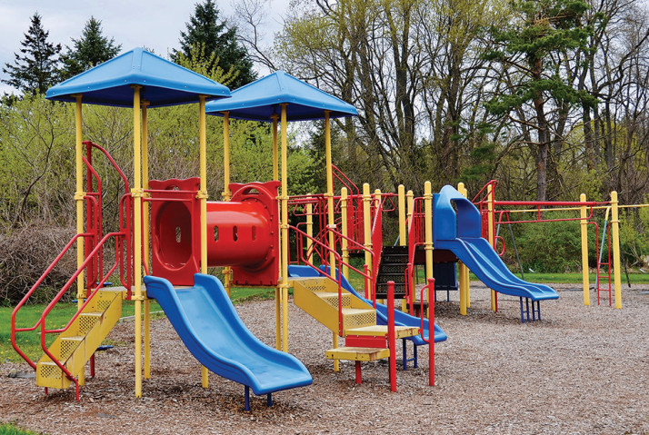
Listen and choose.
library
classroom
playground
Back
Notes:
- Click “Listen and choose” to play the audio.
- Teacher can click each answer to check.
- Click the “Back” button on the bottom right to go back to the game.

Slide 6
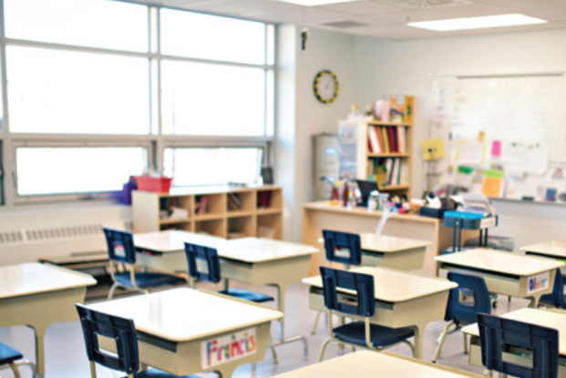
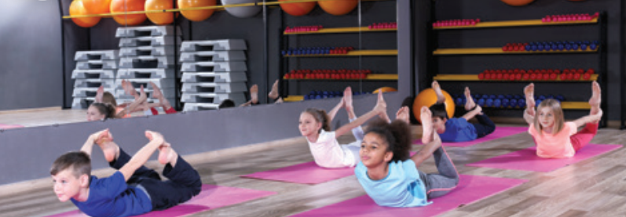
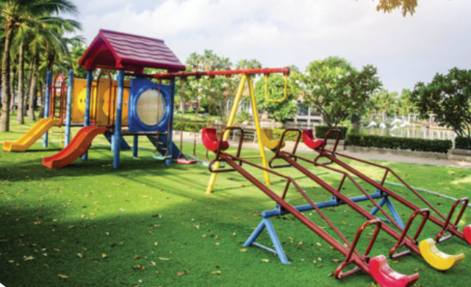
Listen and choose.
classroom
gym
playground
Back
Notes:
- Click “Listen and choose” to play the audio.
- Teacher can click each answer to check.
- Click the “Back” button on the bottom right to go back to the game.

Slide 7
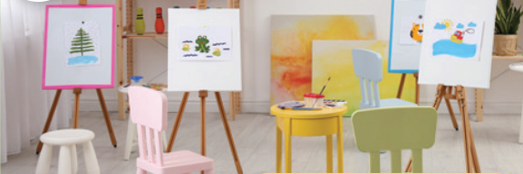
Listen and choose.
Let’s go to the _____.
OK, let’s go.
computer room
gym
art room
Back
Notes:
- Click “Listen and choose” to play the audio.
- Teacher can click each answer to check.
- Click the “Back” button on the bottom right to go back to the game.

Slide 8
Listen and choose.
Let’s go to the _____.
OK, let’s go.
computer room
art room
music room
Back
Notes:
- Click “Listen and choose” to play the audio.
- Teacher can click each answer to check.
- Click the “Back” button on the bottom right to go back to the game.

Slide 9
Listen and choose.
Let’s go to the _____.
OK, let’s go.
music room
gym
art room
Back
Notes:
- Click “Listen and choose” to play the audio.
- Teacher can click each answer to check.
- Click the “Back” button on the bottom right to go back to the game.

Slide 10
Listen and choose.
Let’s go to the _____.
OK, let’s go.
music room
computer room
art room
Back
Notes:
- Click “Listen and choose” to play the audio.
- Teacher can click each answer to check.
- Click the “Back” button on the bottom right to go back to the game.

Slide 11
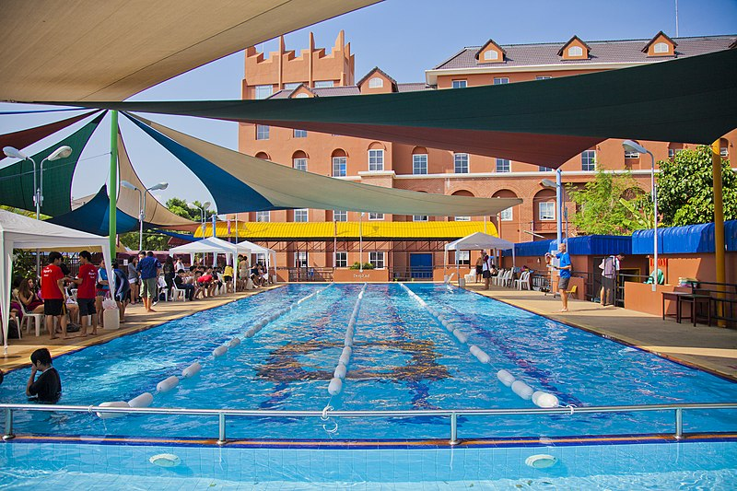
Is this our swimming pool?
Yes, it is./ No, it isn’t.
No, it isn’t.
Yes, it is.
Back
Notes:
- Teacher asks the question then show the picture. - Ask the students if the picture is correct.

Slide 12
Is this our classroom?
Yes, it is./ No, it isn’t.
Yes, it is.
No, it isn’t.
Back
Notes:
- Teacher asks the question then show the picture. - Ask the students if the picture is correct.

Slide 13
Is this our library?
Yes, it is./ No, it isn’t.
No, it isn’t.
Yes, it is.
Back
Notes:
- Teacher asks the question then show the picture. - Ask the students if the picture is correct.

Slide 14
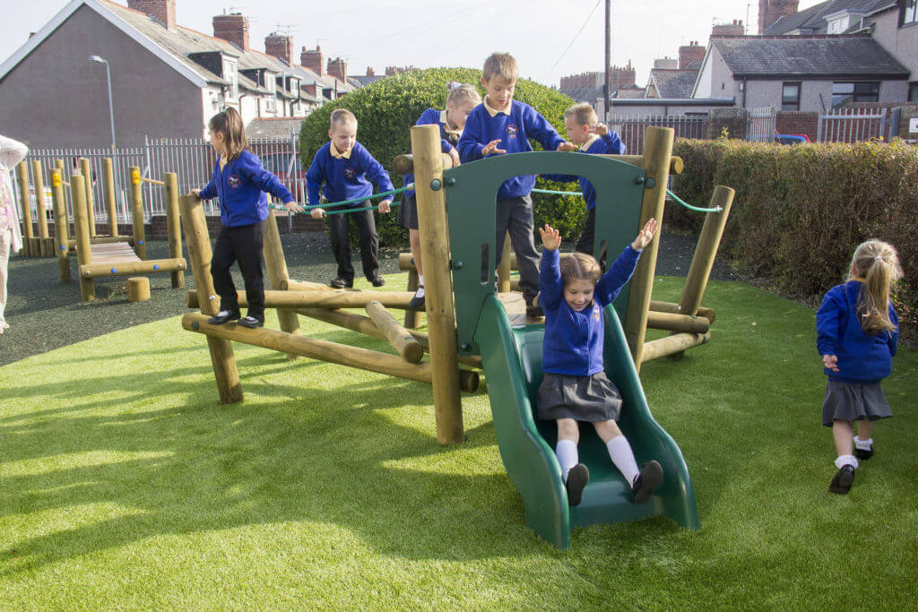
Is this our playground?
Yes, it is./ No, it isn’t.
No, it isn’t.
Yes, it is.
Back
Notes:
- Teacher asks the question then show the picture. - Ask the students if the picture is correct.

Slide 15
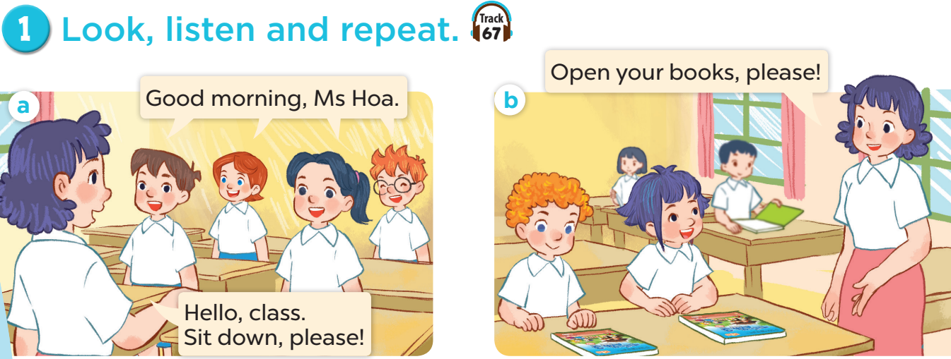

Slide 17
