Slide 1
Unit 4: My body
Lesson 1

Slide 2
Objectives
By the end of this lesson, students will be able to talk about parts of the body, using ….
Vocabulary:
Revise head, leg, arm
Sentence pattern:
Revise Touch your (head).

Slide 3
WARM UP

Slide 4
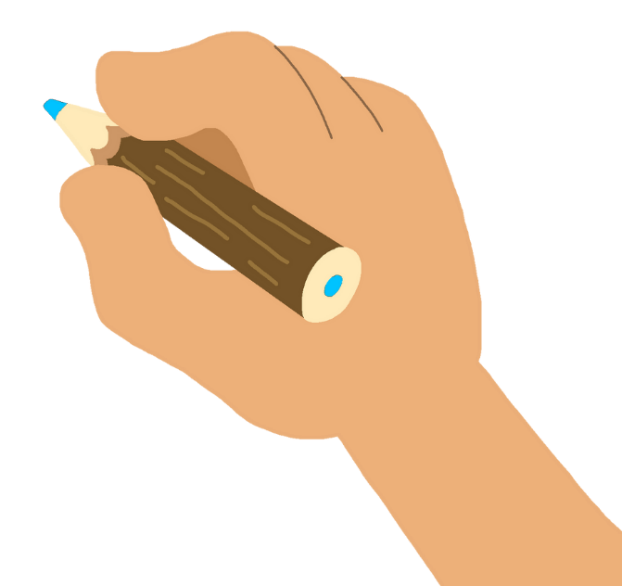
head
arm

Slide 5
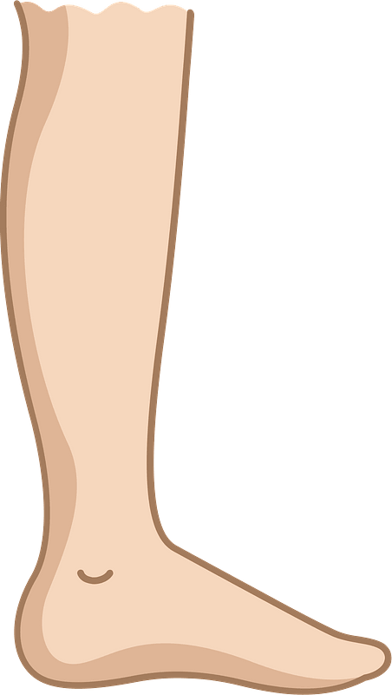
leg
arm

Slide 6
head
arm

Slide 7
It’s time to learn …

Slide 8
Speaking

Slide 9
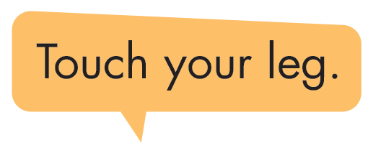
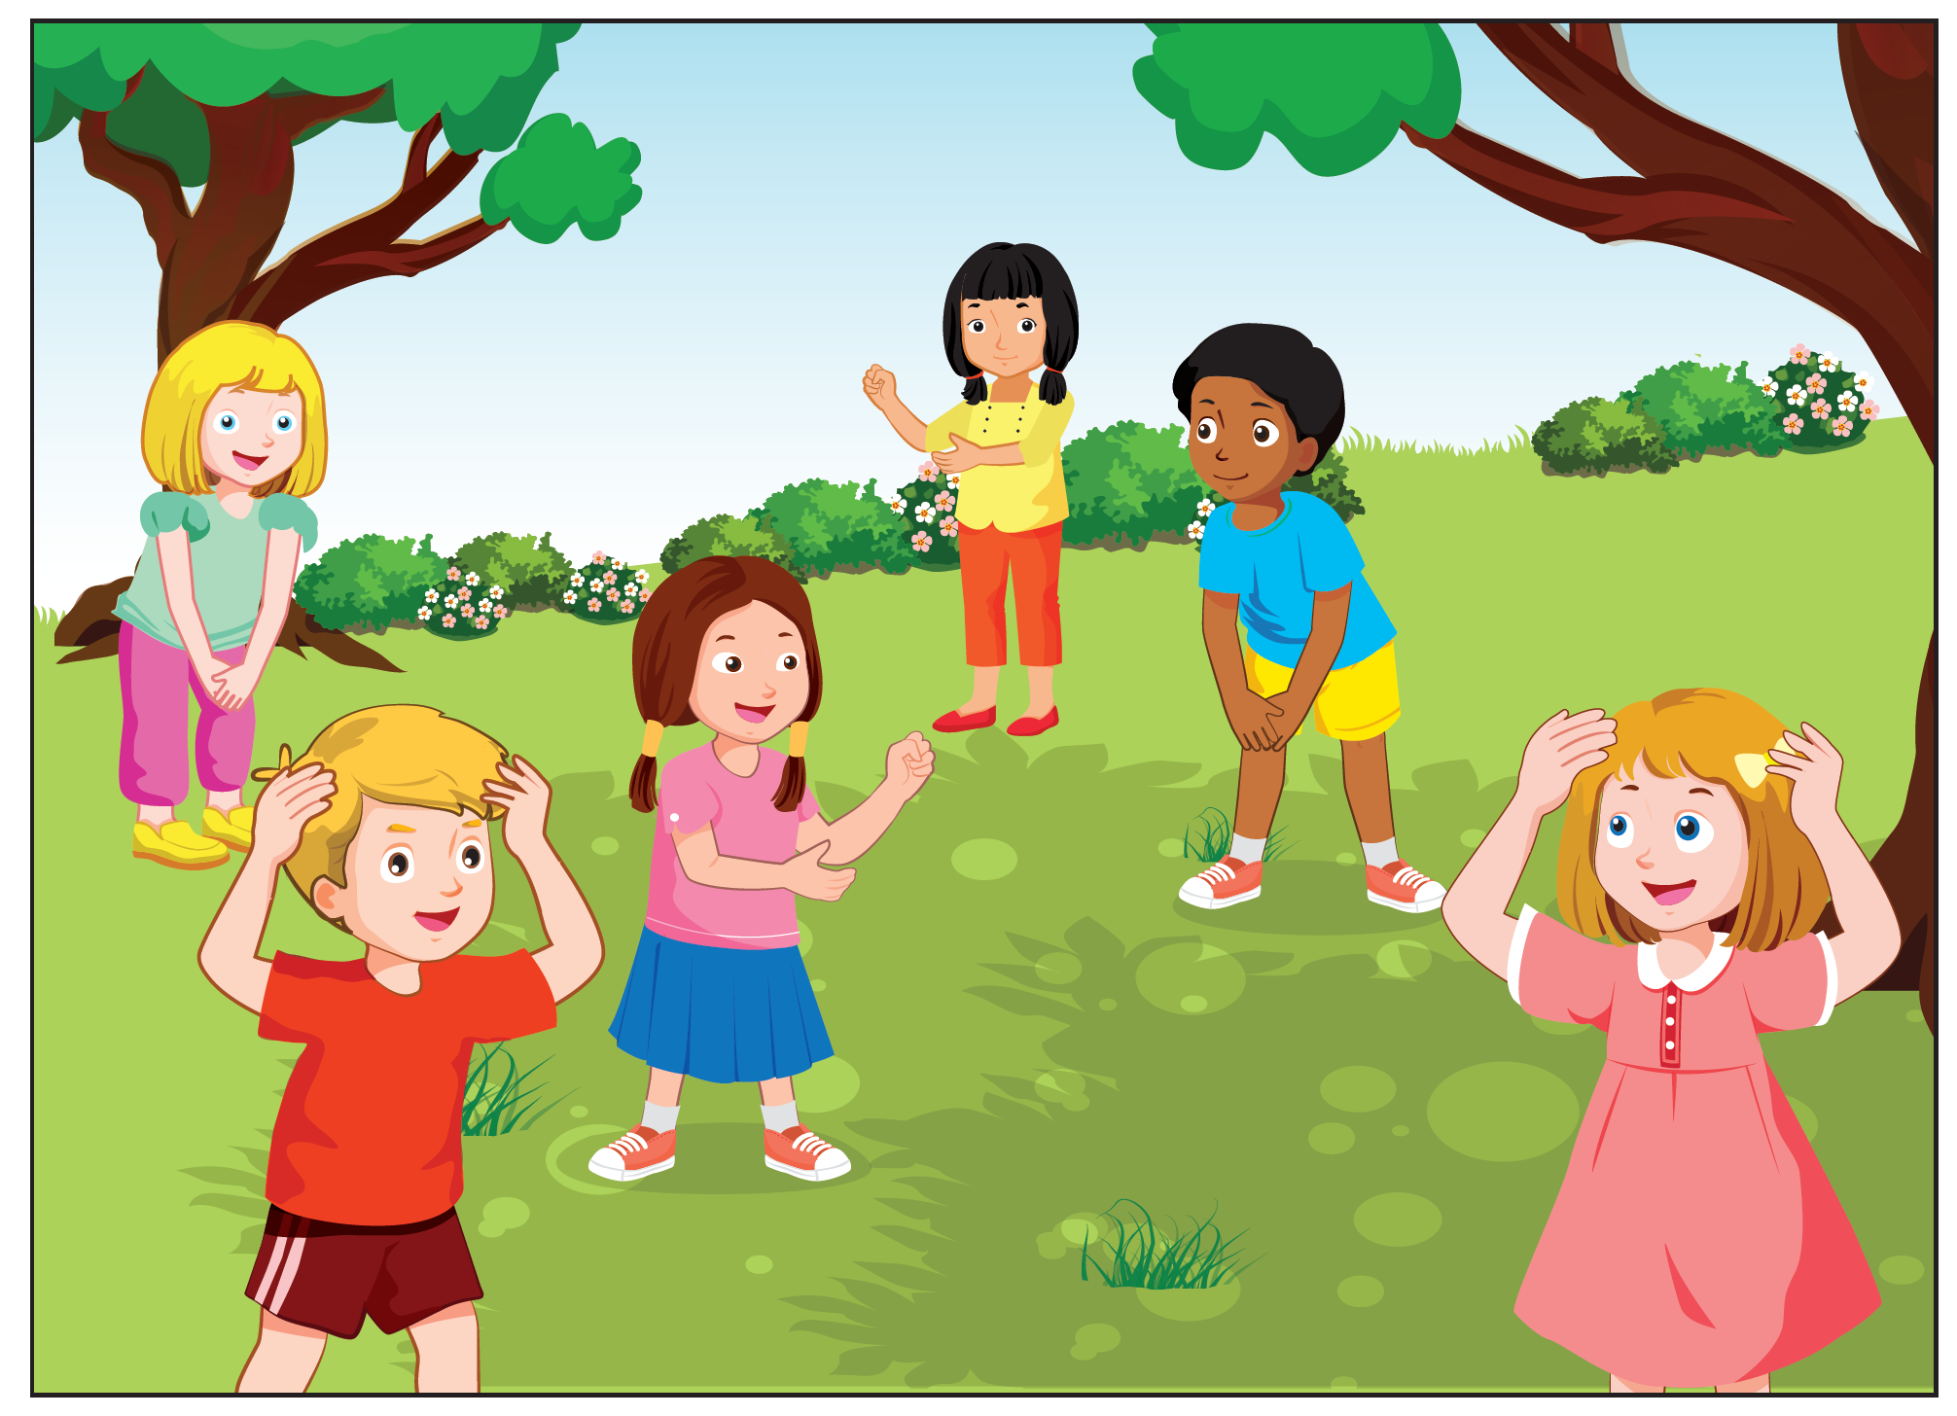
Notes:
Click vào hình A. 1. Listen and point. Repeat để cho cả audio full chạy

Slide 10
Touch your __________
Notes:
Click vào hình A. 1. Listen and point. Repeat để cho cả audio full chạy

Slide 11
Practice

Slide 12
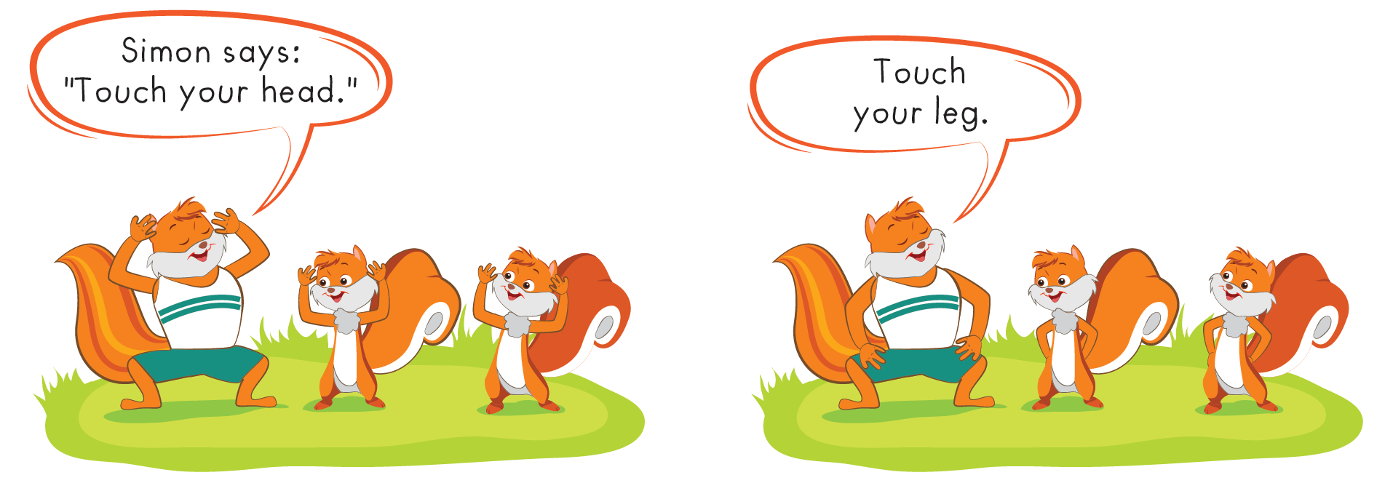
Notes:
B. Listen and point. Repeat. Role-play. (CD1 Track 03)
Have students call out the things they can see in each picture.
Play the audio and have them point to the characters.
Play the audio again and have them repeat the new words.
Divide the class into pairs to role-play the dialogue.
Swap roles and repeat.
Invite some pairs to demonstrate the activity in front of the whole class.
Go around the class and support them if necessary.

Slide 13
It’s time to play …

Slide 14
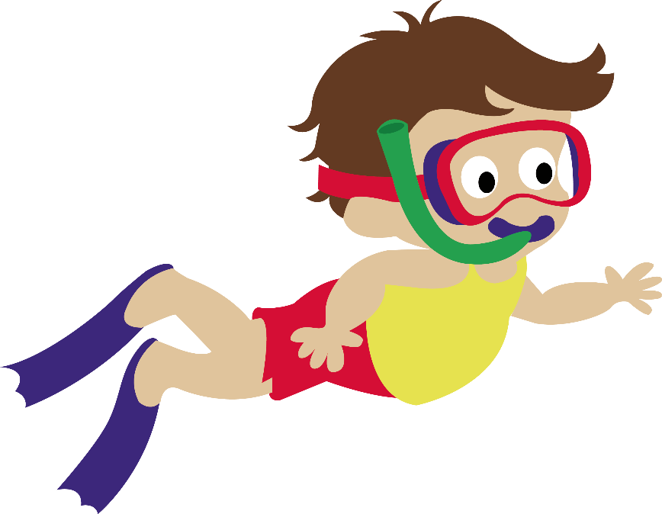
Save Peter Game
???

Slide 15
head
leg
arm

Slide 16
head
arm
leg

Slide 17
leg
arm
head

Slide 18
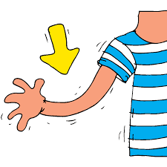
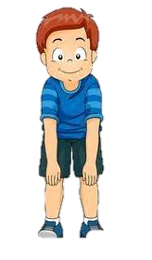
Touch your leg.

Slide 19
Touch your arm.

Slide 20
Touch your leg.

Slide 21
Touch your head.

Slide 22
Further Practice

Slide 23
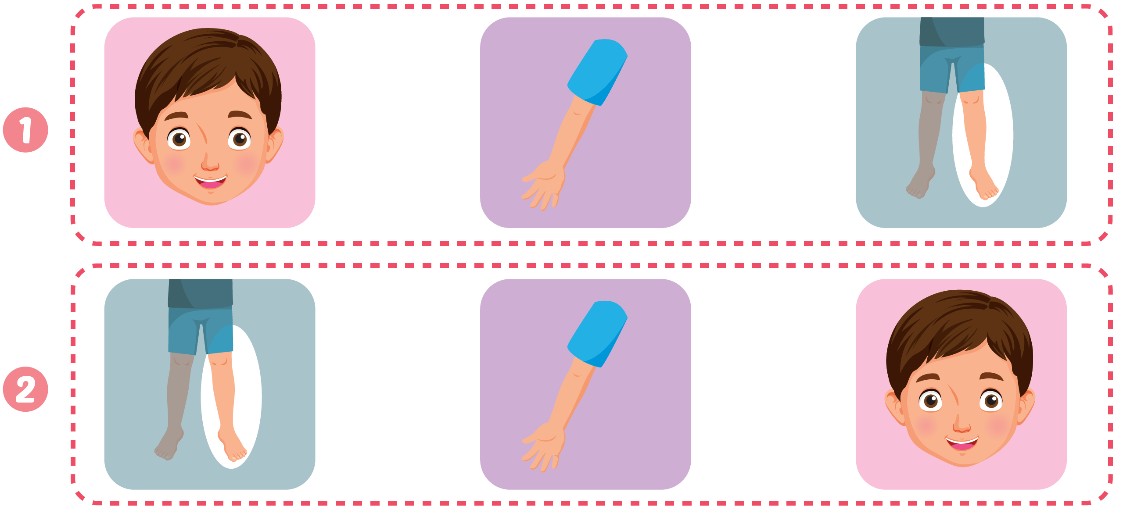

Slide 24
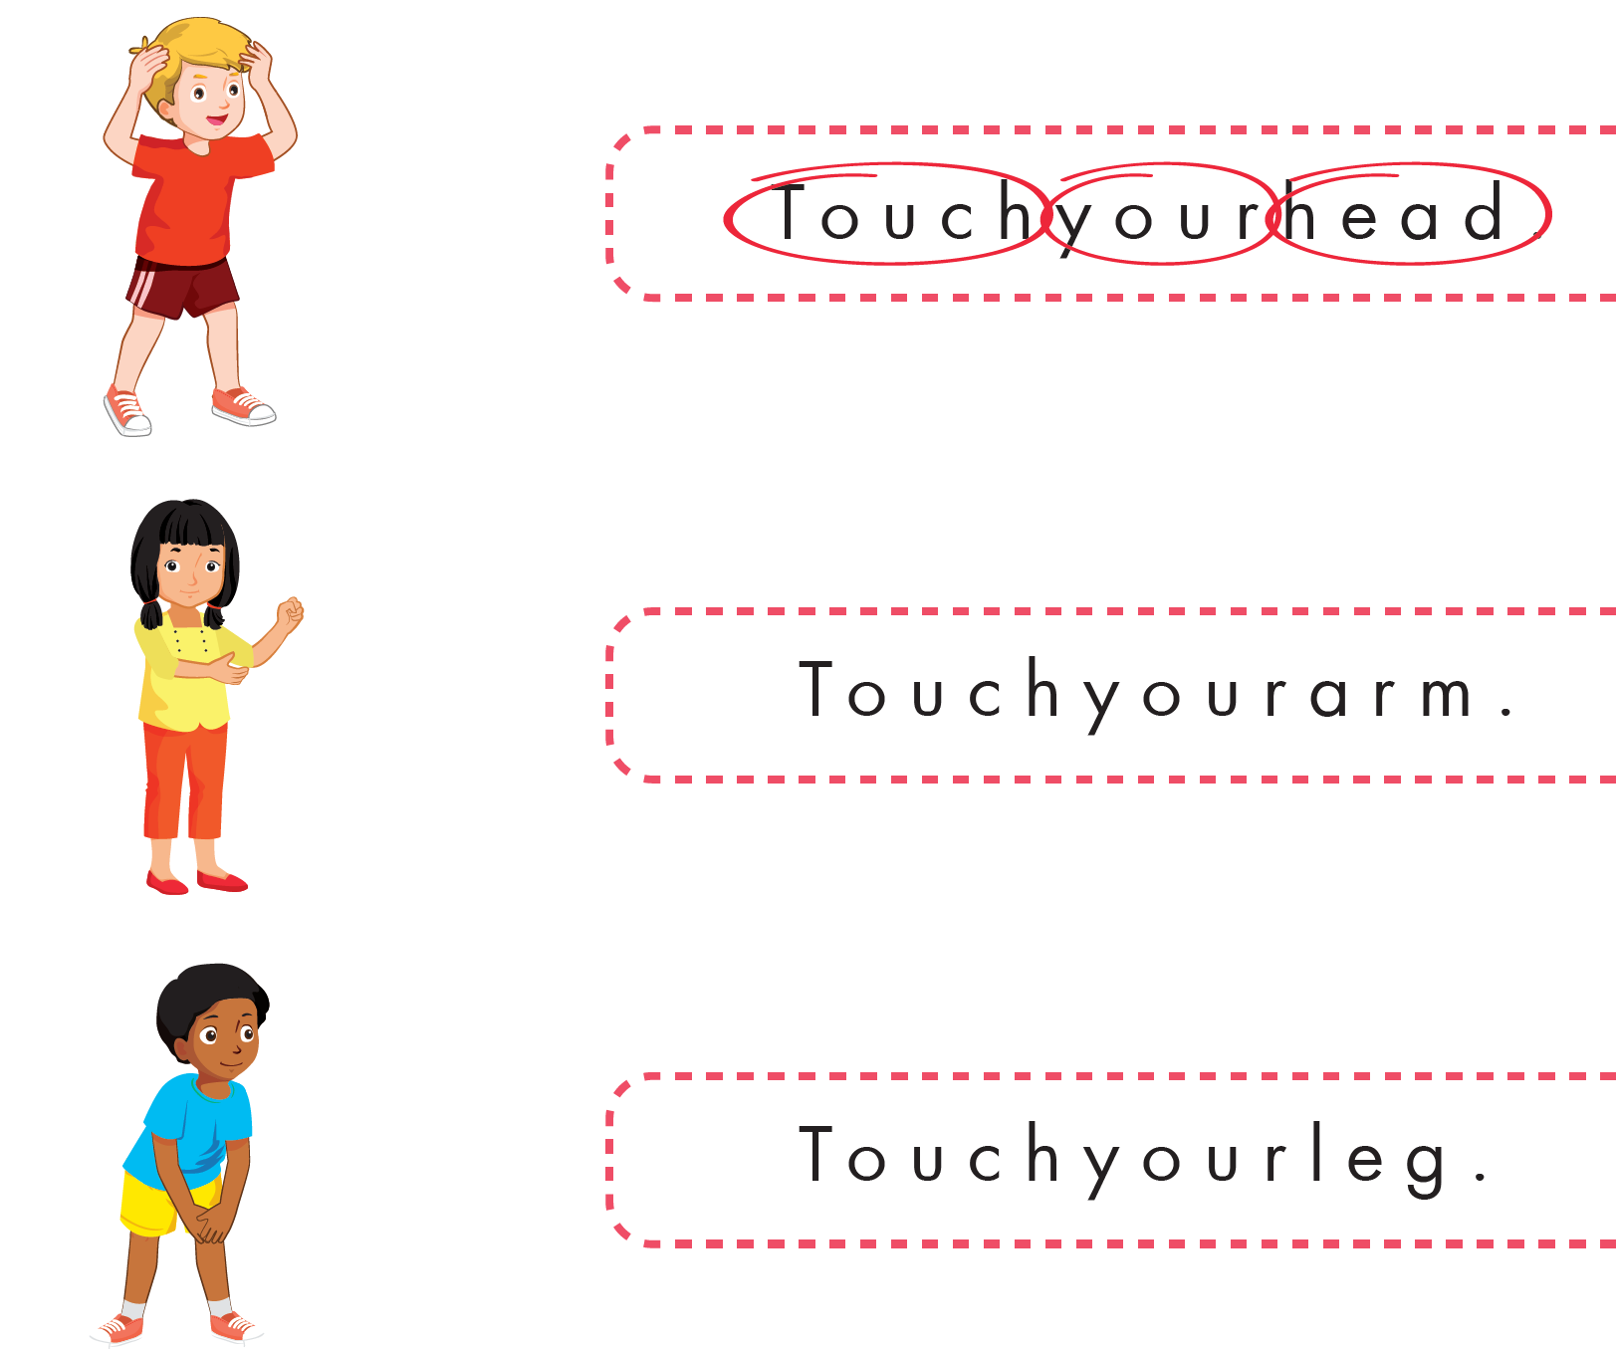

Slide 25
CONSOLIDATION

Slide 26
WRAP-UP

Slide 27
Today’s lesson
Structures/ Sentence patterns
Touch your (head).
Vocabulary
head, leg, arm

