Slide 1
Objectives
By the end of this lesson, students will be able to say what color it is, using …..
Vocabulary:
blue, yellow, red
Sentence pattern:
It's red.

Slide 2
WARM UP

Slide 3
Where is ?
1
2
3

Slide 4
Where is ?
1
2
3

Slide 5
Where is ?
1
2
3

Slide 6
Where is ?
1
2
3

Slide 7
Where is ?
1
2
3

Slide 8
Where is ?
1
2
3

Slide 9
It’s time to learn …

Slide 10
Speaking

Slide 11
Notes:
Click vào hình A. 1. Listen and point. Repeat để cho cả audio full chạy

Slide 12
It's red.
It's yellow.
It's red.
It's yellow.
It's red.
Notes:
Click vào hình A. 1. Listen and point. Repeat để cho cả audio full chạy

Slide 13
It's yellow.
It's yellow.
It's blue.
It's yellow.
It's yellow.
Notes:
Click vào hình A. 1. Listen and point. Repeat để cho cả audio full chạy

Slide 14
It's red.
It's red.
It's yellow.
It's red.
It's red.
Notes:
Click vào hình A. 1. Listen and point. Repeat để cho cả audio full chạy

Slide 15
Practice

Slide 16
Notes:
B. Listen and point. Repeat. Role-play. (CD1 Track 03)
Have students call out the things they can see in each picture.
Play the audio and have them point to the characters.
Play the audio again and have them repeat the new words.
Divide the class into pairs to role-play the dialogue.
Swap roles and repeat.
Invite some pairs to demonstrate the activity in front of the whole class.
Go around the class and support them if necessary.

Slide 17
Further Practice

Slide 18
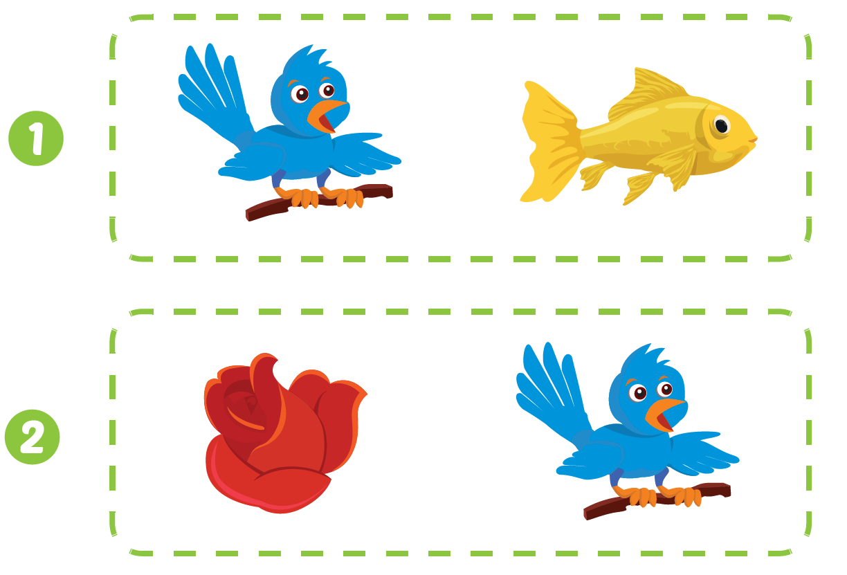

Slide 19
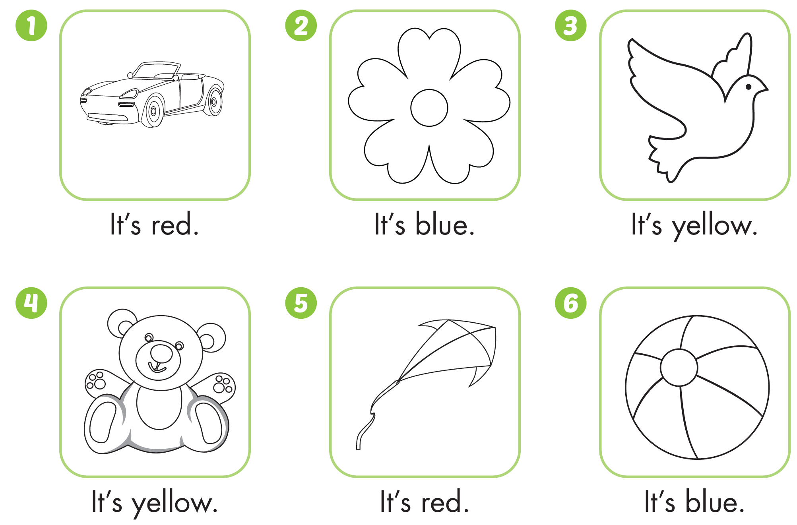

Slide 20
It’s time to play …

Slide 21
Listen and match
It’s blue
It’s red
It’s yellow

Slide 22
Look and write
r e d
b l u e

Slide 23
y e l l o w

Slide 24
CONSOLIDATION

Slide 25
WRAP-UP

Slide 26
Today’s lesson
Structures/ Sentence patterns
It's red.
Vocabulary
blue, yellow, red

Slide 27
Homework
Review the vocabularies & structures and make sentences using them.
Practice the vocabulary and structure in Tiếng Anh 1 i-Learn Smart Start Notebook (page 15)
Do the exercises in Tiếng Anh 1 i-Learn Smart Start Workbook (page 19)
Play the consolidation games in Tiếng Anh 1 i-Learn Smart Start DHA App on www.eduhome.com.vn
Prepare the next lesson (page 22)

