Slide 1
Unit 3 : Numbers
Lesson 1

Slide 2
Objectives
By the end of this lesson, students will be able to ask and answer about number of objects, using ….
Vocabulary: eleven, twelve, thirteen, fourteen, fifteen
Structure: How many (circles) are there?
(Twelve) (circles).

Slide 3
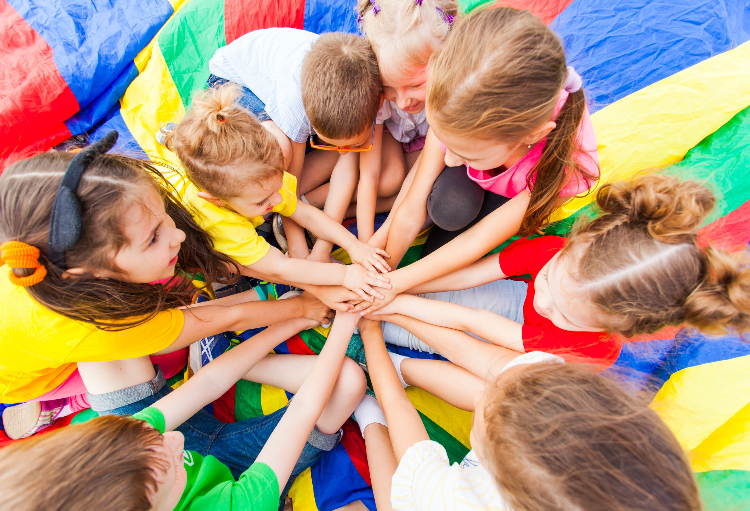
WARM UP

Slide 4
Let’s play!
Telephone game
Notes:
Divide the class into 4 teams
Have each team stand in a line.
Teacher shows a number to the first student of each line. Then says: "Start!"
Students whisper it to the person next to them.
The last students hear the word, will say what they think they heard out-loud.

Slide 5
It’s time to learn …

Slide 6
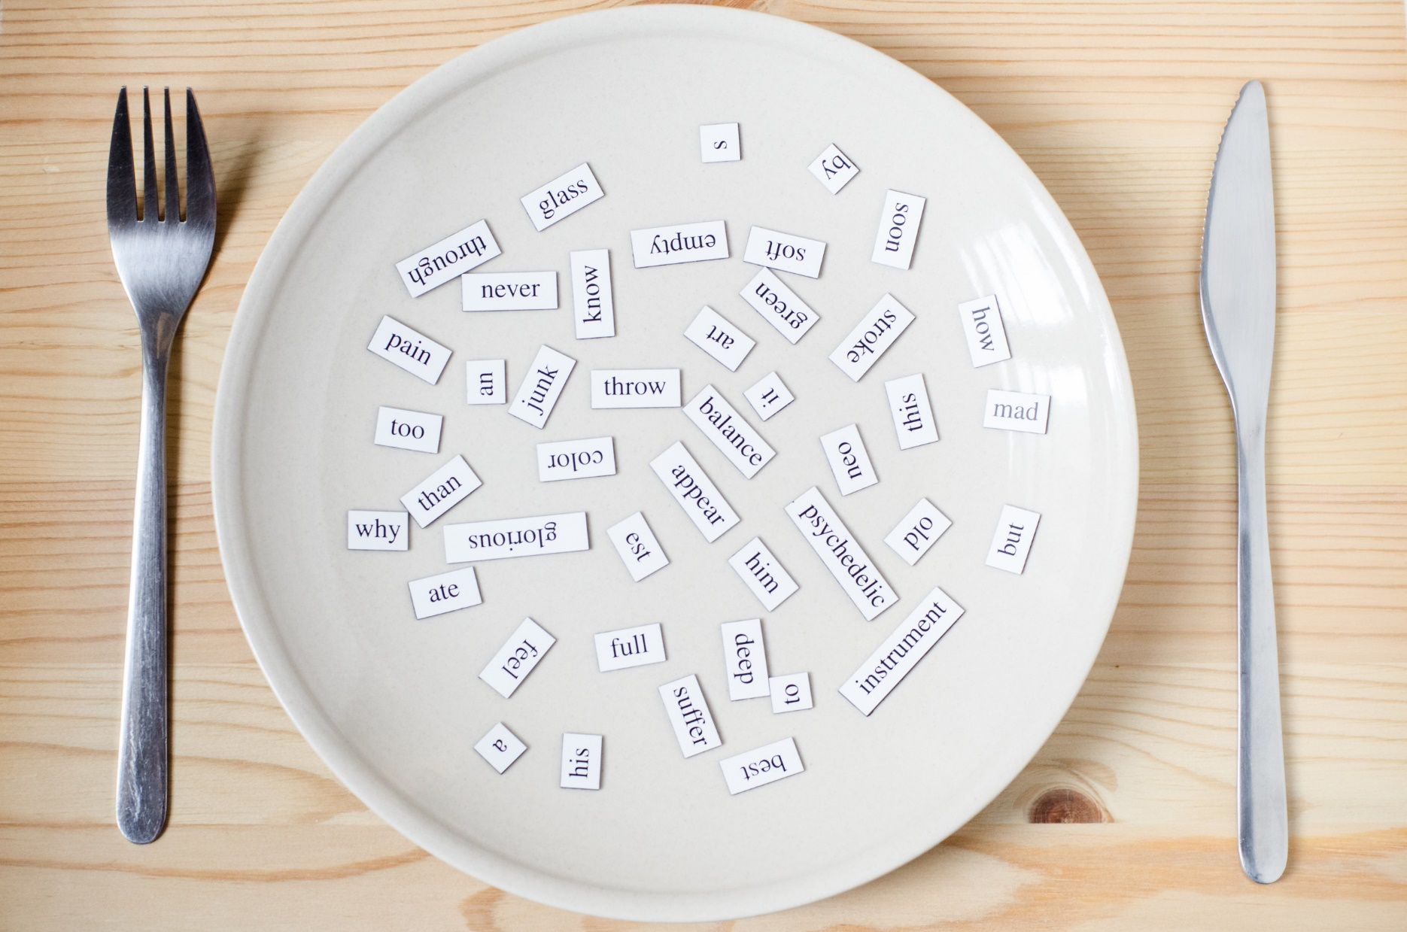
New words
eleven,
twelve,
thirteen,
fourteen,
fifteen

Slide 7
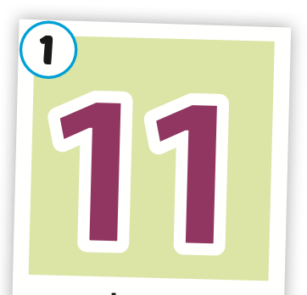
Click on the picture to hear the sound.
eleven
/ɪˈlevn/
số mười một

Slide 8
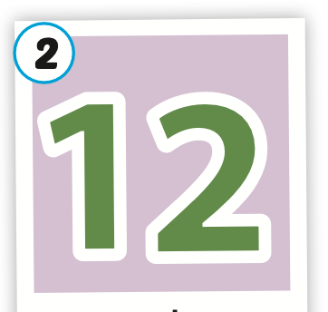
Click on the picture to hear the sound.
twelve
/twelv/
số mười hai

Slide 9
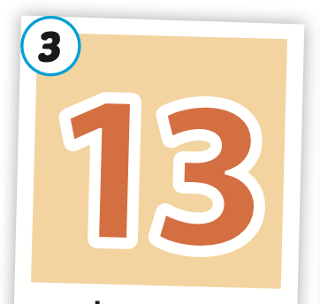
Click on the picture to hear the sound.
thirteen
/ˌθɜːrˈtiːn/
số mười ba

Slide 10
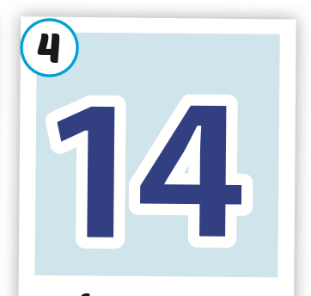
Click on the picture to hear the sound.
fourteen
/ˌfɔːrˈtiːn/
số mười bốn

Slide 11
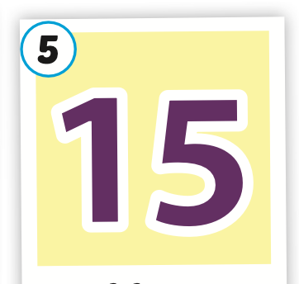
Click on the picture to hear the sound.
fifteen
/ˌfɪfˈtiːn/
số mười lăm

Slide 12
Click on the icon to hear the sound.

Slide 13
Structures
How many (circles) are there?
(Twelve) (circles).

Slide 14
Presentation

Slide 15
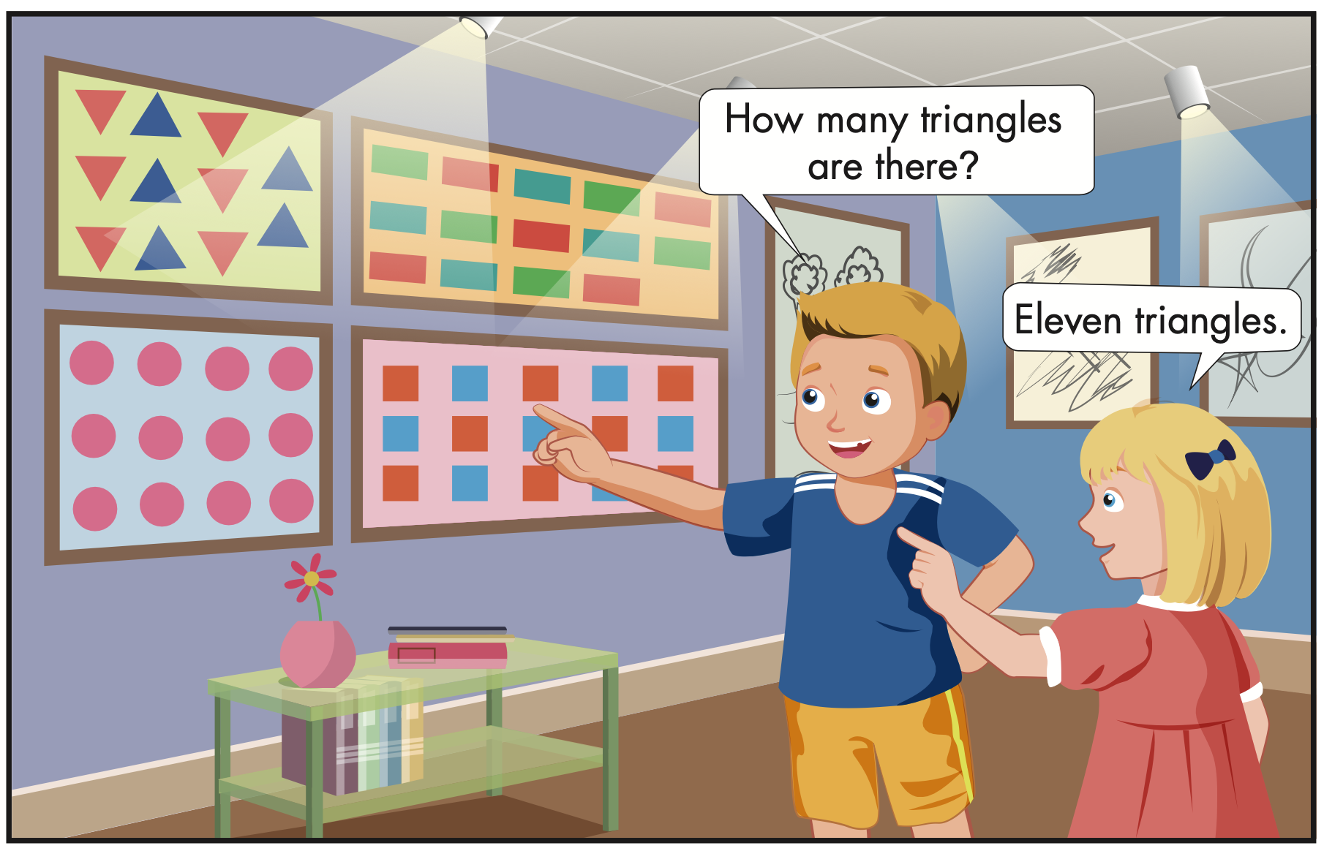
Click on the icon to hear the sound.

