Slide 1
To our class 4B
Teacher: Duong Thi Hoang Anh

Slide 2
Week 10
Friday, November 10th 2023
Warm up: Guessing game

Slide 3
mountains

Slide 4
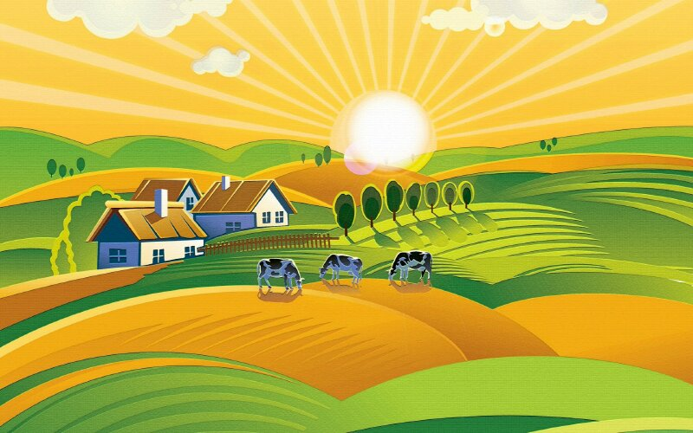
village

Slide 5
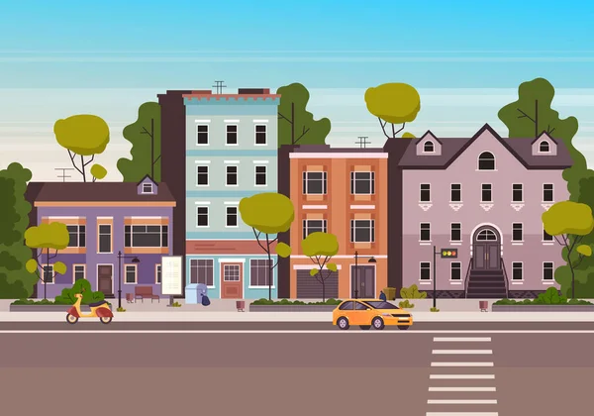
town

Slide 6
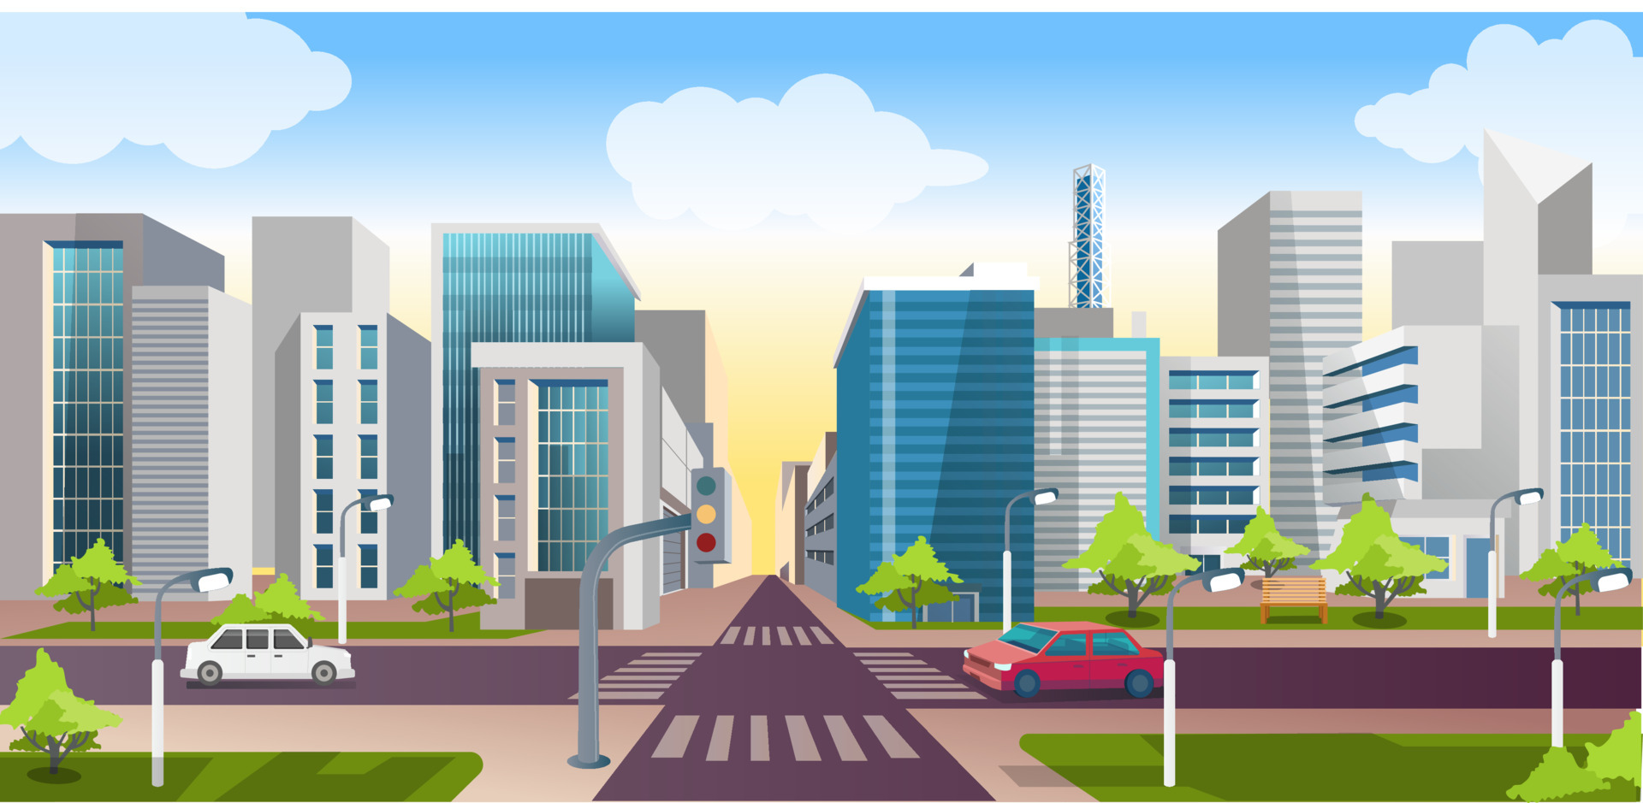
city

Slide 7
Week 10
Friday, November 10th 2023
Unit 6 Our school facilities
LESSON 3 – Activities 1,2,3

Slide 8
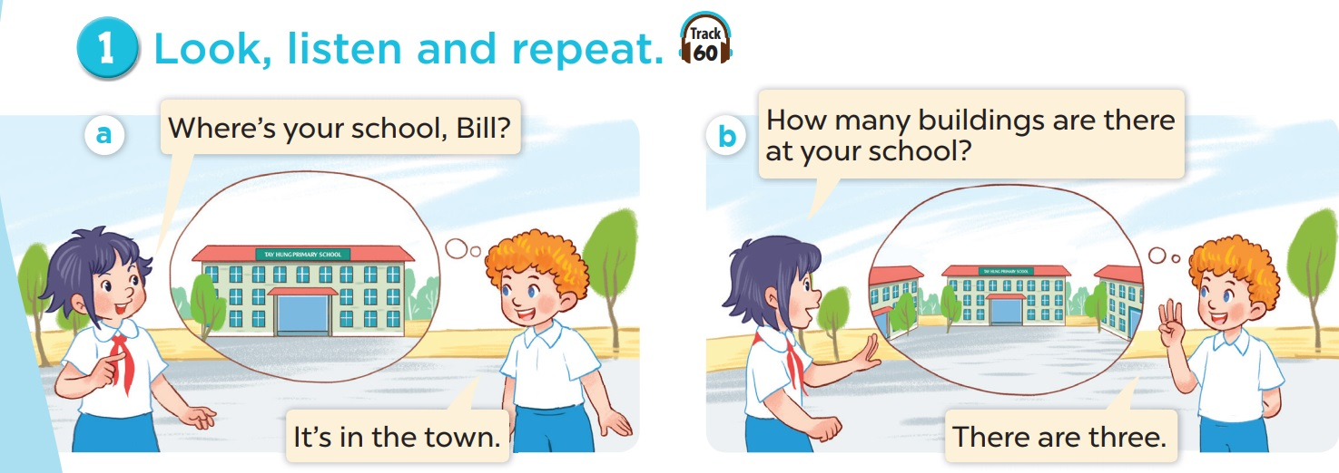
Week 10
Friday, November 10th 2023
Unit 6 Our school facilities
LESSON 3 – Activities 1,2,3

Slide 9
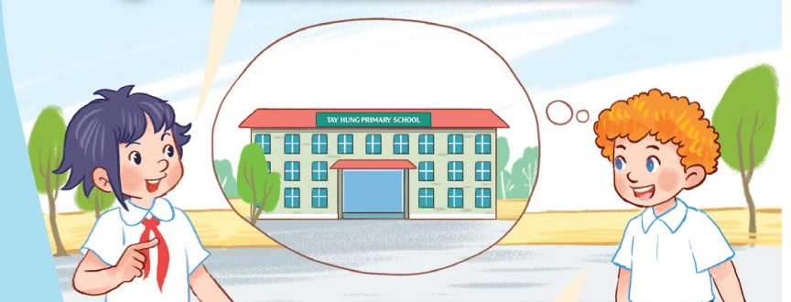
Where’s Bill’s school?
It’s in the town.

Slide 10
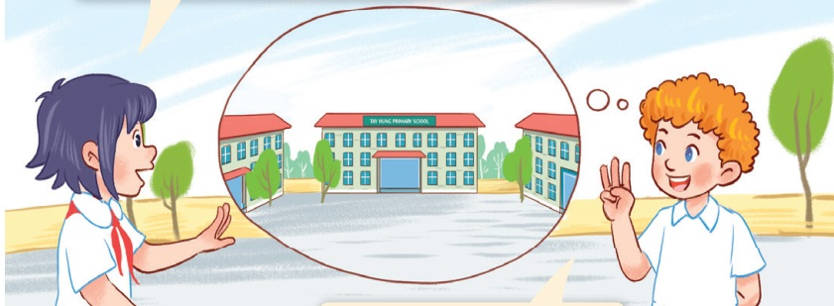
How many buildings are there
at Bill’s school?
There are three.

Slide 11
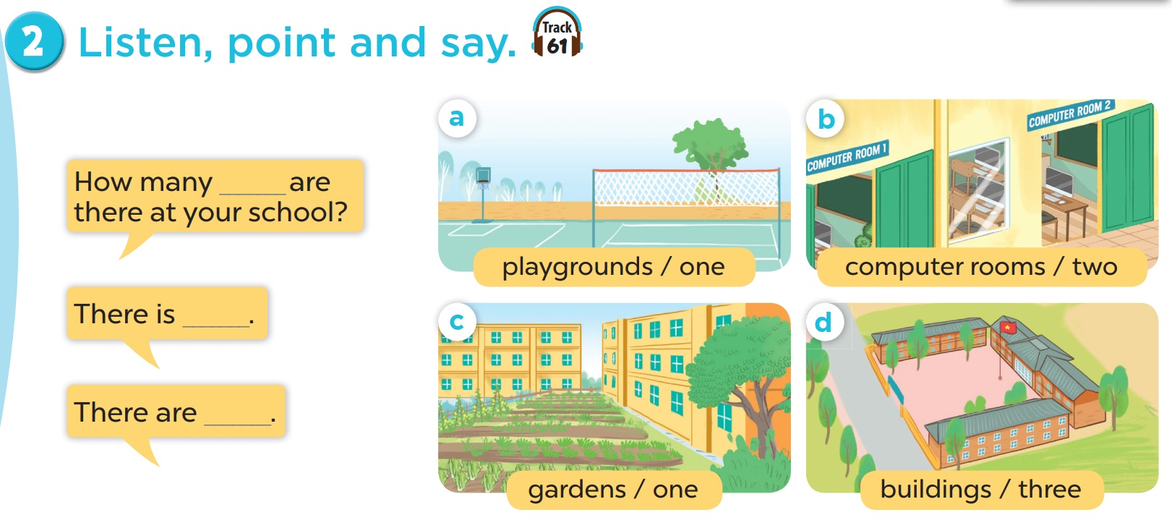
Week 10
Friday, November 10th 2023
Unit 6 Our school facilities
LESSON 3 – Activities 1,2,3

Slide 12
Game

Slide 13
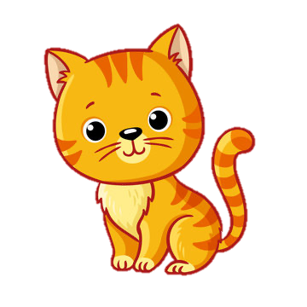
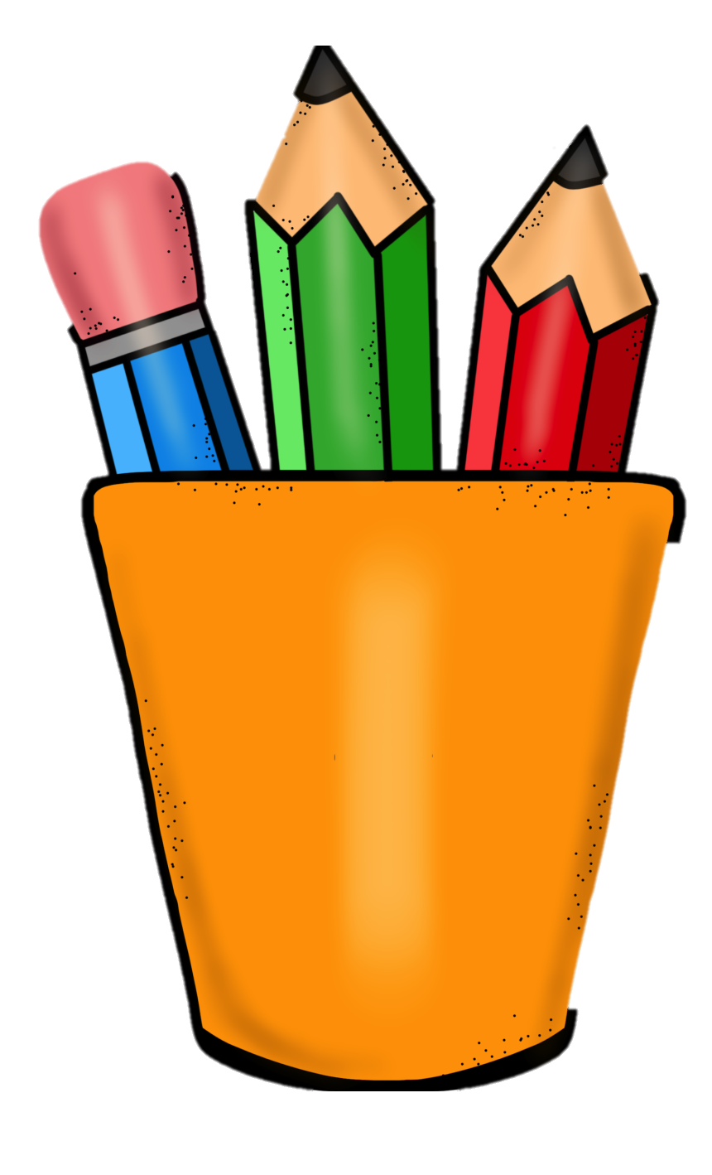
How many?
three
five
two
one

Slide 14
How many cats are there?
There is one.

Slide 15
How many books are there?
There are five.

Slide 16
How many apples are there?
There are two.

Slide 17
How many pencils are there?
There are three.

Slide 18
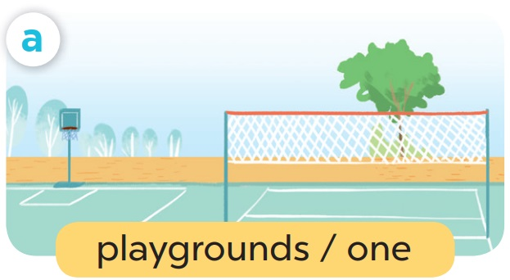
Week 10
Friday, November 10th 2023
Unit 6 Our school facilities
LESSON 3 – Activities 1,2,3
How many playgrounds are there at your school?
There is one.

Slide 19
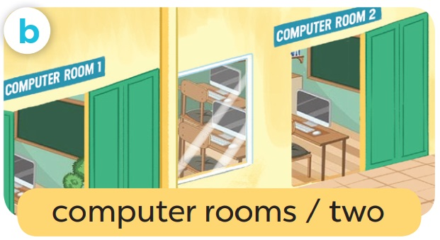
Week 10
Friday, November 10th 2023
Unit 6 Our school facilities
LESSON 3 – Activities 1,2,3
How many computer rooms are there at your school?
There are two.

Slide 20
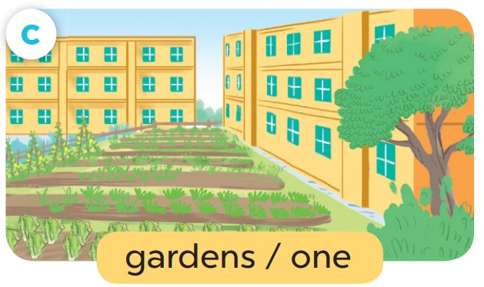
Week 10
Friday, November 10th 2023
Unit 6 Our school facilities
LESSON 3 – Activities 1,2,3
How many gardens are there at your school?
There is one.

Slide 21
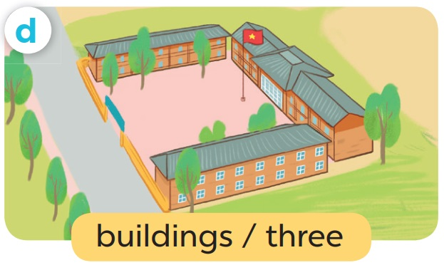
Week 10
Friday, November 10th 2023
Unit 6 Our school facilities
LESSON 3 – Activities 1,2,3
How many buildings are there at your school?
There are three.

Slide 22
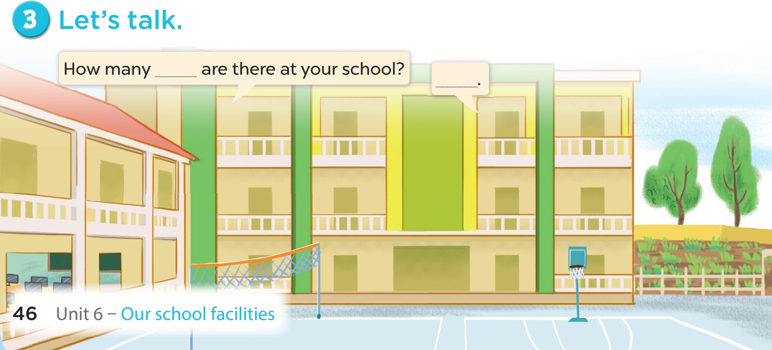
Week 10
Friday, November 10th 2023
Unit 6 Our school facilities
LESSON 3 – Activities 1,2,3

Slide 23
05
Game

Slide 24
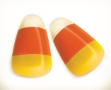
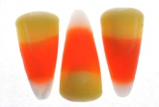
1
2
3
4
5
9
10
6
7
8
End Game

Slide 25
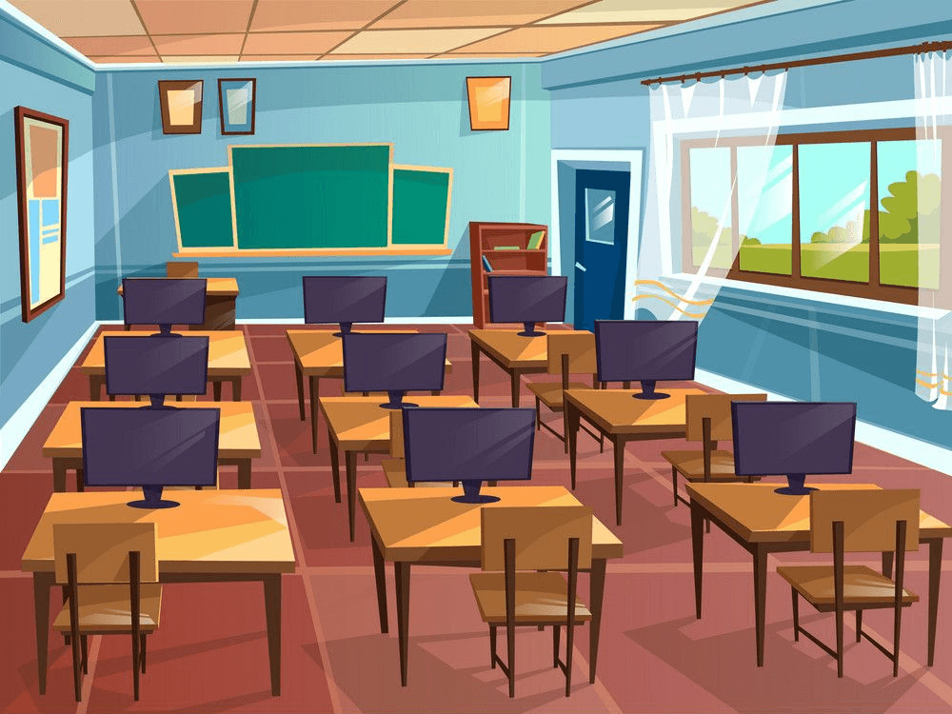
How many computers are there?
There are nine.

Slide 26
_____ three buildings at my school.
There are

Slide 27
There are three ____ in my school.
buildings

Slide 28
What is this?
It’s a computer room.

Slide 29
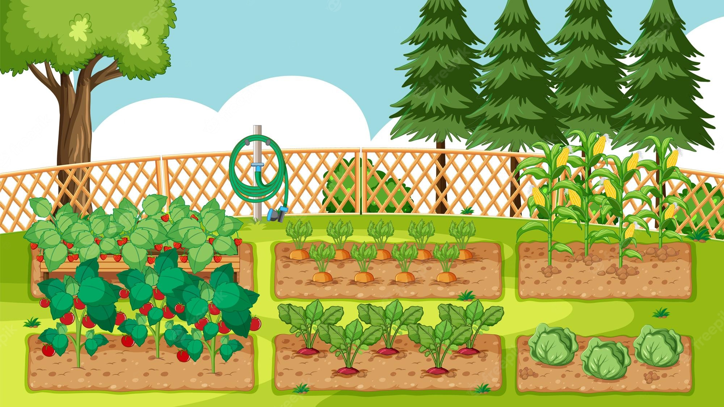
What is this?
It’s a garden.

Slide 30
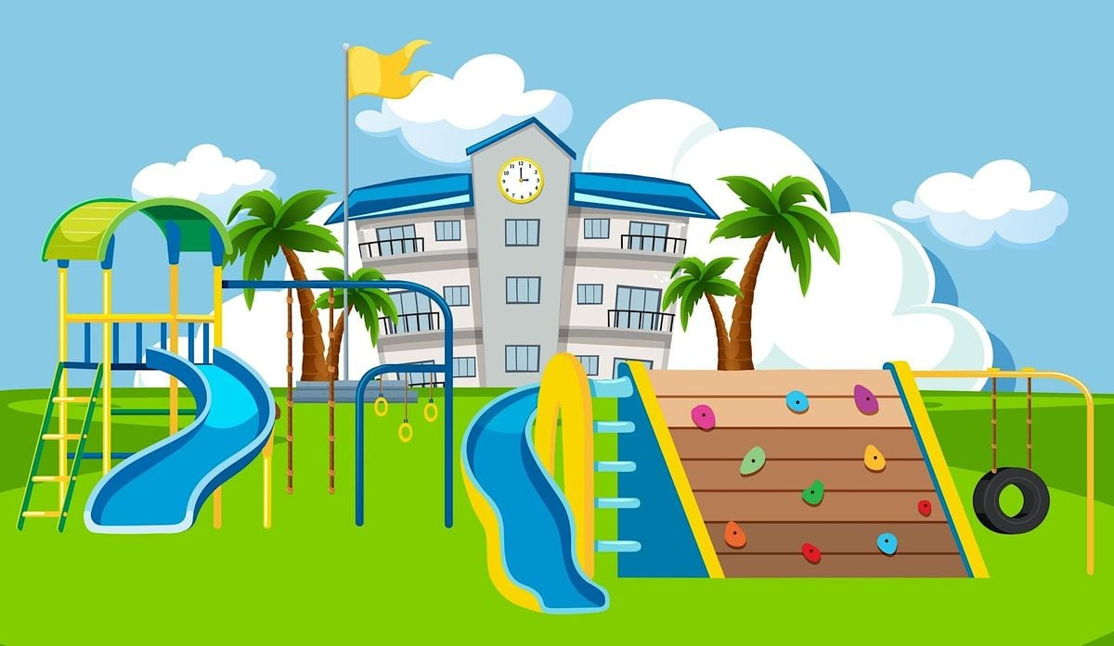
What is this?
It’s a playground.

Slide 31
What are they?
They’re buildings.

Slide 32
____ one playground at my school.
There is

Slide 33
____ gardens are there at your school?
- There is one.
How many

Slide 34
___ one computer room at my school.
There is

