Slide 1
To our class 4C
Teacher: Duong Thi Hoang Anh

Slide 2
Week 6
Monday, October 9th 2023
Warm up: Review

Slide 3
What day is it today?
It’s Monday.

Slide 4
What day is it today?
Tuesday
Wednesday
Monday
Friday
Thursday
Saturday
Sunday
Notes:
quick Q-A

Slide 5
WHAT DO YOU DO ON MONDAYS?
I STUDY AT SCHOOL.

Slide 6
Let’s sing together!

Slide 7
Week 6
Monday, October 9th 2023
Unit 3 My week
LESSON 3 – Activities 1,2,3

Slide 8
Week 6
Monday, October 9th 2023
Unit 3 My week
LESSON 3 – Activities 1,2,3

Slide 9
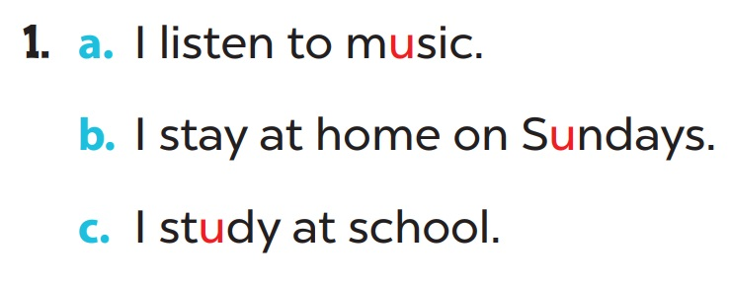
Week 6
Monday, October 9th 2023
Unit 3 My week
LESSON 3 – Activities 1,2,3

Slide 10
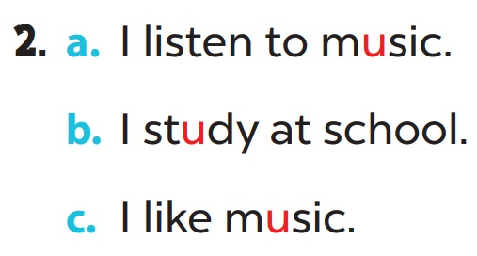
Week 6
Monday, October 9th 2023
Unit 3 My week
LESSON 3 – Activities 1,2,3

Slide 11
Week 6
Monday, October 9th 2023
Unit 3 My week
LESSON 3 – Activities 1,2,3

Slide 12
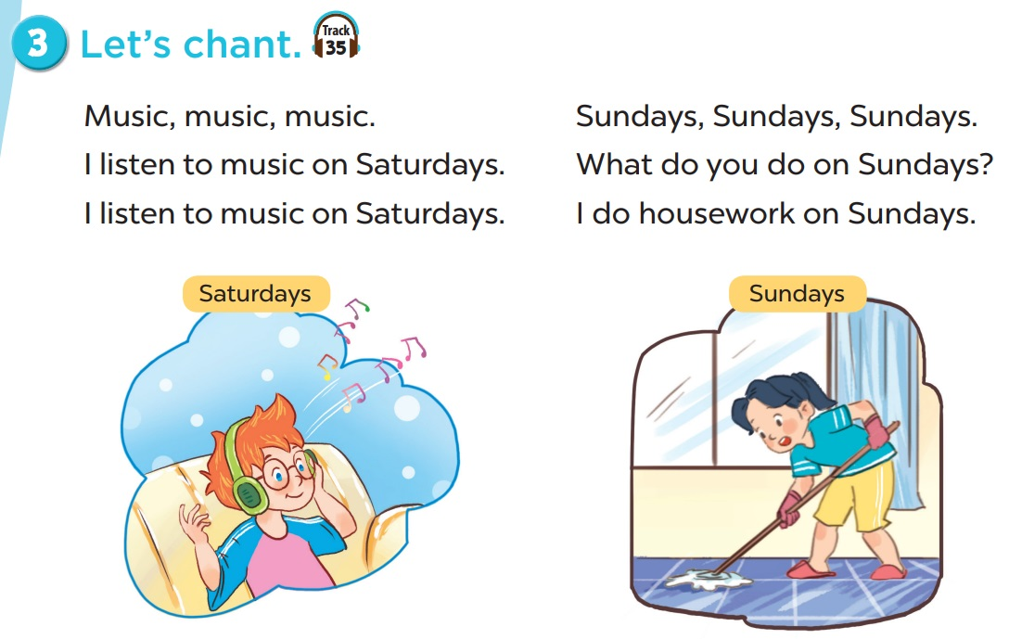
Week 6
Monday, October 9th 2023
Unit 3 My week
LESSON 3 – Activities 1,2,3

Slide 13
Fun corner & wrap-up
Week 6
Monday, October 9th 2023
Unit 3 My week
LESSON 3 – Activities 1,2,3

Slide 14
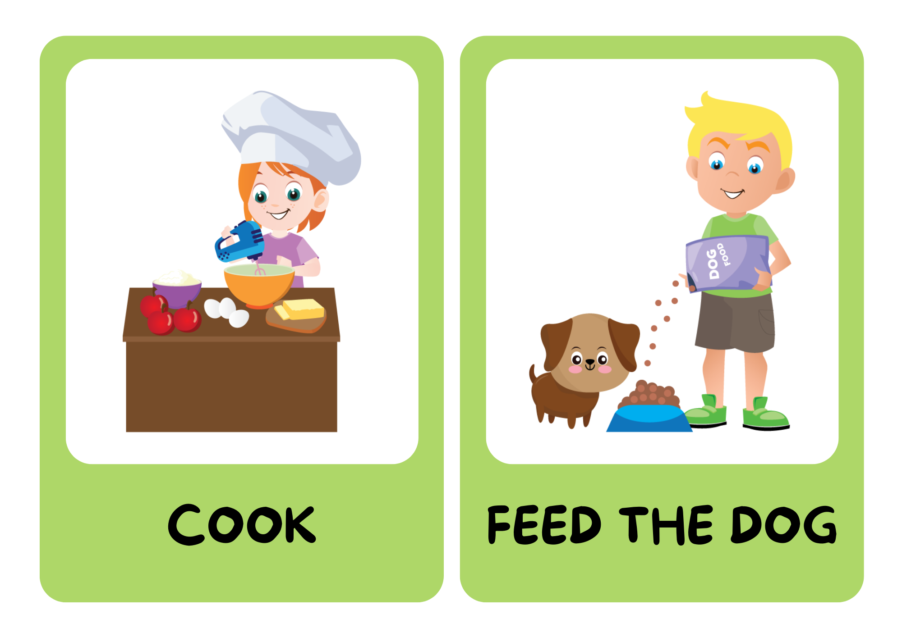
Be a chant composer!

Slide 15
BE A CHANT COMPOSER!
Music, music, music. I listen to music on Thursdays.
Notes:
look at the pictures
say out loud
combine pictures to make a new chant

Slide 16
Fridays, Fridays, Fridays. What do you do on Fridays? I do housework on Fridays.

Slide 17
Mondays, Mondays, Mondays. What do you do on Mondays? I do homework on Mondays.

Slide 18
THANK
YOU

