Slide 1
1
Hello
LESSON 1
Period 1

Slide 2
Contents
1
Look, listen and repeat.
2
Warm-up
3
4
Practice
Let’s talk.
5
Fun corner and wrap-up

Slide 3
1
Warm-up
Game
Notes:
Review Numbers 1-10 and Alphabet

Slide 4
Notes:
Review numbers 1-10 by picking numbers
Step 1: Say the numbers for pupils to choose.
Step 2: Give points to pupils with the correct choosing.

Slide 9
Game: Look and say the missing letters.
Notes:
Step 1: Ask pupils to say the missing letters, then check with the class.
Step 2: Give points to the pupils and encourage them.

Slide 10
a
b
c
d
e
f

Slide 11
m
n
o
p
q
r

Slide 12
s
t
u
w
x
v

Slide 13
2
Look, listen and repeat.

Slide 15
3
Listen, point and say.

Slide 16
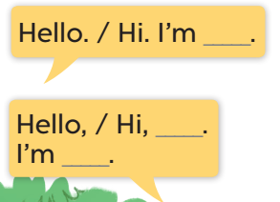

Slide 17
Hello.
I’m Mai.
I’m Minh.
Pair work
Hi, Mai.

Slide 18
4
Let’s talk.

Slide 20
Game time!
Say “Hello”!!!
Notes:
Divide the class into 2 groups: boys and girls. Ask each pupil from one group tp come and practise greeting, self-introducing and responding to greetings with one pupil from the other group. Give points to the groups, praise the pupils.

Slide 22
5
Fun corner and wrap-up
Notes:
Step 1: Ask pupils to look at the pictures and say the sentences.
Step 2: Ask some pupils to say the names or the sentences of the characters.
Step 3: Wrap up the lesson.

Slide 23
Can you say this?
Notes:
Divide the class into groups of four. Ask pupils of each group to come to the board and practise saying the conversation of the characters. Give point to the groups.

