Slide 1
To our class 4B
Teacher: Duong Thi Hoang Anh

Slide 2
Week 1
Thursday, September 7th 2023
Warm up: Game
Who is faster?

Slide 3
Week 1
Thursday, September 7th 2023
Starter C. OUTDOOR ACTIVITIES
1-2-3

Slide 4
sing

Slide 5
skip

Slide 6
swim

Slide 7
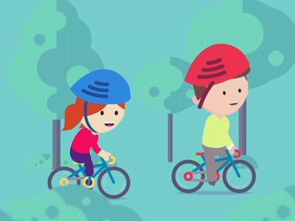
cycle

Slide 8
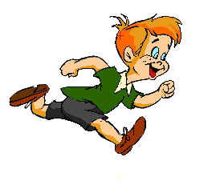
run

Slide 9
skate

Slide 10
Week 1
Thursday, September 7th 2021
Starter C. OUTDOOR ACTIVITIES
Activity 1 Let’s play.

Slide 11
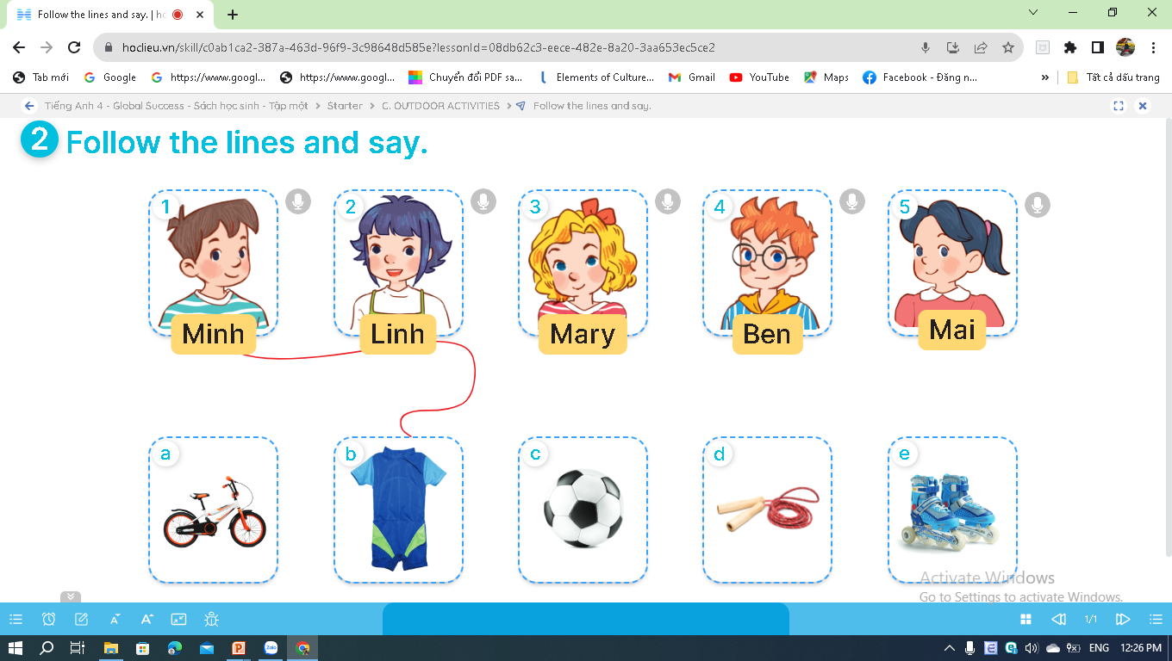
Week 1
Thursday, September 7th 2021
Starter C. OUTDOOR ACTIVITIES
Activity 2 Follow the lines and say.

Slide 12
Who are they?
Minh
Linh
Mary
Ben
Mai

Slide 13
What are they?
a bike
a swimsuit
a football
a skipping
rope
a pair of
skates

Slide 14
Week 1
Thursday, September 7th 2021
Starter C. OUTDOOR ACTIVITIES
Activity 2 Follow the lines and say.

Slide 15
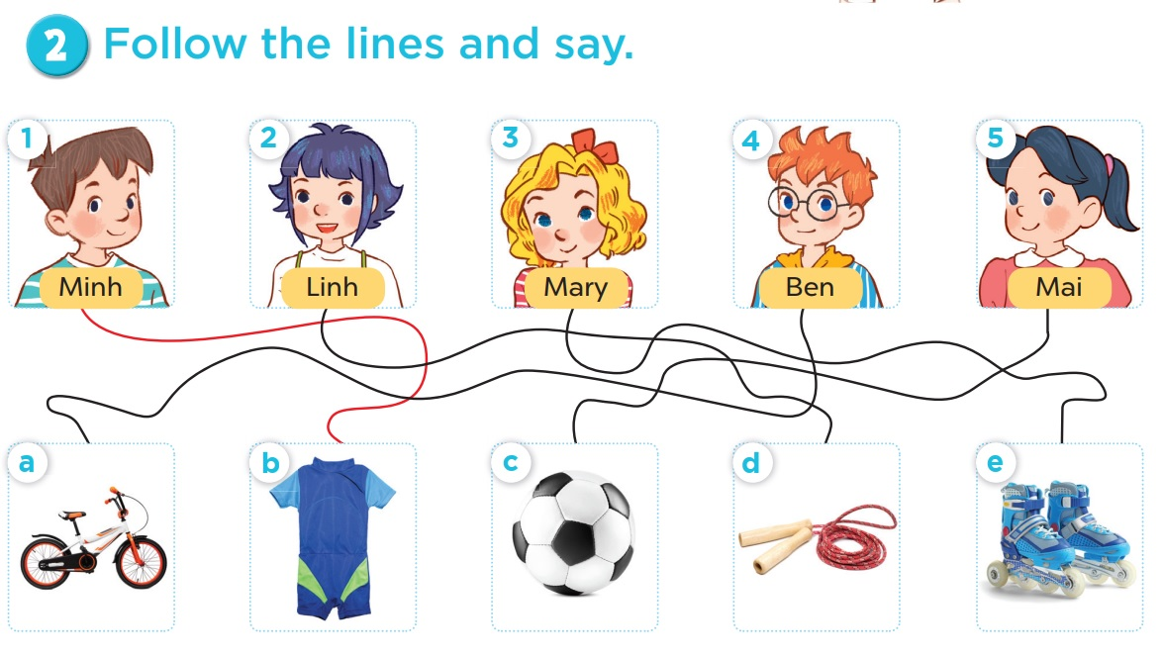
Follow the lines and say.
Look at Minh. His hobby is swimming.

Slide 16
Follow the lines and say.
Look at Linh. Her hobby is skipping.

Slide 17
Follow the lines and say.
Look at Mary. Her hobby is roller skating.

Slide 18
Follow the lines and say.
Look at Ben. His hobby is cycling.

Slide 19
Follow the lines and say.
Look at Mai. Her hobby is playing football.

Slide 20
Week 1
Thursday, September 7th 2021
Starter C. OUTDOOR ACTIVITIES
Activity 3 Read and act out.

Slide 21
1
3
Fun time
2
4
5
6
7
8
- 5
+20
+3
+5
shoot 2
REFERENCES

Slide 22
Look, read and choose.
A. We aren’t playing football.
B. We are playing football.
C. We are playing tennis.

Slide 23
A
B
C
3
5
Notes:
DICE ROLL GAME

Slide 24
Look, read and choose.
A. They aren’t swimming.
B. They are swimming.
C. They are running.

Slide 25
A
B
C
2
7
Notes:
DICE ROLL GAME

Slide 26
Look, read and choose.
A. They are reading.
B. They are riding a horse.
C. They are drawing.

Slide 27
A
B
C
5
2
Notes:
DICE ROLL GAME

Slide 28
Look, read and choose.
A. He is flying a kite.
B. He isn’t flying a kite.
C. He is skating.

Slide 29
A
B
C
4
Notes:
DONE

Slide 30
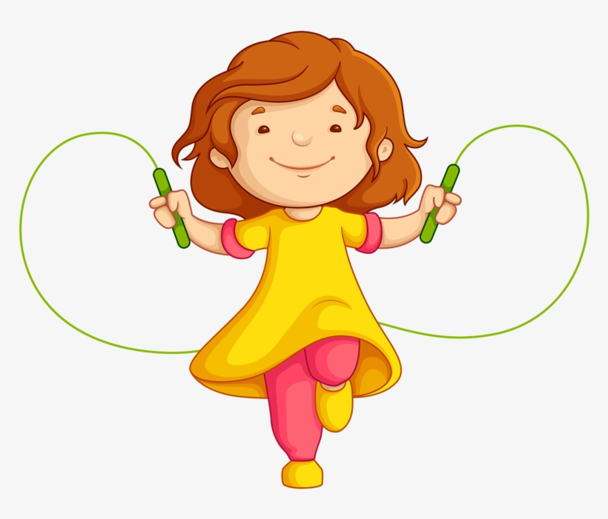
Look, read and choose.
A. Her hobby is running.
B. Her hobby is riding a bike.
C. Her hobby is skipping.

Slide 31
A
B
C
3
5
Notes:
DICE ROLL GAME

Slide 32
Look, read and choose.
A. Her hobby is cycling.
B. Her hobby is swimming.
C. Her hobby is watching TV.

Slide 33
A
B
C
10
Notes:
DONE

Slide 34
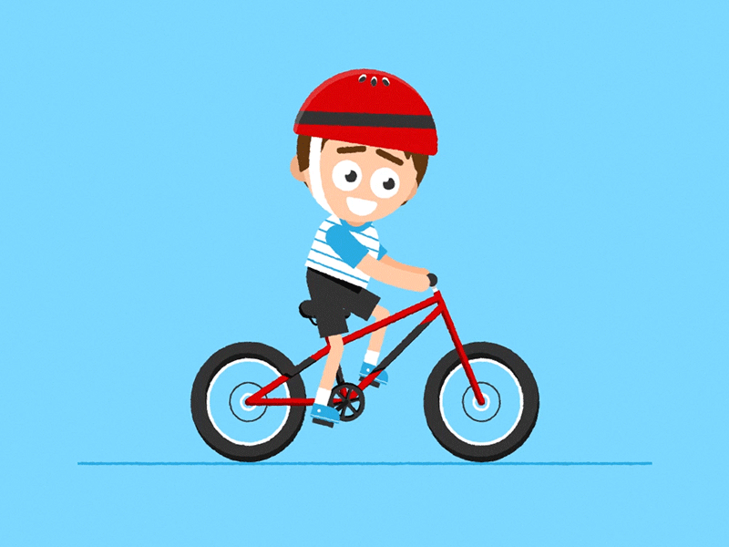
Look, read and choose.
A. His hobby is driving a car.
B. His hobby is running.
C. His hobby is cycling.

Slide 35
A
B
C
5
10
Notes:
DICE ROLL GAME

Slide 36
Look, read and choose.
A. Her hobby is riding a horse.
B. Her hobby is driving a car.
C. Her hobby is playing the piano.

Slide 37
A
B
C
Notes:
DONE

Slide 38
THANK
YOU

